Slide 1



Examining Care Quality within Family Practice and the effect thereof on Healthcare System Sustainability.
Dr Eduard Delport
Medscheme
Aug 2024

Slide 2

Examining Care Quality within Family Practice and the effect thereof on Healthcare System Sustainability.
Outline
Holistic Approach to Measuring Quality of Care Delivery
The Effect of High-Quality, Well Funded Primary Care and Family Practice on Health Systems
Intermountain Healthcare System
ChenMed and ChenMed Senior Medical Centers
Lifespan: Rhode Island Healthcare System
Components of Care Management: Just Nominating A FP is not Enough
Digital Aspects of Healthcare Delivery

Slide 3














Medscheme Health Professional Strategy Unit working in Collaboration with IPAs as Bridge to Funders
The Importance of IPAs and Family Practitioner Representation
Family Practitioners
IPAs and GP Leadership
Funders
Admin and Care Support
Medscheme
Health Professional Strategy Unit
Patient Care
Funding

Slide 4

The unparalleled VALUE of robust, high-quality Family Practice in the South-African healthcare landscape.
The FP is our first port of call.
Primary care-seeking entry point to the care-continuum.
VALUE
The FP is the dominant health-care system point of engagement.
>90% of member population will engage FP some time during the year.
<5% of member population will engage the Oncology program during the year.
VALUE
The FP is central to helping us understand and navigate our complex Health-System
Principle Care-Coordinator.
How can one ENHANCE Family Practitioner VALUE?
Enhancing FP Day-to-Day Operational Support
Enhancing Family Practice Care-Proficiency and Care-Capacity

Slide 5
The unparalleled VALUE of robust, high-quality Family Practice in the South-African healthcare landscape.
The FP is our first port of call.
Primary care-seeking entry point to the care-continuum.
VALUE
The FP is the dominant health-care system point of engagement.
>90% of member population will engage FP some time during the year.
<5% of member population will engage the Oncology program during the year.
VALUE
The FP is central to helping us understand and navigate our complex Health-System
Principle Care-Coordinator.
How can one ENHANCE Family Practitioner VALUE?
Enhancing FP Day-to-Day Operational Support
Enhancing Family Practice Care-Proficiency and Care-Capacity

Slide 6
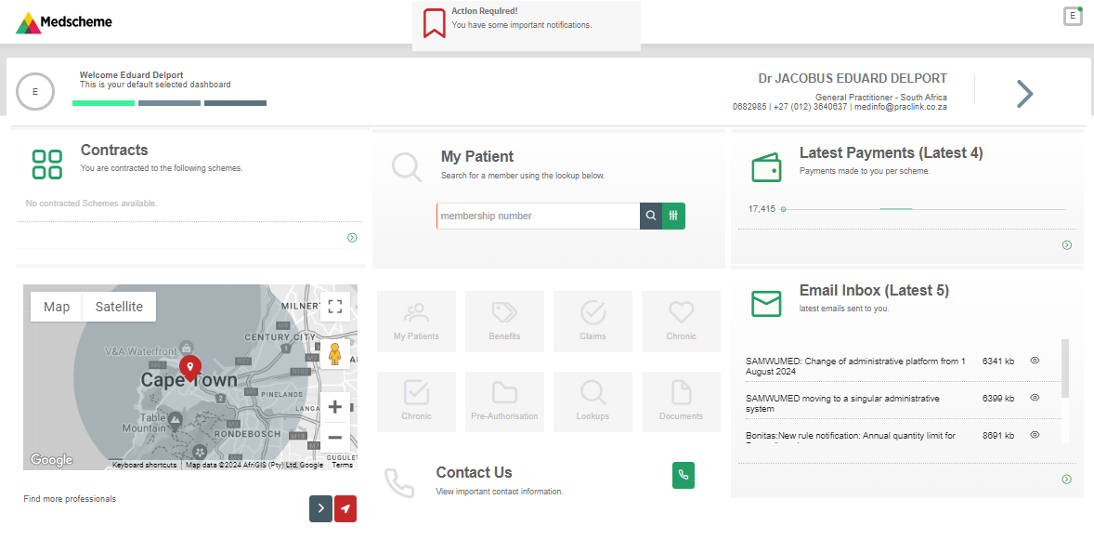
Enhancing FP Day-to-Day Operational Support
Healthcare Professional Web Portal

Slide 7
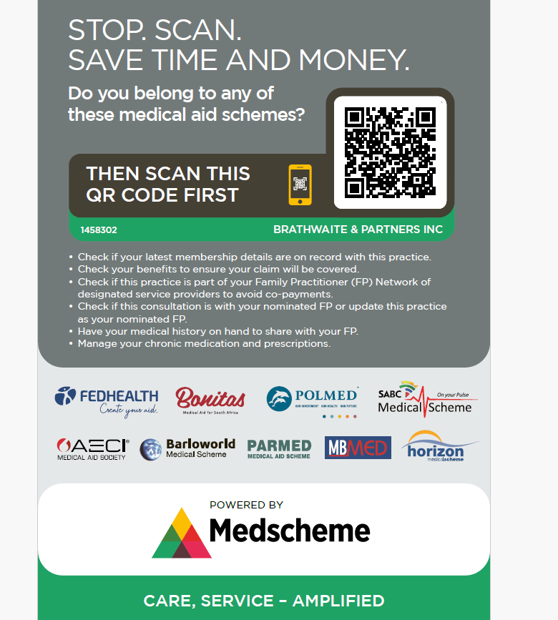
Enhancing FP Day-to-Day Operational Support
QR-Code Patient Focused Health System Navigation Tool

Slide 8
The unparalleled VALUE of robust, high-quality Family Practice in the South-African healthcare landscape.
The FP is our first port of call.
Primary care-seeking entry point to the care-continuum.
VALUE
The FP is the dominant health-care system point of engagement.
>90% of member population will engage FP some time during the year.
<5% of member population will engage the Oncology program during the year.
VALUE
The FP is central to helping us understand and navigate our complex Health-System
Principle Care-Coordinator.
How can one ENHANCE Family Practitioner VALUE?
Enhancing FP Day-to-Day Operational Support
Enhancing Family Practice Care-Proficiency and Care-Capacity

Slide 9
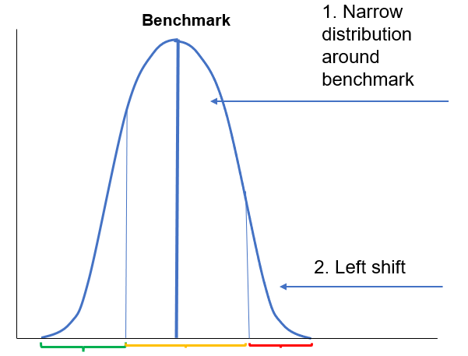
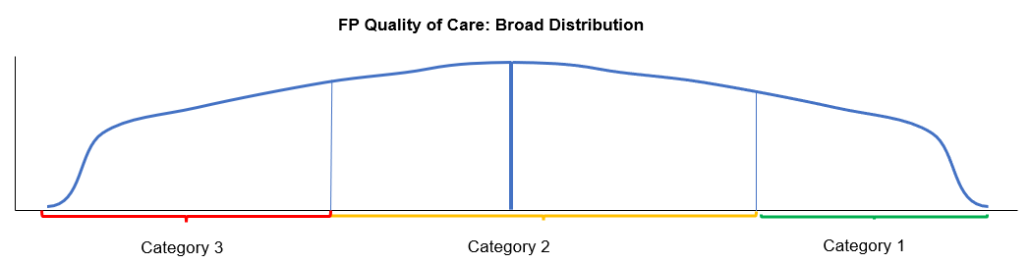
Increasing FP VALUE through Enhancing FP Proficiency and Care-Performance
Driving Family Practitioner Value:
87% of FPs within 15% of 50th Centile
In other words, most FPs are generally within a similar utilization band.
1. Efficiency
How do we define FP Proficiency and Care Performance?
Lesser focus on Efficiency,
Greater focus on Care Quality
Clinical Care Delivery
Patient Engagement and shared decision making and counseling.
Health System Navigation and Care Coordination
2. Care Quality
Effect on Healthcare System

Slide 10

Aspects Of Care Measured To Determine Family Practitioner Quality Of Care Delivery
Create your aid.
Robust Family Practice Peer to Peer Profiling Tool
Quality of Care and Clinical Outcomes
How is Quality of Care Delivery Measured? Full Framework – Based on HEDIS model
Aspect of Care Delivery | Measurement
Appropriate Chronic Condition Screening, Diagnoses And Program Enrolment | A. Quantifying the undiagnosed / unregistered population footprint.
Adherence To Appropriate Chronic Care Provision And Clinical Decision Making for the Following Chronic Conditions: Hypertension Diabetes Atherosclerotic cardiovascular disease (coronary heart disease, cerebrovascular disease and peripheral arterial disease) Hyperlipidaemia Asthma Mental Health HIV | A. Medicine and Treatment Adherence.
 | B. Process measures: Disease monitoring Disease complication monitoring
 | C. Clinical outcomes monitoring
 | D. Downstream utilization: Specialist utilisation In-hospital utilisation
Preventative Care, Screening and Vaccination | A. Cancer and other screening. B. Influenza and other vaccinations.

Slide 11
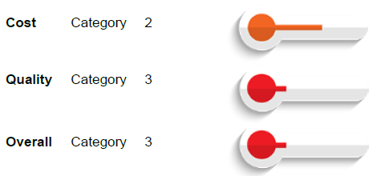
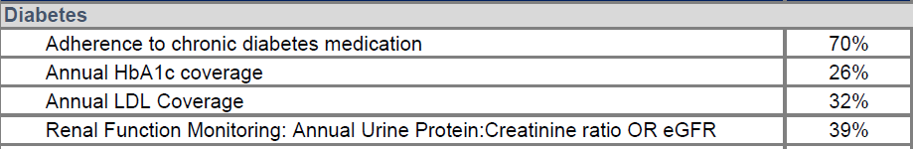
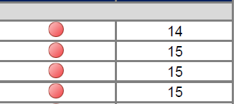
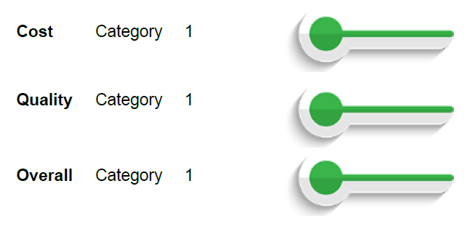
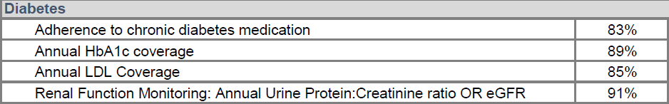
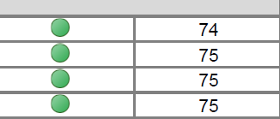
Aspects Of Care Measured To Determine Family Practitioner Quality Of Care Delivery
Measuring Processes:
Claims Data
Measuring Clinical Outcomes:
Pathology Test Results
Measuring Care Impact:
Downstream Utilization
1. Typical Poor Performing Family Practitioner: Diabetes
Below-average Chronic Care Delivery for Diagnosed Diabetic patient panel.
2. Typical High Performing Family Practitioner: Diabetes
Above-average Process and Clinical Outcomes measures, despite high-average age of 53yo.
Dr Eduard Delport, Medscheme

Slide 12

Holistic Approach to Quality-of-Care Measurement:
Tracking Chronic Disease Clinical Outcomes only is not enough.
Unique to REPI²
Undiagnosed or Unregistered Patient Cohort of Beneficiaries
Insufficient Screening and Diagnoses of Chronic Disease
Leads to significant Undiagnosed / Unregistered Patient Cohort, who most likely has some form of chronic disease, but are unaccounted for.
Chronic disease ‘Blind spot’.
Neglect in registering and enrolling diagnosed patient in chronic disease program.
Major driver of:
*Late Patient Presentation
*Increased morbidly and mortality.
* Increased specialist and in-hospital costs.
Can one quantify this Undiagnosed / Unregistered chronic disease population footprint?

Slide 13
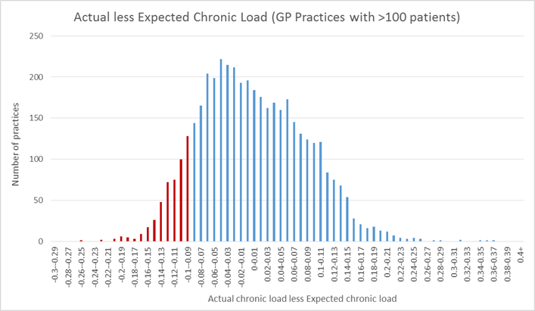
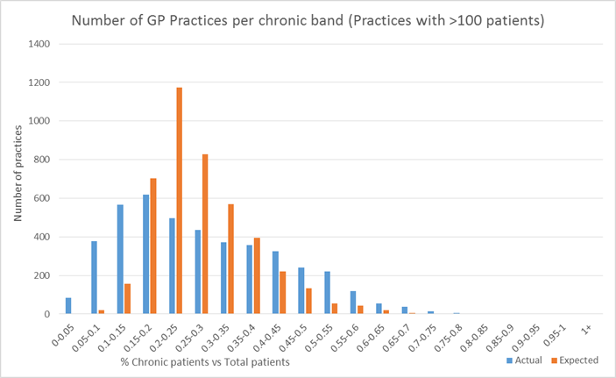
Holistic Approach to Quality-of-Care Measurement:
Tracking Chronic Disease Clinical Outcomes only is not enough.
Appropriate chronic disease screening, diagnoses and program enrolment:
Quantifying the undiagnosed / unregistered population footprint.
Calculating Actual to Expected Chronicity, considering age band / gender demographics.
EXPECTED CHRONIC DISEASE FOOTPRINT FOR PRACTICE DEMOGRAPHIC | 80 PATIENTS (EXPECTED)
ACTUAL ATTRIBUTED PATIENTS WITH CHRONIC DISEASE | 50 PATIENTS (ACTUAL DIAGNOSED AND REGISTERED) | 30 PATIENTS (UNDIAGNOSED / UNREGISTERED)
.
250-400 Practices with significant undiagnosed unregistered patient footprint.

Slide 14
Holistic Approach to Quality-of-Care Measurement:
Tracking Chronic Disease Clinical Outcomes only is not enough.
Practice Specific Chronic Disease Quality Of Care Assays
Global Measurement of Quality-of-Care Delivery, including Practice Specific Chronic Disease Blind-spot .
Practice Specific Chronic Disease Assays:
Improved Accuracy of measuring quality of care delivery.
Pragmatic Quality of Care Measurement, not to punify, but to support.
Dr Eduard Delport Pr 0732532 Practice Specific Quality of Care Chronic Disease Assay: Diabetes
Diabetes | Expected Diabetics for Practice Demographic | 50
 | Actual Diabetics Diagnosed and Registered |  | 30 (60%)
 | HBA1C's coverage in Diagnosed Diabetics |  |  | 20 (40%)
 | HBA1C's below 8,5% |  |  |  | 10 (20%)
Dr Eduard Delport, Medscheme

Slide 15
Holistic Approach to Quality-of-Care Measurement:
Tracking Chronic Disease Clinical Outcomes only is not enough.
REPI²
Healthcare Analytics for Family Practice
External Factors Influencing Practice Specific Quality of Care Delivery Outcomes
Clinical and industry appropriate Quality of Care Measure interpretation paramount.
Various External, Non-healthcare Provider Related Factors, Influence Overall Disease Outcomes
Social Determinants of Health
Aspects Paramount In Appropriate Quality Of Care Delivery Measurement
Practice specific
Clinically appropriate
Holistic approach
Non-punitive, for the purpose of practice support and mentorship.
Dr Eduard Delport, Medscheme

Slide 16
Holistic and Pragmatic Approach to Quality-of-Care Measurement:
Tracking Chronic Disease Clinical Outcomes only is not enough.
REPI²
Healthcare Analytics for Family Practice
Specialist to Family Practitioner Chronic Care Delivery Overlap
Example: Specialist to Family Practitioner Chronic Care Delivery Overlap
Below-average Chronic Care Delivery for Diagnosed Diabetic patient panel.
Total Diabetics Attributed to be under Family Practitioner Care
Total Diabetics Receiving Regular Follow Up At Specialist
11
Specialist to Family Practitioner Care Delivery Overlap
73%
15

Slide 17
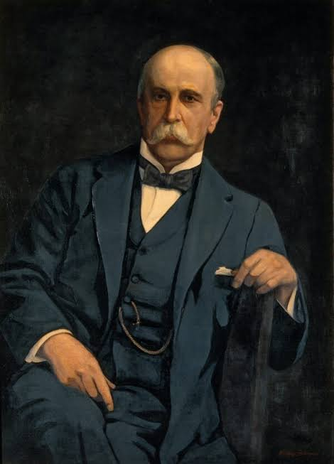
Dr William Osler says that Healthcare Quality is Diligence, Thoroughness, Attention to Detail
Learnings from the US HealthCare System
Founding doctor of the Department of Medicine for the Johns Hopkins School of Medicine in Baltimore – over 100 years ago.
Greatest shortcoming of Doctors is: “Apathy, Complacency, Indifference”
Conversely, high quality healthcare is defined by just the opposite... Diligence, Thoroughness, Attention to Detail
Johns Hopkins School of Medicine:
Establish and work by an ‘Oslarian Culture’ of:
Diligence
Dr. William Osler
Outcomes Measurement
Patient Panel Size and Funding
HCP to Patient Mismatch
Could lead to ‘Cherry Picking’ only Well-Controlled Chronic and Non-Elderly Patients.
Can a FP provide Diabetic care delivery Diligence:
- 2x15min a year?
- Seeing 50pts a day?
Matching more Specialised and focused services to patients that need Diligent Care.
Better Outcomes!
Diligent Care
How can we measure:
Diligence?
Funding Structure:
Promote Diligence, Decrease Rushing.
Smaller Patient Pannels

Slide 18
A The Importance Measuring Family Practitioner Level Quality of Care Delivery: A Pragmatic, Real-World approach.
REPI²
Healthcare Analytics for Family Practice
Broad National Distribution of Family Practitioner (FP) Quality of Care.
FP Quality of Care Delivery National Distribution
Category 3
Category 2
Category 1
30%
30%
Large National Below Average Performing FP Footprint
Below-average Clinical Process, Outcomes and other Measures.
Large National Above-Average Performing FP Footprint
Above-average Clinical Process, Outcomes and other Measures.
Dr Eduard Delport, Medscheme

Slide 19




Poor Quality of Care FPs with inadequate Chronic Condition Management:
Increases ER care-seeking and hospital level acute NCD events
REPI²
Healthcare Analytics for Family Practice
Typical Features of a “Supermarket Type” Family Practice
Under diagnosing of chronic disease: No screening protocols for high risk patients.
Under registration of chronic disease to scheme programs
Low % chronic disease in relation to average age.
Poor REPI chronic disease and preventative care metrics.
Poor Chronic Disease Management
High consultation volume per day with short consultation time of 5-7min.
Consultations
Uniform dispensing habits:
Dispensing same combination of tablets for various presenting complaints. (Panamor, Rub-Rub, Amoxil 250mg for 3days, MultiVit)
Low chronic medicine costs
Dispensing
Practice Operations and Management
Typically, locum run practices.
Probability for using non-sanctioned locums
(Nurses, clinical associates, non-registered providers).
Dr Eduard Delport, Medscheme

Slide 20
The Effect of High-Quality, Well Funded Primary Care and Family Practice on Health Systems
Outline
Intermountain Health
ChenMed and ChenMed Senior Medical Centers
Lifespan: Rhode Island Healthcare System
Components of Care Management: Consulting a FP is not enough.
Digital Aspects of Healthcare Delivery
Roll of the Primary Care Practice VS Roll of the Funder
Who’s Roll?

Slide 21

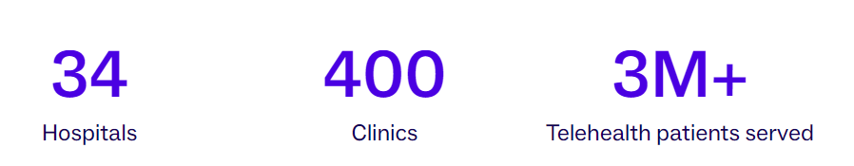
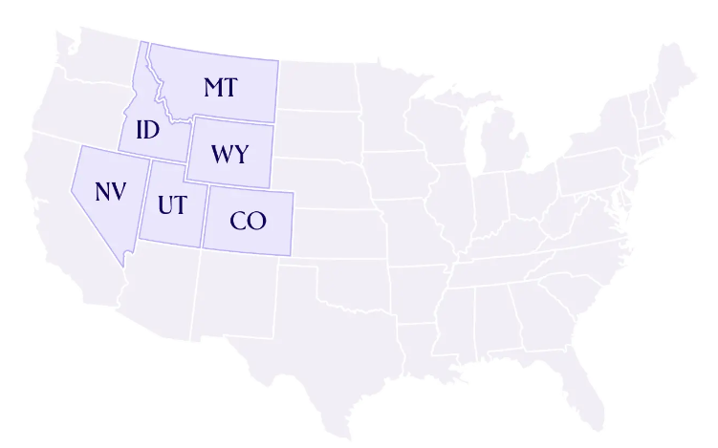
High Quality, Well Funded Primary Care and Family Practice Models
Learnings from the US HealthCare System
According to the Kaiser Family Foundation, Utah's per capita spending on healthcare is 44% below the US national average.
President Barack Obama:
"We have long known that some places, like the Intermountain Healthcare in Utah, offer high-quality care at a cost below average."
30%-50% all health care spending is quality associated waste.
Intermountain Health Outcomes
11% Decrease ER Admissions
22% Decrease in Hospital Admissions

Slide 22
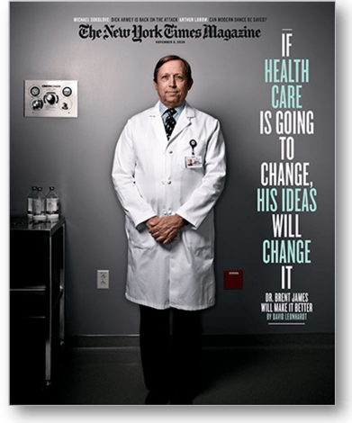
High Quality, Well Funded Primary Care and Family Practice Models
Learnings from the US HealthCare System
What do they do?
Prof. Brent James: Chief Quality Officer for the Intermountain Healthcare System.
Prof at the University of Utah school of Medicine,
Associate Prof Harvard and Stanford
Trained under Edward Denning - Foremost Manufacturing Quality Expert 20th Century.) Took Dennings Approach and Applied it to Healthcare.
Says that 30% to 50% of all health care spending is quality associated waste. (Intermountain Healthcare System)
Inappropriate care, Avoidable care, Variations in care, Inefficient care.
What’s the Answer?
Third Generation Medical Home – Primary Care Practice
1. Team Based Chronic Care Management
2. Mental and Behavioural Health Integration.
3. Health System and Medical aid Navigation

Slide 23


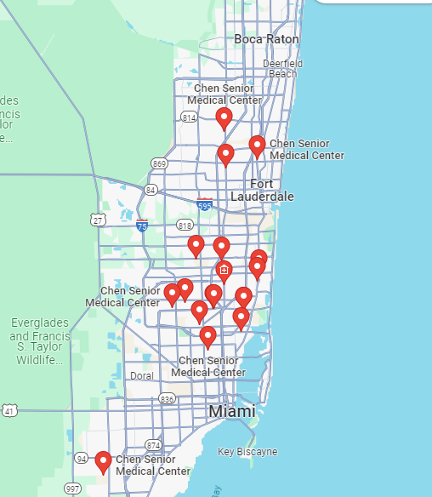
High Quality, Well Funded Primary Care and Family Practice Models
Learnings from the US HealthCare System
ChenMed, is a US based privately owned medical, management and technology company that delivers the high-touch and personalized primary care.
.130 Primary Care Centers, in 40 Cities, Across 14 States, 5000 Employees.
Take Full Capitated Risk on Medicare and Medicaid Patients: Per member per month fee. Completely financially responsible for all care components.
Miami
.40% of Patients: Qualify for both Medicare (elderly) and Medicaid (Low-income and no income).
30%-50% (Av. 33%) Decrease Hospitalizations and ER Visits
ChenMed’s Outcomes
70% Decrease in Congestive Heart Failure Admissions
22% Decrease in Strokes

Slide 24
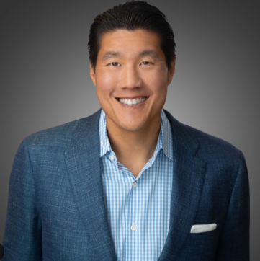
High Quality, Well Funded Primary Care and Family Practice Models
Learnings from the US HealthCare System
The CEO of ChenMed Dr. Chris Chen: Presentation to the US Department of Health and Human Services where he lays out the ChenMed primary care strategy in detail.
What do they do?
Patient Centered Medical Homes (Triple Aim):
  Ful Multidisciplinary Team Approach:
  Doctor, Nurse Practitioners and DNE, Case Mangers, Pharmacists, Social Groups.
  Behavioural and Mental Health Support
  Appropriate health system navigation
What else?
Cap on Patient Panel: 450 patients per primary care physician. (Average 345)
Minimum: Monthly Visit, with direct access via cell phone, and after hour services.
They Retrain their Primary Care Physicians.
- Leadership, Engage Influence Patients, Customer Service, Health Syst. Nav via EMR.
Has On-Site Pharmacies that Dispense 90% of the Medications That Their Patients Need.
Provide Door-to-Door Transportation for Their Patients with a Minivan at No Extra Cost.
Holds Its Primary Care Physicians Accountable:
- Pay base rate comparable to market salary, 20-30% Bonus Based on Achieving
- Those Outcomes – among the highest paid PCP in US. ($340 000 p/y)
EMR: Controls and Facilitates Clinical Workflow.
Patient Centered Medical Homes

Slide 25

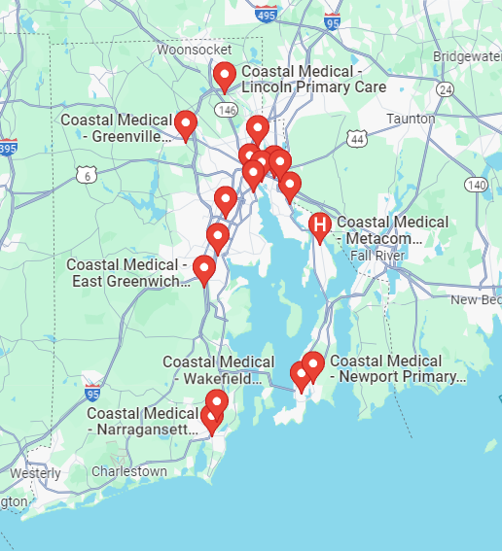
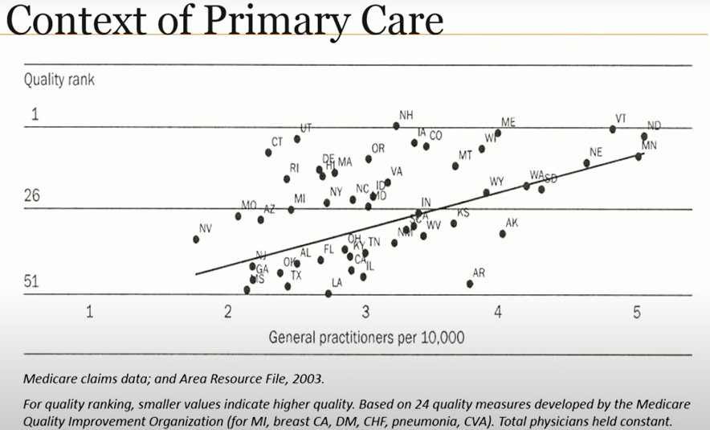
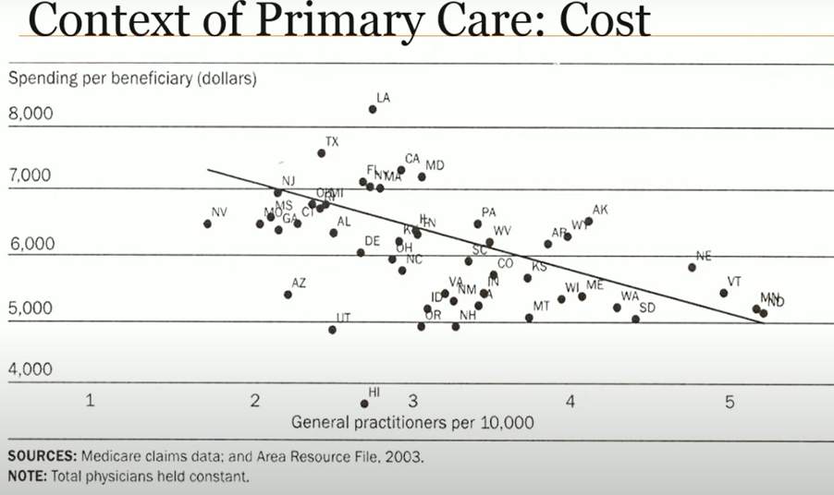
High Quality, Well Funded Primary Care and Family Practice Models
Learnings from the US HealthCare System
Rhode Island Healthcare System
Primary Care Driven System, 165,000 patients, 150 Primary Care Clinicians (Coastlands), Behavioural Health Centres (Gateway)
6 Hospitals, 3 Academic Hospitals, Brown University.
Increased Primary Care Care- Capacity – more Primary Care Practices
  Double primary care health care spend:
  20-30% relative decrease in overall healthcare cost
Greater Primary Care-Capacity, Greater Health System Quality
Greater Primary Care-Capacity, Less Overall Resource Spent

Slide 26
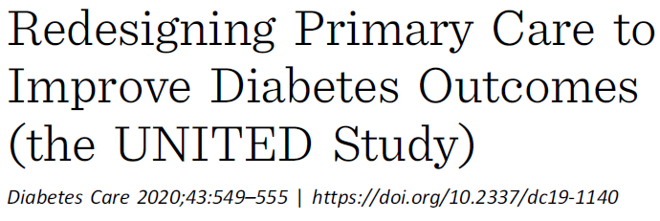
University of Minnesota Medical School:
Three Components of Care Management Leading to Superior Diabetes and Chronic Disease Outcomes
Chronic Disease Care Checklist
Atul Gawande's surgery checklist improved surgical outcomes.
Something as simple as a checklist of standards-of-care for diabetes also improves outcomes.
Chronic Patient Panel Manager or Dashboard
University of Minnesota Medical School
Guideline-Based Screenings
10.8%
Improvement Achieving performance measures
Age and gender appropriate screenings.
Hypertension, high cholesterol, depression, cigarette smoking, alcohol abuse and other health concerns.
Vital to preventing disability, suffering and even death in those with diabetes.
Health System and Funding Aspects
Shared Decision-Making and counselling
Prolonged Consultation
Virtual care follow up consultations.
Ability to increase chronic care seeking events.
A collaborative dialogue between patient and physician around what are reasonable Management Options for Each Individual.
Everyone's situation is unique, and that uniqueness must be considered in the care plan.
Dr Eduard Delport, Medscheme

Slide 27
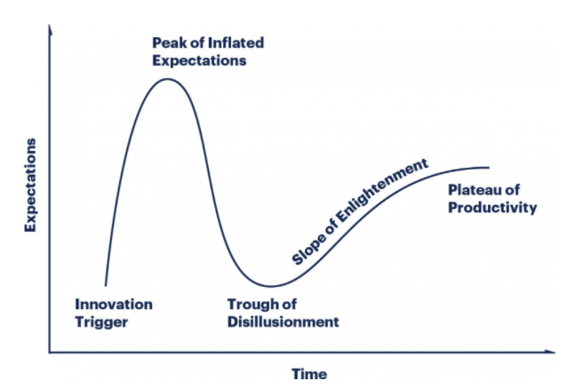
Evidence-based Practice Management Strategies To Improve Quality Of Care
Evidence-based and Approach To Integrating Technology Solutions Within One's Practice
Understanding and Applying the Gartner Technology Hype-Cycle
Application of Drone Based Delivery
Facebook Metaverse
Telemedicine and Virtual Care Application
Provider facing Electronic Health Record keeping and Application
Dr Eduard Delport, Medscheme

Slide 28

Evidence-based Practice Management Strategies To Improve Quality Of Care
Issues identified relating to doctor-to-administrator electronic medical record keeping.
“Double” electronic medical record keeping input needed from doctor.
Doctor keeping notes on own clinical record keeping interface:
EMR or physical.
1.
Additional expectation on provider to input clinical information again into a separate interface.
2.
Double EMR Input Issues
Increase provider administrative burden.
Decrease doctor-patient time spent.
Decrease doctor-patient shared decision making and dialogue.
Increase physician fatigue.
Decrease overall Quality of Care and clinical outcomes.
Decrease participating provider adherence.
Dr Eduard Delport, Medscheme

Slide 29
EMR Strategy Overview
Issues Identified Relating To Doctor-to-administrator Electronic Medical Record Keeping.
“Double” electronic medical record keeping input needed from doctor.
“There is building resentment against the shackles of the present EHR; every additional click inflicts a nick on physicians' morale.”¹⁵
Physician burnout contributor: Completing too many administrative tasks
Among doctors with physician burnout, 60 percent say too many bureaucratic tasks such as charting and paperwork are to blame. About a third say that the “computerization of the practice” or the rise of electronic health records (EHR) are one of the largest contributors to physician burnout.
“The study found that physicians spent 49.2 percent of their office day on EHRs and other desk work. “For every hour the physicians spent facing their patients, they spent nearly 2 additional hours facing the computer, entering data.
“EHRs have evolved into data-collection devices for administrators and other government regulations.¹³ ”“Consequently, they focus more on processes than on outcomes, adding to the physician's workload while not improving patient care”
Dr Eduard Delport, Medscheme

Slide 30
EMR Strategy Overview
Issues Identified Relating To Doctor-to-administrator Electronic Medical Record Keeping.
“Double” electronic medical record keeping input needed from doctor.
“For many physicians, the EHR has become the final straw. Although intended to overcome the flaws inherent in a paper-based system, the EHR has produced its own set of problems, perhaps the most important of which is the absence of social and behavioral factors fundamental to a patient's treatment response and health outcomes.”
Re-engineering current EHRs will be difficult. In fact, Zulman and colleagues¹⁵ concluded that, in many clinical situations, patient care could be improved simply by “de-implementing” the EHR.
Plan
  Meaningful use of EHR
  Develop uniform standards for technical EHR certification.
  Penalize vendors to ensure they develop high-quality products that support interoperability across multiple EHR systems with HHS mandating and imposing penalties to decertify systems that take part in actions that hinder true interoperability.
  Minimize the role that doctors play in administrative tasks like non-meaningful EHR.
Value Of Chronic Patient Panel Management and Dashboarding Software
e.g. SyntoP EMR
Dr Eduard Delport, Medscheme

Slide 31
Recent evidence on understanding Virtual Care, its benefits and where it is most useful within a Primary Care Delivery model.
Virtual Care
TYPE
VALUE ADD
CARE DELIVERY
Day-to-Day Care Seeking
Increasing Access Day-to-Day Care Seeking
Member Convenience Benefit Value Add
Designated Virtual Care or Telemedicine practice
AMP Anchor Practice:
Integrated Virtual Care.
Navigate health system, trained telemedicine, EMR integration, clinical oversight, etc.
Quick simple access to VC by member, THROUGH APP, phone number, website.
Note: NOT a tool for cost saving.
Chronic Disease Follow Up
Chronic disease follow up
Improved adherence and chronic care quality.
Primary Family Practitioner
A tool through which CHRONIC DISEASE FOLLOW UP CONSULTATIONS, lifestyle counselling, medicine adherence counselling and chronic script repeat can be actioned.
Primary FP pro-actively includes VC as a modality in the overall care management strategy.
Down stream cost saving value add.
Chronic beneficiary not able to renew script timeously.
Allows for ‘active follow up’ of patients who might otherwise ‘be to busy’ to attend physical consultation voluntarily
Dr Eduard Delport, Medscheme

Slide 32

A Simplified view of the Healthcare System Components in relation to Family Practitioner Level Primary Care Delivery
The importance of IPAs and Family Practitioner Representation
Family Practitioners
IPAs and GP Leadership
Funders
Admin and Care Support
Medscheme
Health Professional Strategy Unit
Patient Care
Funding

Slide 33
References
NMG HQA Health Quality Assessment Report of 2020, 23 July 2020
Redesigning Primary Care to Improve Diabetes Outcomes (the UNITED Study) Diabetes Care 2020;43:549–555 | Kevin A. Peterson,1 Caroline Carlin, et al.
Health Informational Exchange (HIE): Improving Patient Care Through Interoperability: Lori Manteufel et al, _/www.metastar.com
The Primary Care Revolution. Harvard Medical School Center for Primary Care Lecture Series. Director Prof Russell Phillips et al. ttps://hms.harvard.edu/
National Academies of Sciences, Engineering, and Medicine: Implementing High-Quality Primary Care: Rebuilding the Foundation of Health Care_Recomendations and Reactions._www.nationalacademies.org/ (http://reactions._www.nationalacademies.org/) Johansen et al., 2016, Martin et al., 2020
Chapman DP, Perry GS, Strine TW. The vital link between chronic disease and depressive disorders. Prev Chronic Dis [serial online] 2005 Jan [date cited]. Available from: URL: http://www.cdc.gov/pcd/issues/2005/jan/04_0066.htm.
Addressing Mental Health Promotion in Chronic Disease Prevention and Health Promotion Geraldine S. Perry DrPH, RD, Letitia R. Presley-Cantrell PhD, and Satvinder Dhingra MPH. American Journal of Public Health (ajph.
Association of Mental Health Disorders With Health Care Utilization and Costs Among Adults With Chronic Disease Sporinova et al. JAMA Network Open. 2019;2(8)

Slide 34
Thank You

