Slide 1
Burden of Pneumococcal Disease
Dr TC Manzini
Infectious diseases Specialist Physician
PP-PRV-ZAF-0151

Slide 2
HCP Presentation
This presentation is being presented at a Pfizer hosted meeting in the interests of continuous medical education. This presentation and its contents is medical in nature and is intended for healthcare professionals attending this event. Notwithstanding that it is presented at a Pfizer hosted meeting, Pfizer does not have influence over content, views and recommendations in this presentation, and the views expressed by the presenter and author of this presentation do not necessarily reflect those of Pfizer or of its subsidiary or affiliated companies and neither Pfizer nor its subsidiary or affiliated companies shall be liable for any damages, claims, liabilities, costs or obligations arising from the use or misuse of the information provided in this presentation and the presentation is for information purposes and is intended for reference by authorized healthcare practitioners only and not any other third parties. The sale, commercial recording or distribution of this presentation in any manner is prohibited.
In addition, while due care and caution has been taken to ensure that the author and presenter has based their information on scientific research and study, Pfizer, does not warrant or assume any legal liability or responsibility for the quality, accuracy, completeness, usefulness of any information disclosed, for any action taken, opinion expressed, advice rendered or accepted, any direct incidental, special or consequential loss and damage caused on the basis of any material or information published in this compilation.
This presentation is not to be construed as medical advice or to substitute the advice of a health care practitioner but rather provide delegates with information to better understand certain health and disease areas. Pfizer is also unable to make any treatment recommendations for individual patients; clinical judgment based on the medical history and the clinical status of a specific patient should dictate the appropriate actions to be taken. In this regard, Pfizer does not support the use of products for off label indications, nor for dosing which falls outside the approved label recommendations and viewers must refer to the Package Insert of any product for full prescribing guidelines.
In case of a suspected side effect or adverse reaction, please contact ZAF.AEReporting@Pfizer.com or
Fax to +27 11 895 1600 to report the side effect or adverse event.
PP-PRV-ZAF-0151

Slide 3
Disclosure
No Disclosures

Slide 4
Outline
Background
Epidemiology
South Africa context
Guideline for vaccination
Impact of vaccination

Slide 5
Introduction
Streptococcus pneumoniae, a gram-positive bacterium carried
asymptomatically in the nasopharynx
Causative agent of non-invasive upper respiratory tract infections (URTI) to pneumococcal pneumonia, meningitis or bacteraemia
The isolation of the pneumococcus from a sterile site such as cerebrospinal fluid, blood, joints, peritoneum or pleura, is termed invasive pneumococcal disease

Slide 6
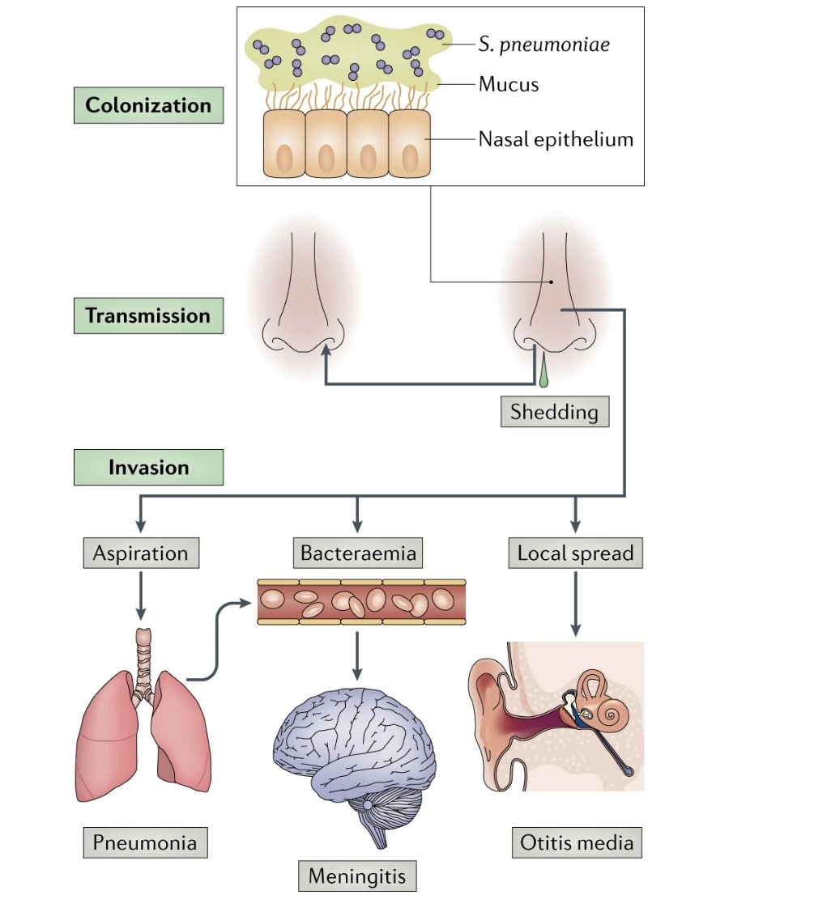
Strept…
Weiser, J.N., Ferreira, D.M. & Paton, J.C. Streptococcus pneumoniae: transmission, colonization and invasion. Nat Rev Microbiol 16, 355–367 (2018). https://doi.org/10.1038/s41579-018-0001-8

Slide 7
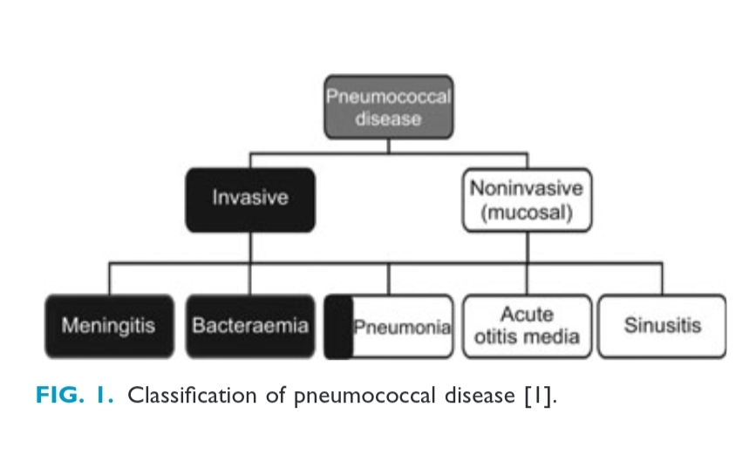
Spectrum of disease
Ludwig E, Bonanni P, Rohde G, Sayiner A, Torres A. The remainingchallenges of pneumococcal disease in adults. Eur Respir Rev 2012; 21:57–65

Slide 8
Spectrum of disease
Potentiate cardiovascular events
There is fourfold higher risk of MI, stroke and fatal chronic heart failure (HF) has been described in the first 30 days after pneumonia hospitalization
Exacerbation of asthma and chronic obstructive disease
Corrales-Medina VF, Alvarez KN, Weissfeld LA, et al. Association between hospitalization for pneumonia and subsequent risk of cardiovascular disease. JAMA 2015;313:264-74. 10.1001/jama.2014.18229

Slide 9
Epidemiology
Lower respiratory tract infections (LRTIs) continue to be associated with significant morbidity and mortality.
In 2016, LRTIs caused 2,377,697 deaths in people of all ages worldwide
Streptococcus pneumoniae being the leading cause of LRTI morbidity and mortality globally and resulting in some 55.4% (1,189,937) of all deaths
GBD 2016 Lower Respiratory Infections Collaborators. Estimates of the global, regional, and national morbidity, mortality, and aetiologies of lower respiratory infections in 195 countries, 1990-2016: a systematic analysis for the Global Burden of Disease Study 2016. Lancet Infect Dis 2018;18:1191-210. 10.1016/S1473-3099(18)30310-4

Slide 10
Epidemiology
LRTIs were found to be highest in sub-Saharan Africa and South/Southeast Asia.
Reduction the burden of LRTIs, particularly in younger children is noted, however the burden in the elderly, especially those older than 70 years of age (1,080,958 deaths), was increasing.
GBD 2016 Lower Respiratory Infections Collaborators. Estimates of the global, regional, and national morbidity, mortality, and aetiologies of lower respiratory infections in 195 countries, 1990-2016: a systematic analysis for the Global Burden of Disease Study 2016. Lancet Infect Dis 2018;18:1191-210. 10.1016/S1473-3099(18)30310-4

Slide 11
South African context
In 2018 in South Africa (SA) IPD incidence was highest in infants (21 cases per 100,000 population) with a second peak occurring in adults 25 years and older (6 cases per 100,000 population)
Apart from HIV-coinfection, almost half (45%) of the persons with IPD had an underlying risk factor/condition predisposing them to infection.
This included a history of smoking, underlying chronic lung disease or chronic renal disease
Overall, in-hospital mortality from IPD was 32%, with 23% of those presenting with pneumococcal meningitis suffering sequelae post discharge
Meiring S, Cohen C, Quan V, et al. HIV Infection and the Epidemiology of Invasive Pneumococcal Disease (IPD) in South African Adults and Older Children Prior to the Introduction of a Pneumococcal Conjugate Vaccine (PCV). PLoS One 2016;11:e0149104. 10.1371/journal.pone.0149104 [PMC free article] [PubMed] [CrossRef] [Google Scholar]
National Institute for Communicable Diseases. GERMS-SA Annual Report 2018. 2019. Available online: http://www.nicd.ac.za/publications/archives/

Slide 12
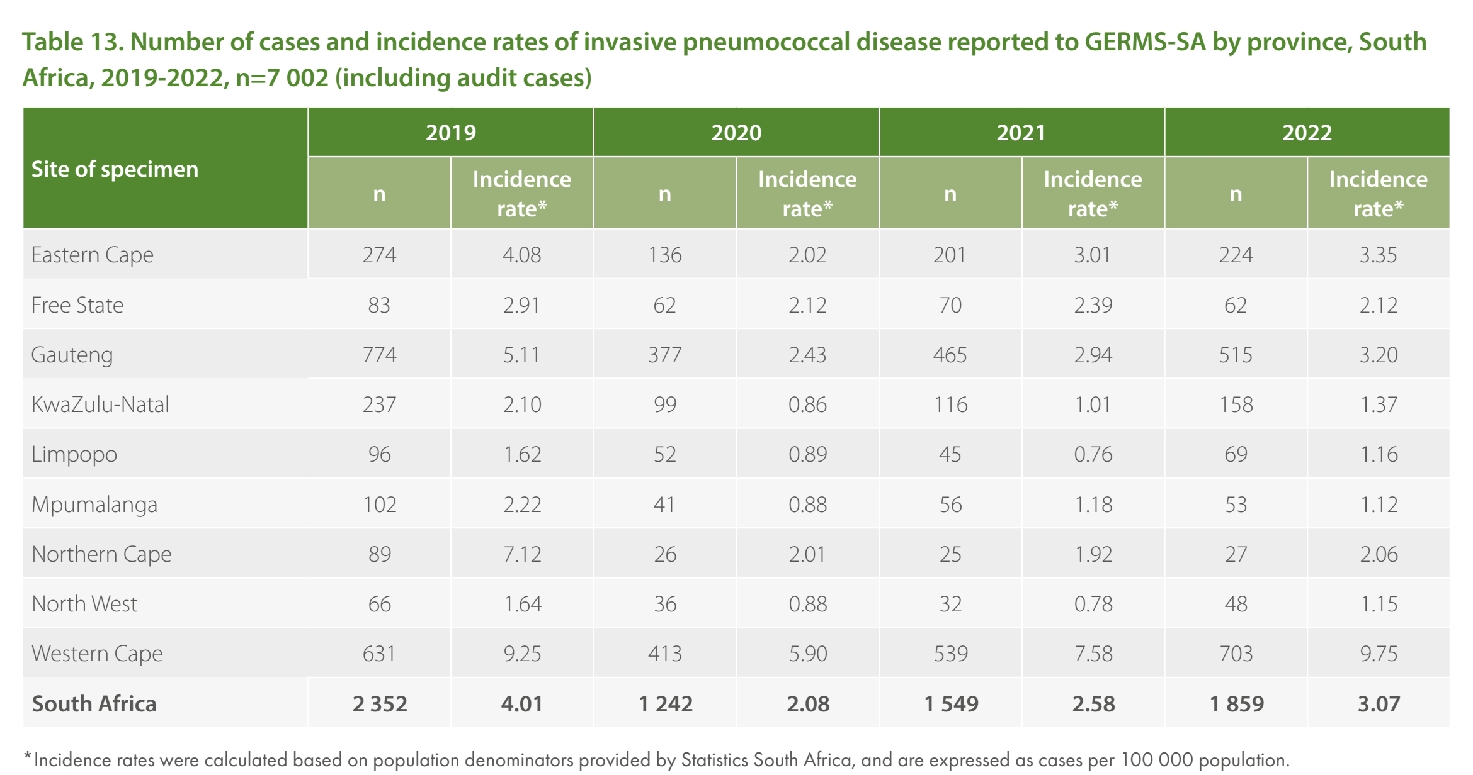
South Africa context
GERMS-SA Annual Report 2022. Available from: https://www.nicd.ac.za/wp-content/uploads/2024/02/NICDGERMS-Annual-Report-2022.pdf

Slide 13
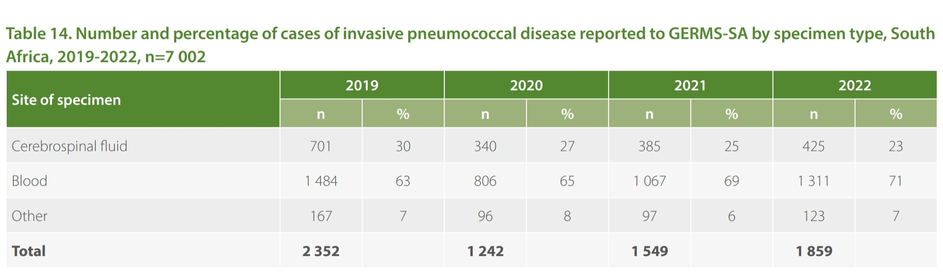
Cases with IPD in SA
GERMS-SA Annual Report 2022. Available from: https://www.nicd.ac.za/wp-content/uploads/2024/02/NICDGERMS-Annual-Report-2022.pdf

Slide 14
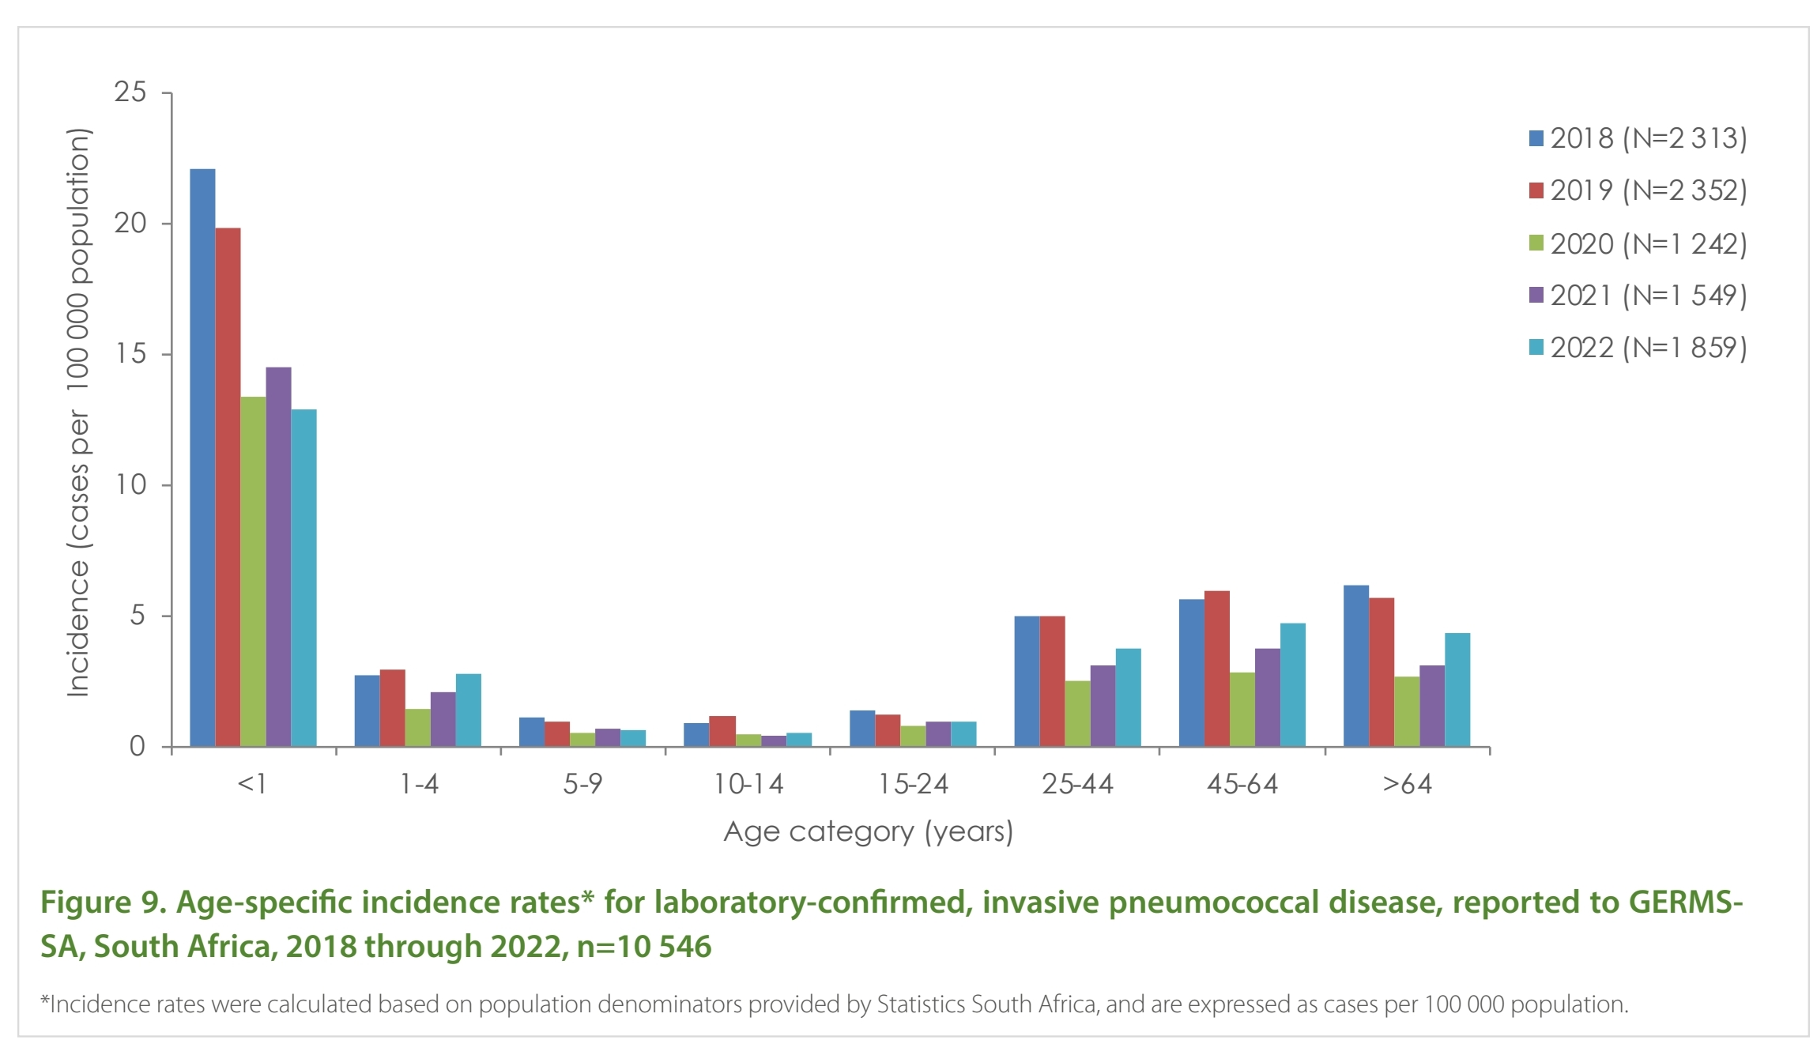
Incidence of IPD in SA
GERMS-SA Annual Report 2022. Available from: https://www.nicd.ac.za/wp-content/uploads/2024/02/NICDGERMS-Annual-Report-2022.pdf

Slide 15
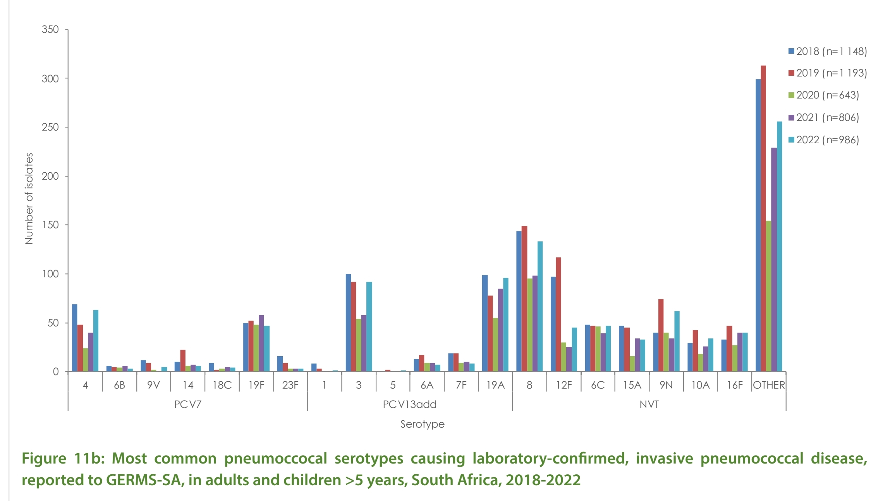
Serotypes causing IPD in SA
GERMS-SA Annual Report 2022. Available from: https://www.nicd.ac.za/wp-content/uploads/2024/02/NICDGERMS-Annual-Report-2022.pdf

Slide 16
Microbiology is made in 20% of the cases for CAP furthering increased diagnostic costs for improved sensitivity
Children under 5 years of age, the elderly population, and people with respiratory disease, diabetes, human immunodeficiency virus (HIV) infection, and immuno-suppression are at greater risk of pneumococcal disease
GERMS-SA Annual Report 2022. Available from: https://www.nicd.ac.za/wp-content/uploads/2024/02/NICDGERMS-Annual-Report-2022.pdf

Slide 17
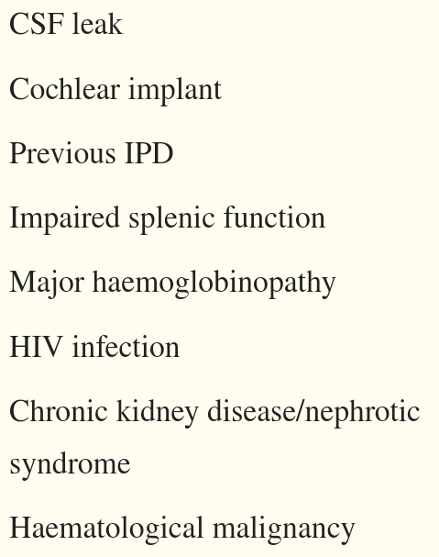
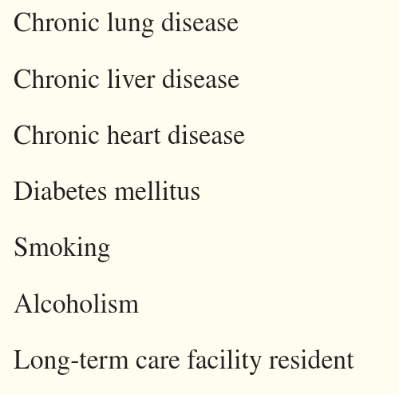
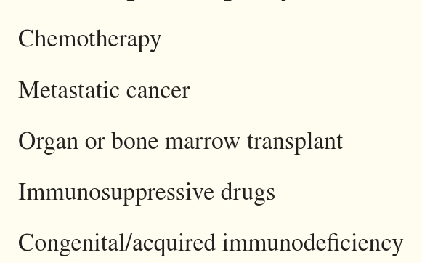

Population at risk for invasive disease
J Thorac Dis. 2022 Oct; 14(10): 4150–4172. doi: 10.21037/jtd-22-287

Slide 18
Risk for Invasive disease
Previous viral infections eg influenza
Residing in nursing homes
Lifestyle choices eg smoking alcohol etc

Slide 19
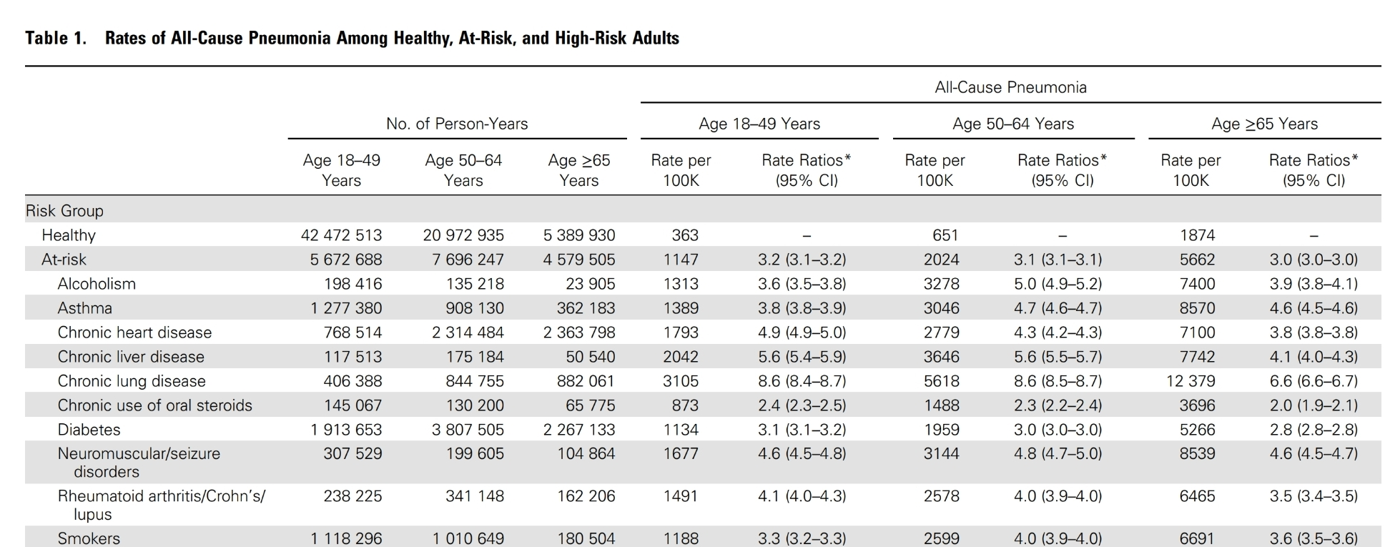
Population at risk
Open Forum Infectious Diseases, Volume 1, Issue 1, Spring 2014, ofu024, https://doi.org/10.1093/ofid/ofu024

Slide 20
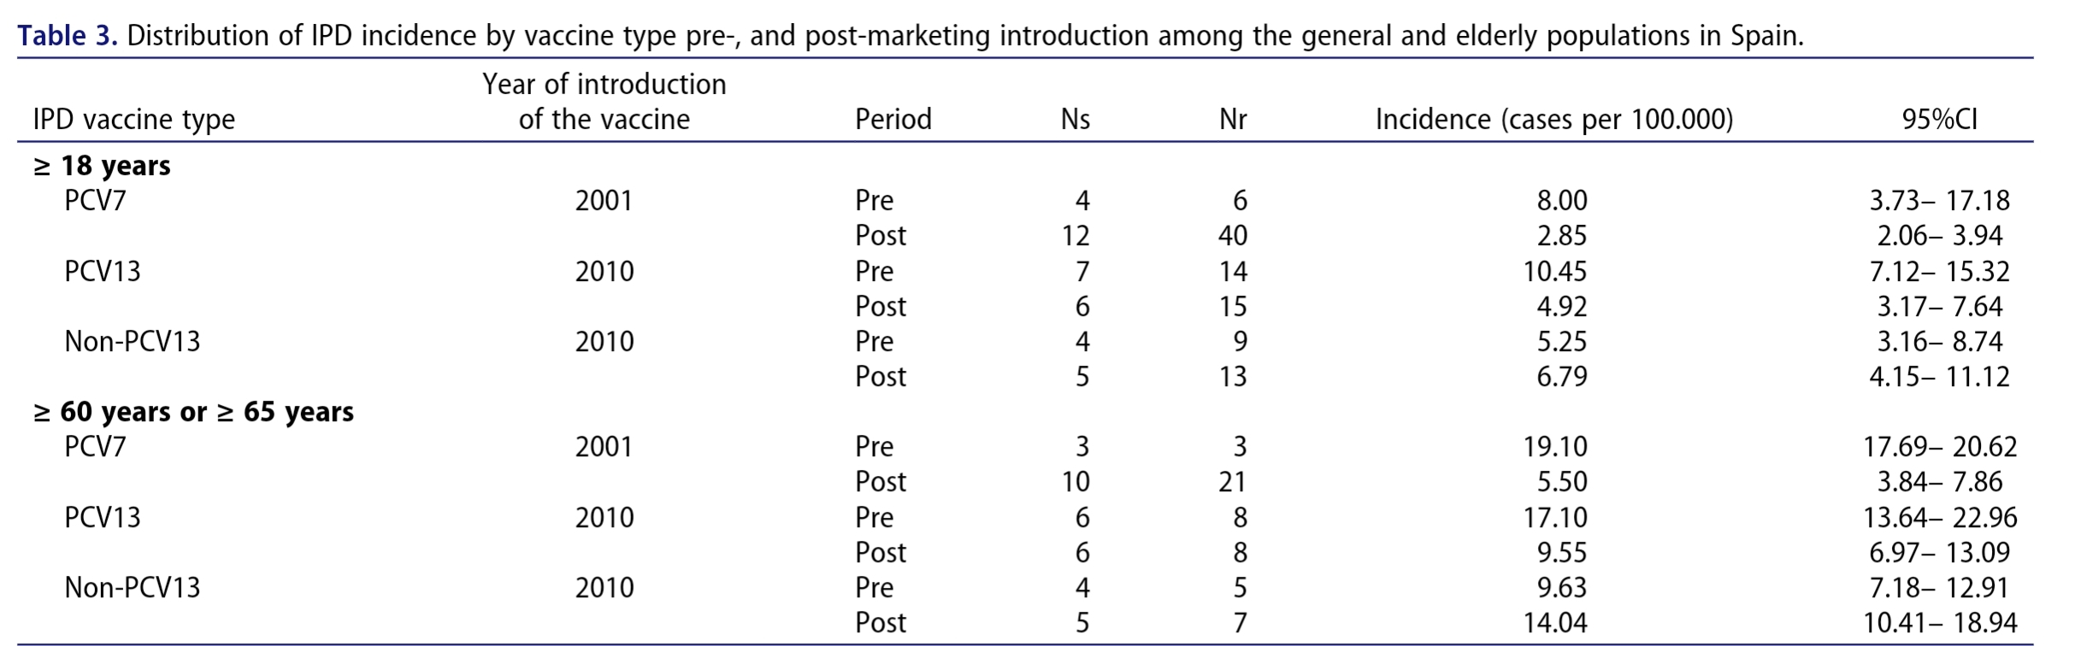
Burden of pneumococcal ds Europe

Slide 21
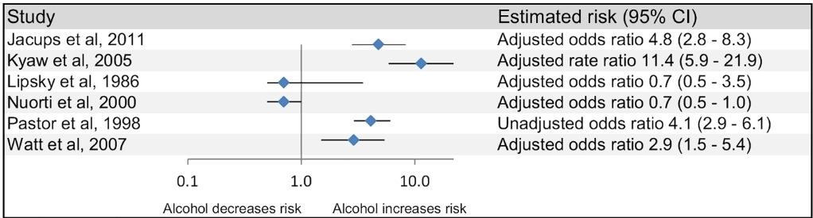
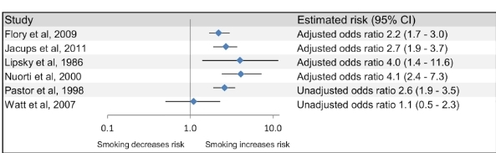

Lifestyle risk for IPD

Slide 22
IPD and HIV disease
Streptococcus pneumoniae is the most common cause of bacteremia and bacterial pneumonia among HIV-infected persons, and has been shown to occur between 30 and 100 times more frequently in HIV-infected than HIV-uninfected individuals
IPD and HIV-coinfection was associated with more bacteremia (with or without pneumonia) and higher in-hospital case fatality than HIV-uninfected cases
Haart has shown 7% reduction in developing IPD
Feikin DR, Jagero G, Aura B, Bigogo GM, Oundo J, Beall BW, et al. High rate of pneumococcal bacteremia in a prospective cohort of older children and adults in an area of high HIV prevalence in rural western Kenya. BMC Infect Dis. 2010; 10:186.

Slide 23
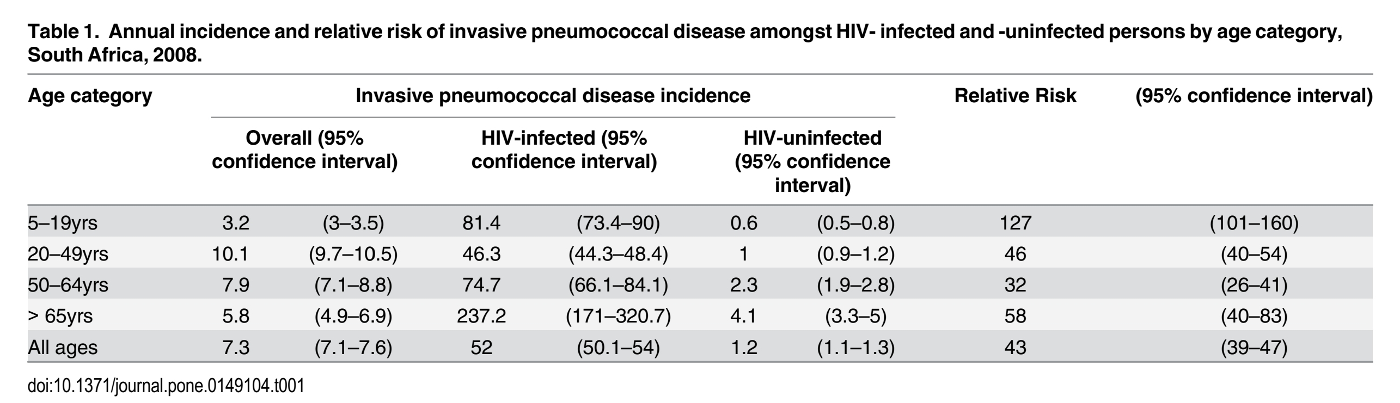
Hiv infected individuals
Meiring, Susan, et al. "HIV infection and the epidemiology of invasive pneumococcal disease (IPD) in South African adults and older children prior to the introduction of a pneumococcal conjugate vaccine (PCV)." PloS one 11.2 (2016): e0149104.

Slide 24
Guideline of Pneumococcal Vaccine

Slide 25
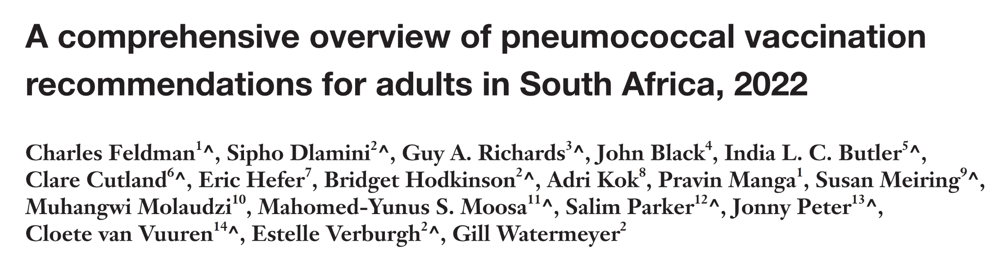
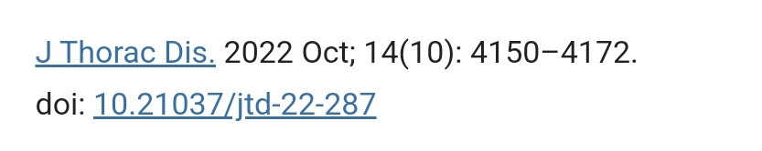

Slide 26
Available vaccine in South Africa
Number of serotypes | 13 | 23
Serotypes included | 1, 3, 4, 5, 6A, 6B, 7F, 9V, 14, 18C, 19A, 19F, 23F | 1, 2, 3, 4, 5, 6B, 7F, 8, 9N, 9V, 10A, 11A, 12F, 14, 15B, 17F, 18C, 19F, 19A, 20, 22F, 23F, 33F
Approximate costs | Single exit price (South Africa): PCV13 = R912.33 | Single exit price (South Africa): PPV23 = R198.70
 | Immunisation = R46.80 | Immunisation = R46.80
 |  | Doctor’s script = R255.91
Volume and administration | 0.5 mL; intramuscular | 0.5 mL; intramuscular or subcutaneous
Vaccine properties/conjugates | Capsular polysaccharides covalently linked (conjugated) to diphtheria CRM₁₉₇ toxoid (16,17) | Purified capsular polysaccharides of the most common serotypes causes the majority of serious pneumococcal infections (17-19)
Age groups | Initially developed for infants and children but subsequently found to be efficacious in adults, including the elderly and high-risk patients (17-20) | Poor response in children less than 2 years of age; used in children >2 years of age and adults

Slide 27
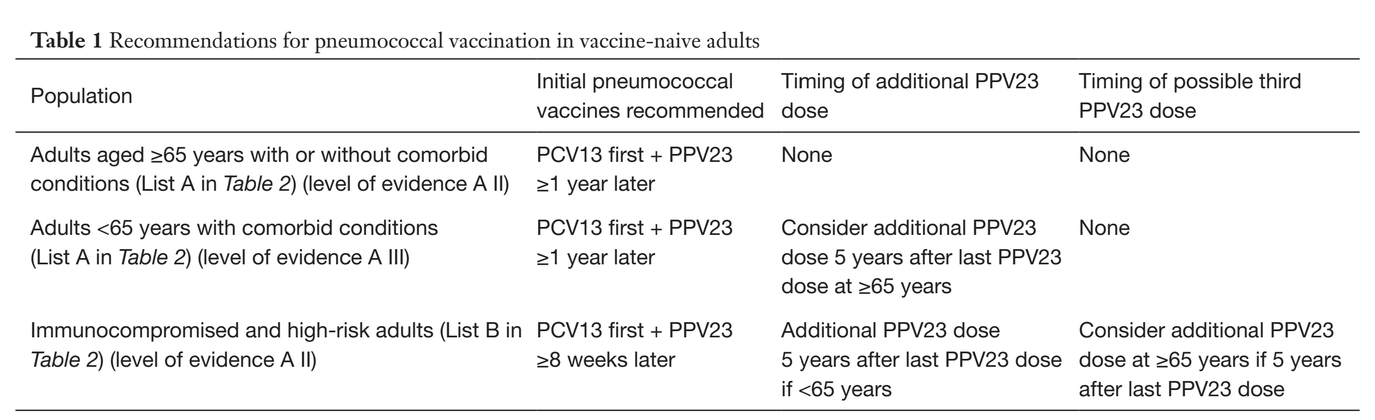
SA guidelines
J Thorac Dis 2022;14(10):4150-4172 | https://dx.doi.org/10.21037/jtd-22-287

Slide 28
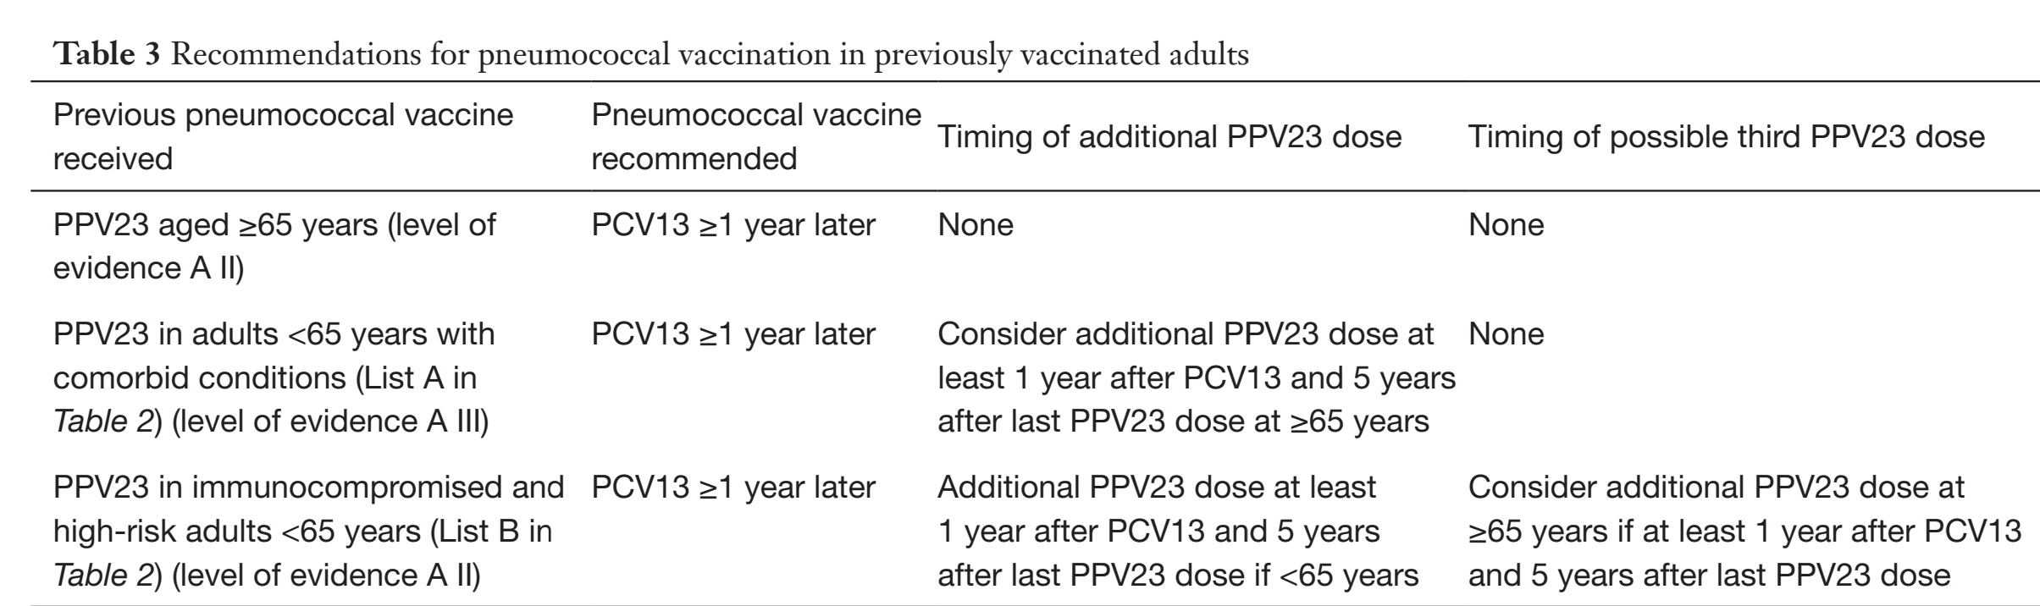
South Africa Guidelines
J Thorac Dis 2022;14(10):4150-4172 |https://dx.doi.org/10.21037/jtd-22-287

Slide 29
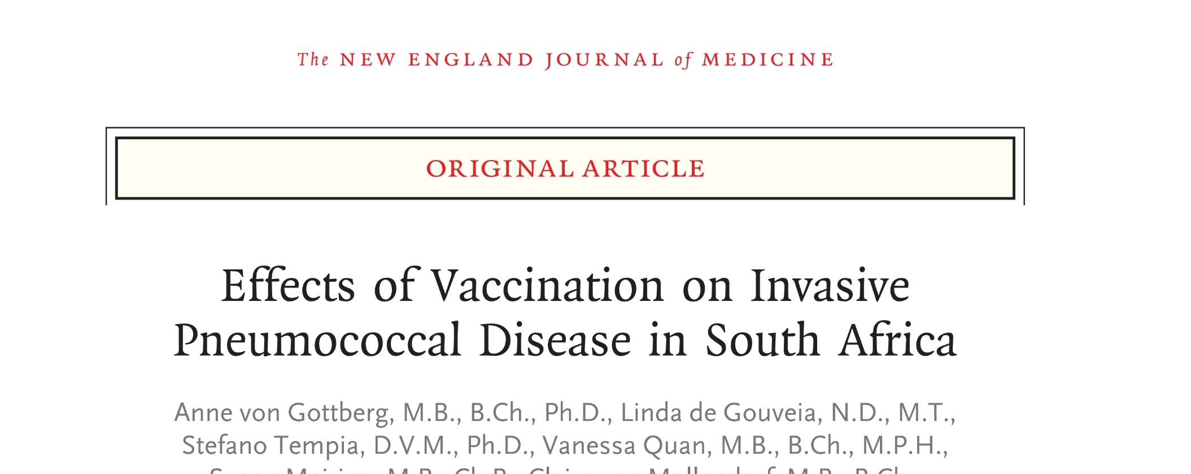


Slide 30
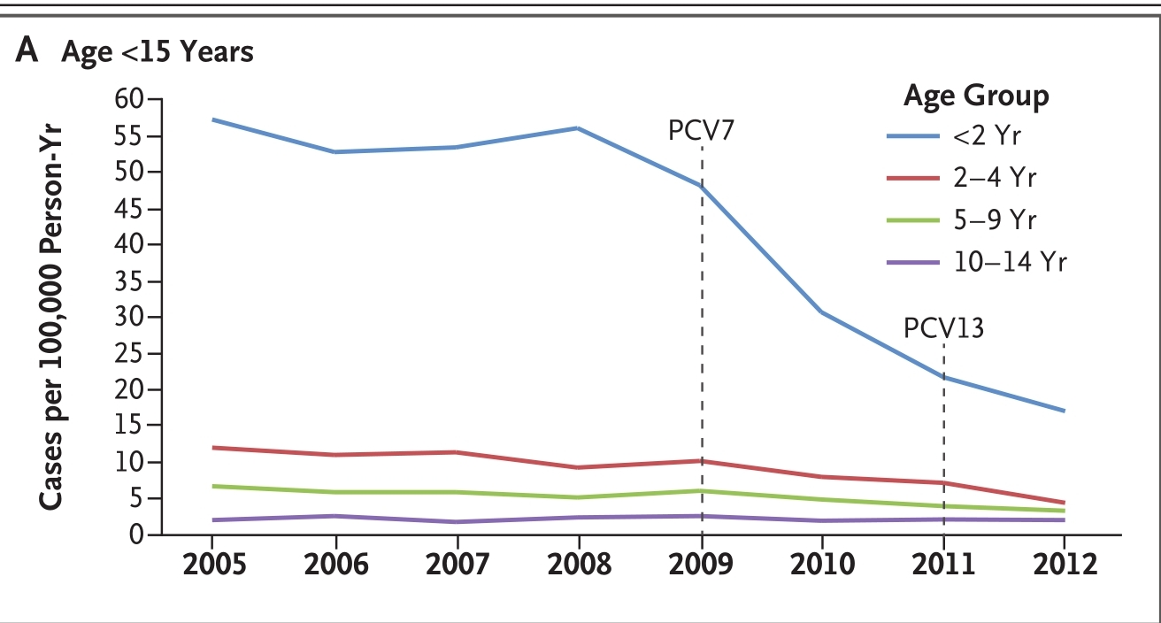
Impact of vaccination

Slide 31
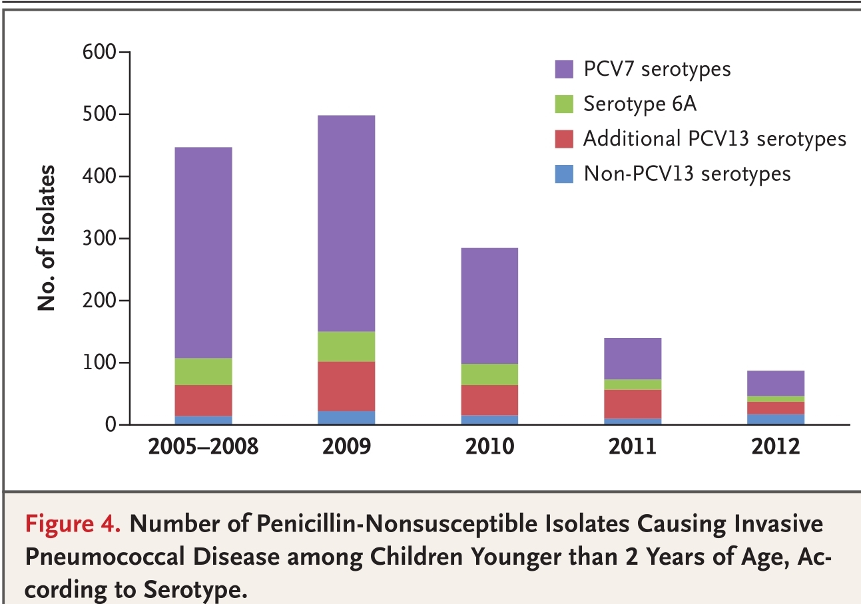
Impact on resistance

Slide 32
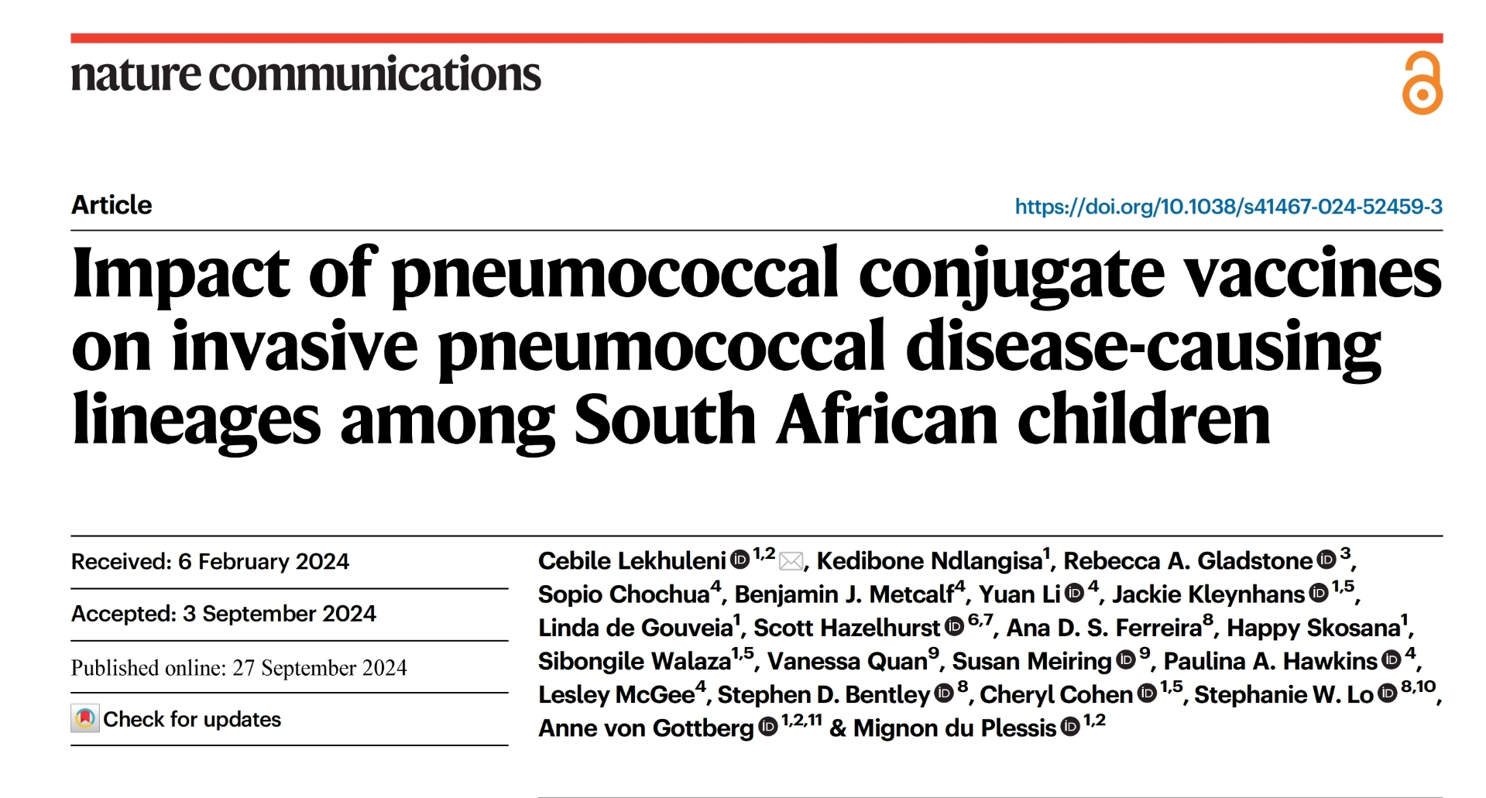
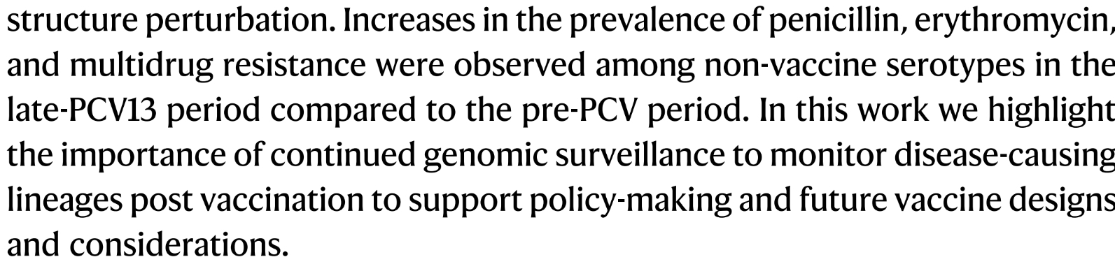

Slide 33
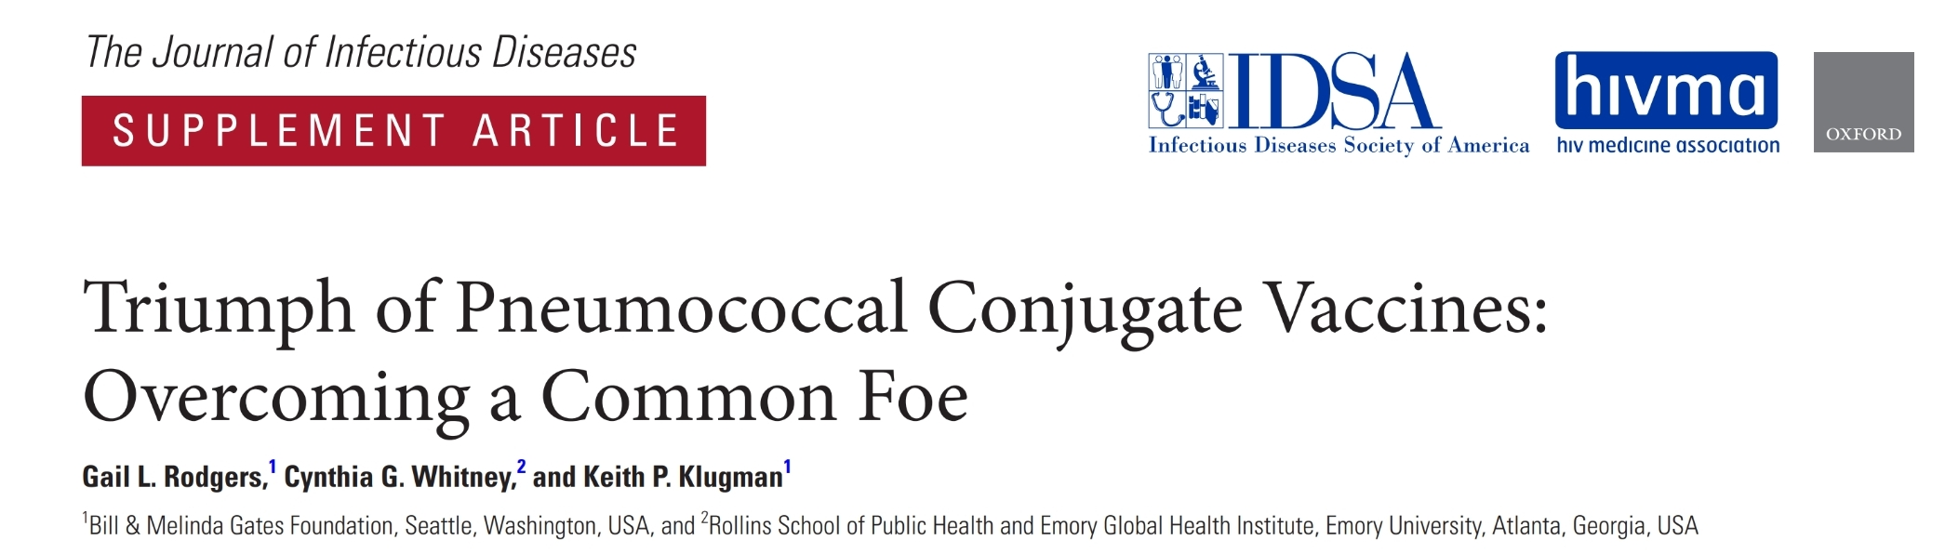
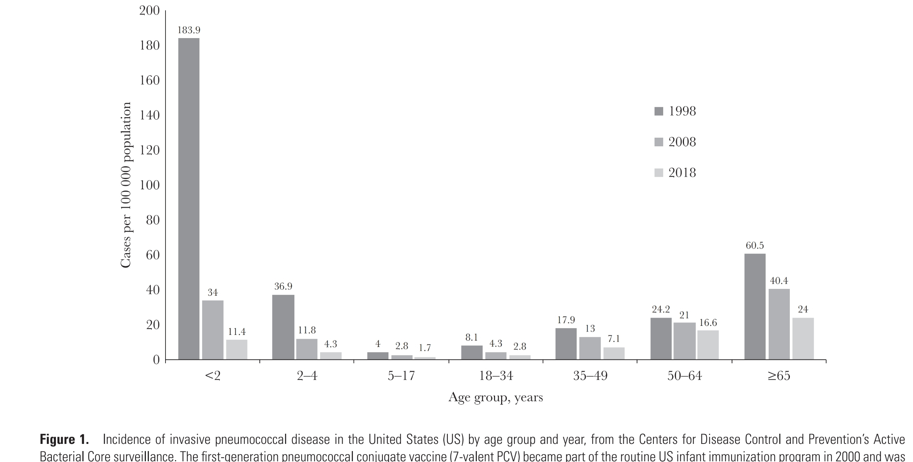

Slide 34
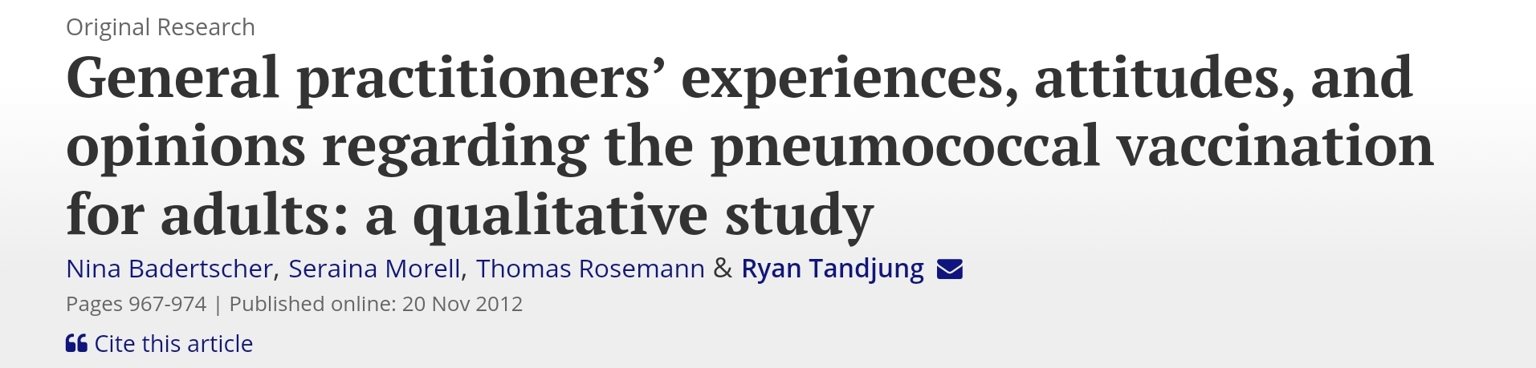
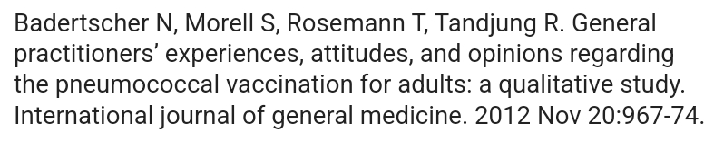
We found the generally low level of priority given within a consultation, the missing awareness of this subject in daily practice, and the perception of epidemiologic and scientific data as insufficient, as the reasons for the low rate in pneumococcal vaccinations.

Slide 35
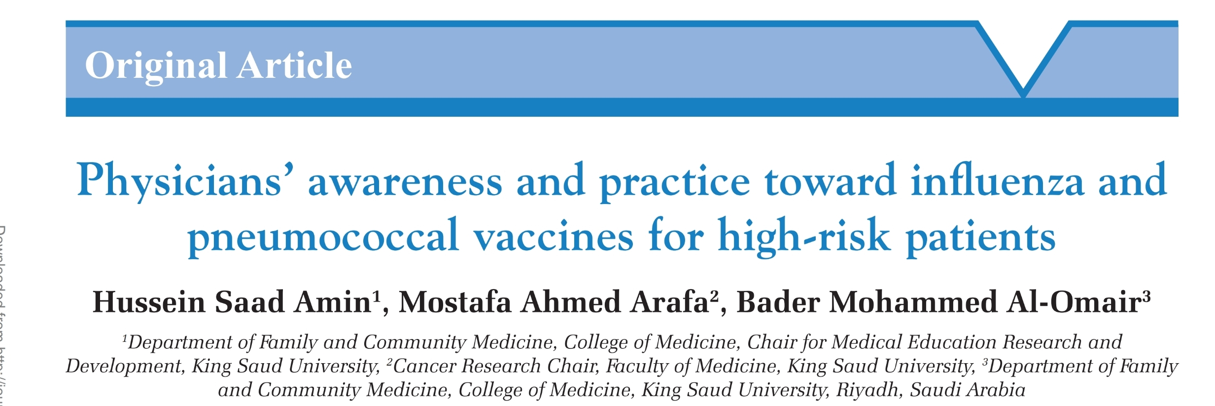
The overall knowledge of physicians about influenza and pneumococcal vaccines was inadequate and was more toward pneumococcal vaccine, in spite their respectable knowledge about the target population. The main reasons for non- prescribing of vaccines were forgetfulness (59.4%), the availability of vaccines (33.9%), and the patients’ refusal (23.3%). The tools that might help for prescribing were the need for the presence of electronic reminder (69.4%) and the patients should follow a regular family physician (47.2%).
Journal of Family Medicine and Primary Care 8(7):p 2294-2299, July 2019. | DOI: 10.4103/jfmpc.jfmpc_343_19

Slide 36
Conclusion
Pneumococcal diseases results in high morbidity and mortality
It causes invasive disease and potentiate complications of chronic diseases
Pneumococcal vaccine has shown efficacy in reducing invasive disease and improve clinical outcome
Vulnerable population need to receive vaccination
Influenza and pneumococcal vaccine are recommended in patients with underlying comorbidities

