Slide 1
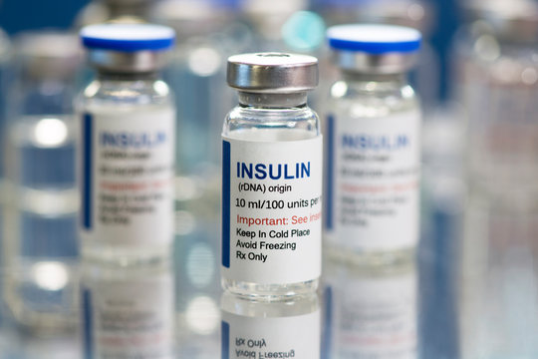
Advances in Insulin Therapy
New Solutions to Old Problems
13 October 2024
Dr Nasrin Goolam Mahyoodeen
MBChB, FCP(SA), Cert. Endo. & Metab. (SA), PhD
MAT-ZA-2400509–v1-10/2024

Slide 2
DISCLAIMER
This presentation is intended to facilitate continuing medical education.
The views expressed in this presentation are those of the presenters and do not necessarily reflect the views of Sanofi.
Sanofi does not recommend the use of its products in any manner inconsistent with that described in the local Professional Information.
Before using any product mentioned here-in please refer to the full local Professional Information.
For full prescribing information on any products mentioned in this presentation, refer to the Professional Information approved by the Regulatory Authority

Slide 3
Disclosures
The speaker has the following financial or other relationships to disclose:
  Consultant for: Boehringer Ingelheim, Sanofi, Lilly
  Speaker for: Boehringer Ingelheim, Sanofi, Lilly, Novo Nordisk, Astra Zeneca
  Grant/research support from: Carnegie Foundation of New York, Medical Research Council, National Research Foundation, Astra Zeneca
  Honoraria from: as above

Slide 4
Outline
  Setting the Scene
  Case study
  The Journey of Insulin
  Therapeutic challenges
  Conclusion

Slide 5
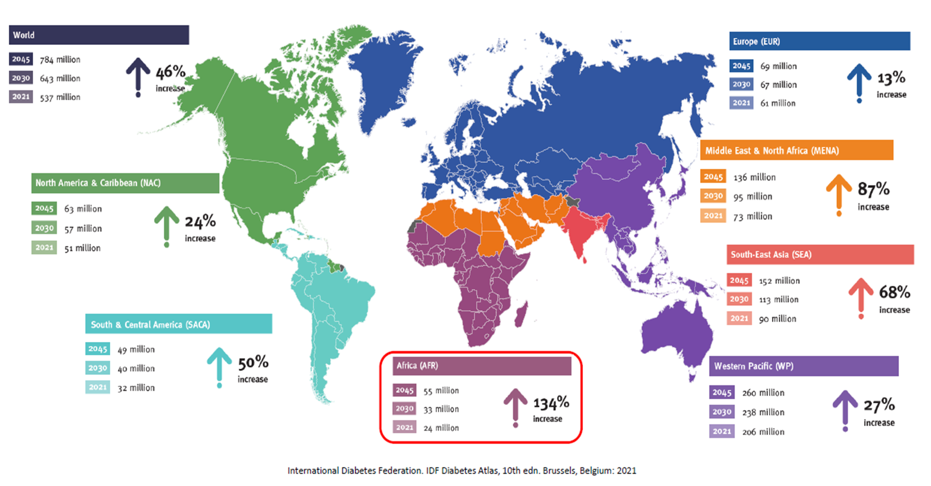
Epidemiology

Slide 6
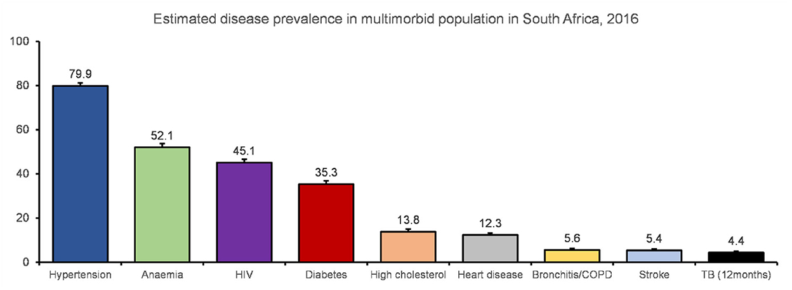
Front. Public Health, 2023, Vol 10 - 2022 | https://doi.org/10.3389/fpubh.2022.1082587

Slide 7
Diabetes in adults (20-79 years): South Africa (IDF 2021)
Adult total population (1000s)
37,416.8
Estimated adult diabetes population (1000s)
4,234.0
Diabetes age-adjusted comparative prevalence (%)
10.8
Cost per person with diabetes (USD)
1,700.7
Diabetes-related deaths
95,676
Proportion of undiagnosed diabetes (%)
45.4
1 in 9 adults has diabetes
The International Diabetes Federation (IDF) Diabetes Atlas (2021)

Slide 8
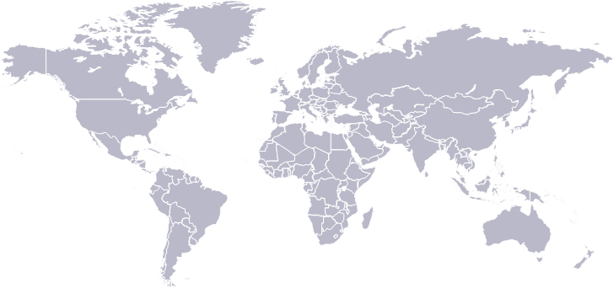

Despite several treatment options, many people with T2D do not meet their glycemic goals
In Europe, 37.4% of adults with T2D have an HbA1c ≥7%⁴
In the US, 50.5% of adults with diabetes have an HbA1c <7%¹
In the US^{†2} and Canada,^{‡3} nearly 15% of adults with diabetes have an
HbA1c ≥9.0%
In LMIC countries, <50% of people with T2D achieve glycemic targets⁵
Additionally, ~80% of adults with T2D in LMIC treated with premix or basal insulin have an HbA1c ≥7%⁶
†According to the US CDC of individuals ≥18 years in the US (2013–2016). ‡Data from 10,590 people with T2D from the Canadian LMC Diabetes Registry.
CDC, Centers for Disease Control and Prevention; LMIC, low- and middle-income countries; T2D, Type 2 diabetes; US, United States.
1. Fang M, et al. N Engl J Med 2021;384;2219–28; 2. CDC. The National Diabetes Statistics Report 2020. Available at: https://www.cdc.gov/diabetes/pdfs/data/statistics/national-diabetes-statistics-report.pdf (Last accessed April 2022); 3. Aronson R, et al. J Diabetes 2016;8:76–85; 4. Pablos-Velasco P, et al. Clin Endocrinol 2014;80:47–56; 5. v.
6. Ramachandran A, et al. Poster presented at EASD 2019 #873.

Slide 9
Diabetes prevalence, screening, diagnosis, treatment, and control: South African adults aged ≥15 years
The diabetes care cascade
Of 521 people with diabetes:
  55% have ever been screened for diabetes, a 45% loss.
Of those who have ever had their blood sugar measured,
  73% received a diagnosis of high blood sugar or sugar diabetes, a 27% loss.
Of those who received a diagnosis,
  94% were being treated with oral glycemic medication or insulin, a 6% loss.
Of those who were currently taking medication,
  51% had controlled blood sugar (HbA1c < 7.0%), a 49% loss.
-45
-27
-6
-49
Stokes A et al. PLoS ONE 2017; 12(10): e0184264

Slide 10
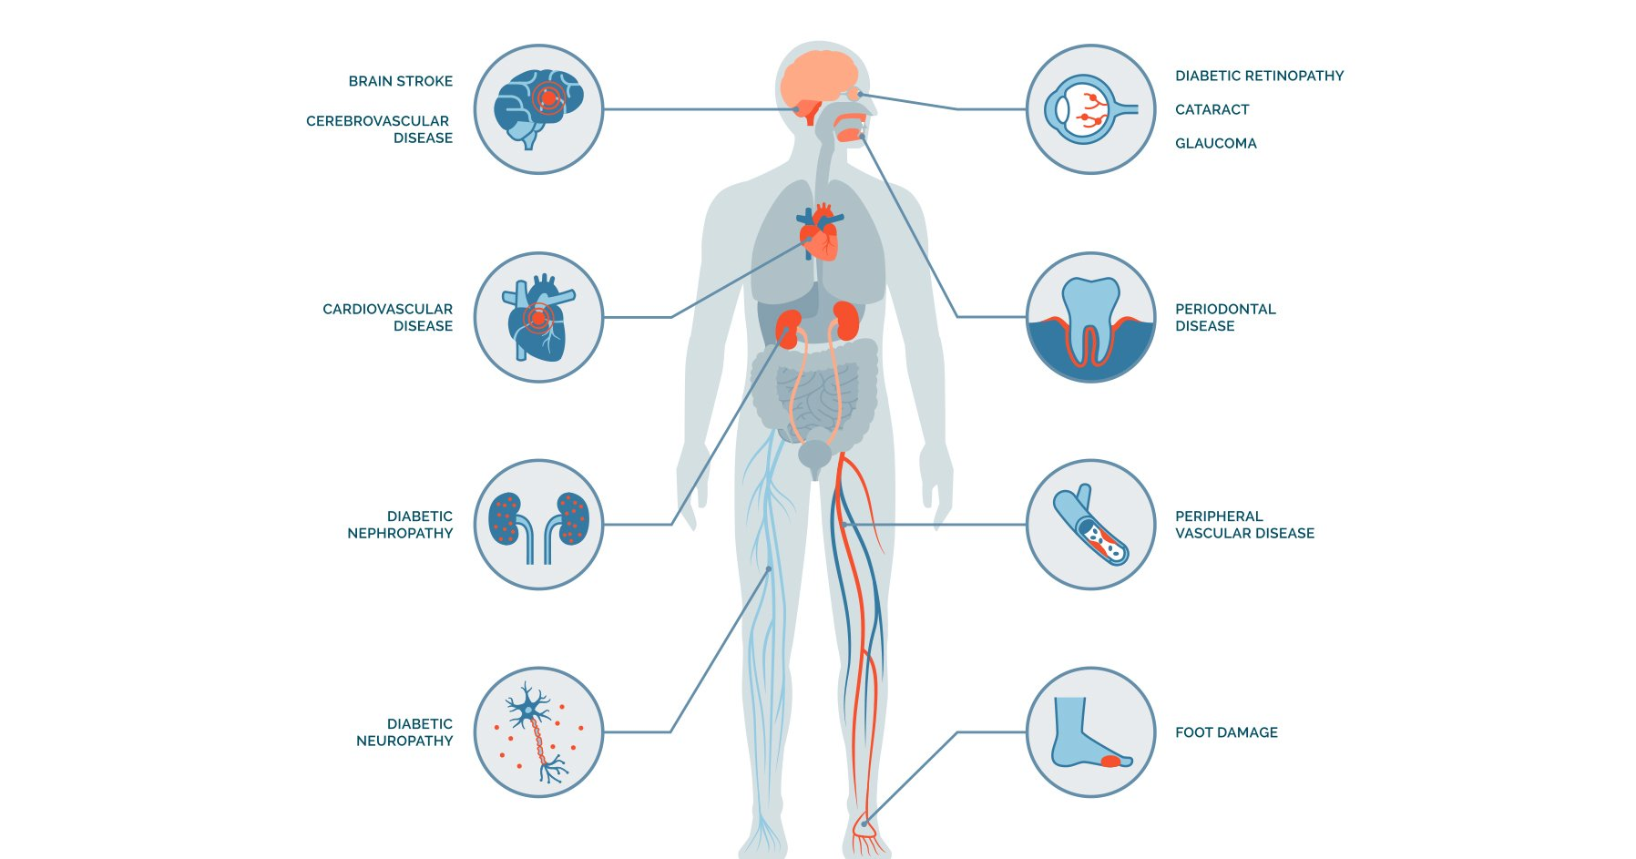
Complications of Diabetes
https://www.endocrine.org/-/media/endocrine/images/patient-engagement-webpage/condition-page-images/diabetes-and-glucose-metabolism/diabetes_complications_pe_1796x943.jpg

Slide 11



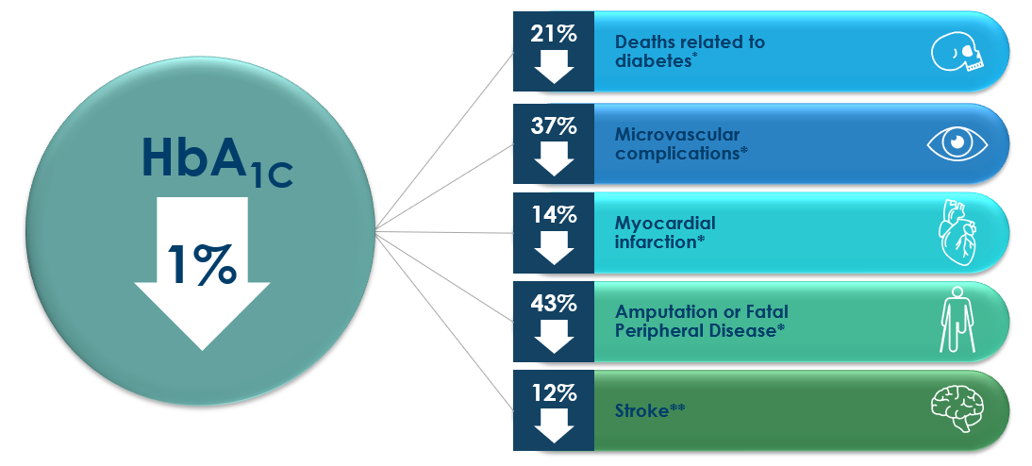
Better HbA1c = Less Complications
* p<0,0001 ** p< 0,035
Stratton et al. UK Prospective Diabetes Study (UKPDS). BMJ. 2000; 231:455-412

Slide 12
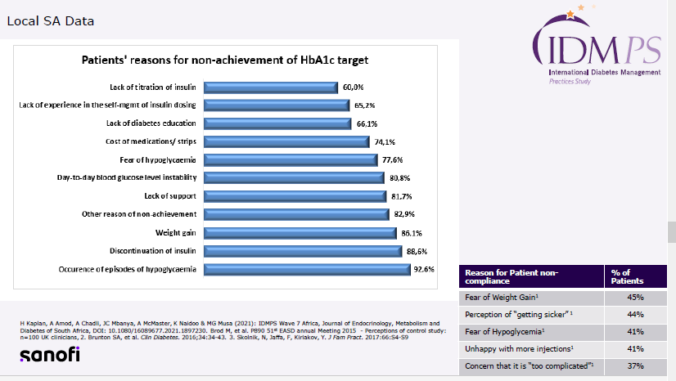
South AFRICA

Slide 13










Treatment advancement to insulin-based therapy is often associated with a number of challenges…
Current intensification options may not fully address physician and patient concerns
Physician concerns
Patient concerns
Insulin
titration
Adherence
Multimorbidity
Adverse
events
Hypoglycemia
Weight gain
Regimen
complexity
Retaining
driving license
Simple, more effective advancement options are required to overcome these challenges
1. Khunti K and Millar-Jones D. Prim Care Diabetes 2017;11:3–12; 2. Graveling AJ and Frier BM. Clin Diabetes and Endocrinol 2015; doi: 10.1186/s40842-015-0007-3.

Slide 14
Substantial inertia exists in the intensification of therapy
Substantial inertia exists at each sequential intensification step
1.6-2.9 yrs
6.9-7.2 yrs
6-7.1 yrs
3.7 yrs
Patient on
1 OAD
Adding 2nd OAD*
Adding 3rd OAD*
Adding insulin*
Adding
GLP-1RA,
premixed
and bolus insulin**
*Retrospective cohort study based on 81,573 people with T2D (including 50,476 people taking one OAD) in the UK Clinical Practice Research Datalink between January 2004 and December 2006, with follow-up until April 2011. Values indicate median duration from time when HbA1c was ≥7.0%, ≥7.5% or ≥8.0%. ** Retrospective cohort study based on 11,696 people with T2D (including 1752 people taking one OAD) in the UK Clinical Practice Research Datalink (CPRD) between January 2004 and December 2011, with follow-up until December 2013. Values indicate median duration from time when HbA1c was ≥7.5%. GLP-1 RA, glucagon-like peptide-1 receptor agonist
Adapted from Khunti K, et al. Diabetes Care 2013;36:3411–7; Khunti K, et al. Diabetes Obes Metab 2016;18:401–9

Slide 15
Mrs. XN, 56-year-old nurse
Comorbidities | Type 2 diabetes (2014) Hypertension (2010) Dyslipidaemia (2014)
Treatment | Metformin 1000mg bd po Glimepiride 6mg daily po Dapagliflozin 10mg daily Enalapril 10mg bd Atorvastatin 20mg nocte
Physical Examination | Waist circumference – 102cm BMI – 32.5 kg/m² BP 138/89 mm Hg No diabetic retinopathy | Albuminuria HDL Cholesterol – 0.9mmol/L LDL Cholesterol – 2.3 mmol/L HbA1c 9.2%

Slide 16
Mrs. XN, 56-year-old nurse
She is aware that she has poor glycaemic control and has struggled to improve her diet and lifestyle. She has consulted with at least 2 doctors previously both of whom recommended she commence insulin.
She was offered the following options Biphasic insulin Multiple daily injections Basal insulin
Defaulted because of practical challenges Timing of injections and meals Recurrent minor hypoglycaemic episodes Intermittent hyperglycaemic episodes

Slide 17
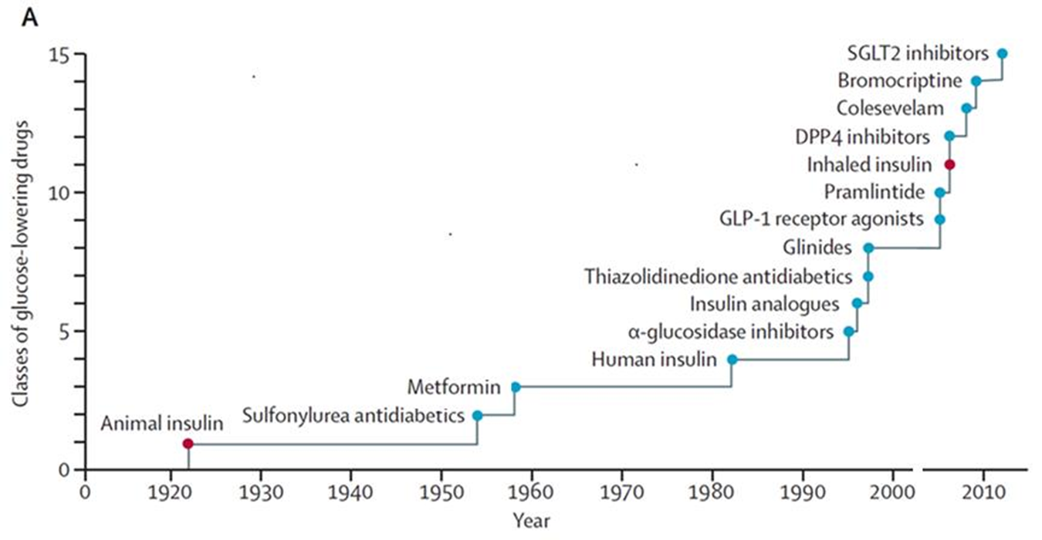
Arsenal of DM treatment
Kahn SE et al. Lancet Diabetes and Endocrinol. Published Online 4 Dec 2013

Slide 18
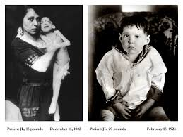

Slide 19


Slide 20



Slide 21
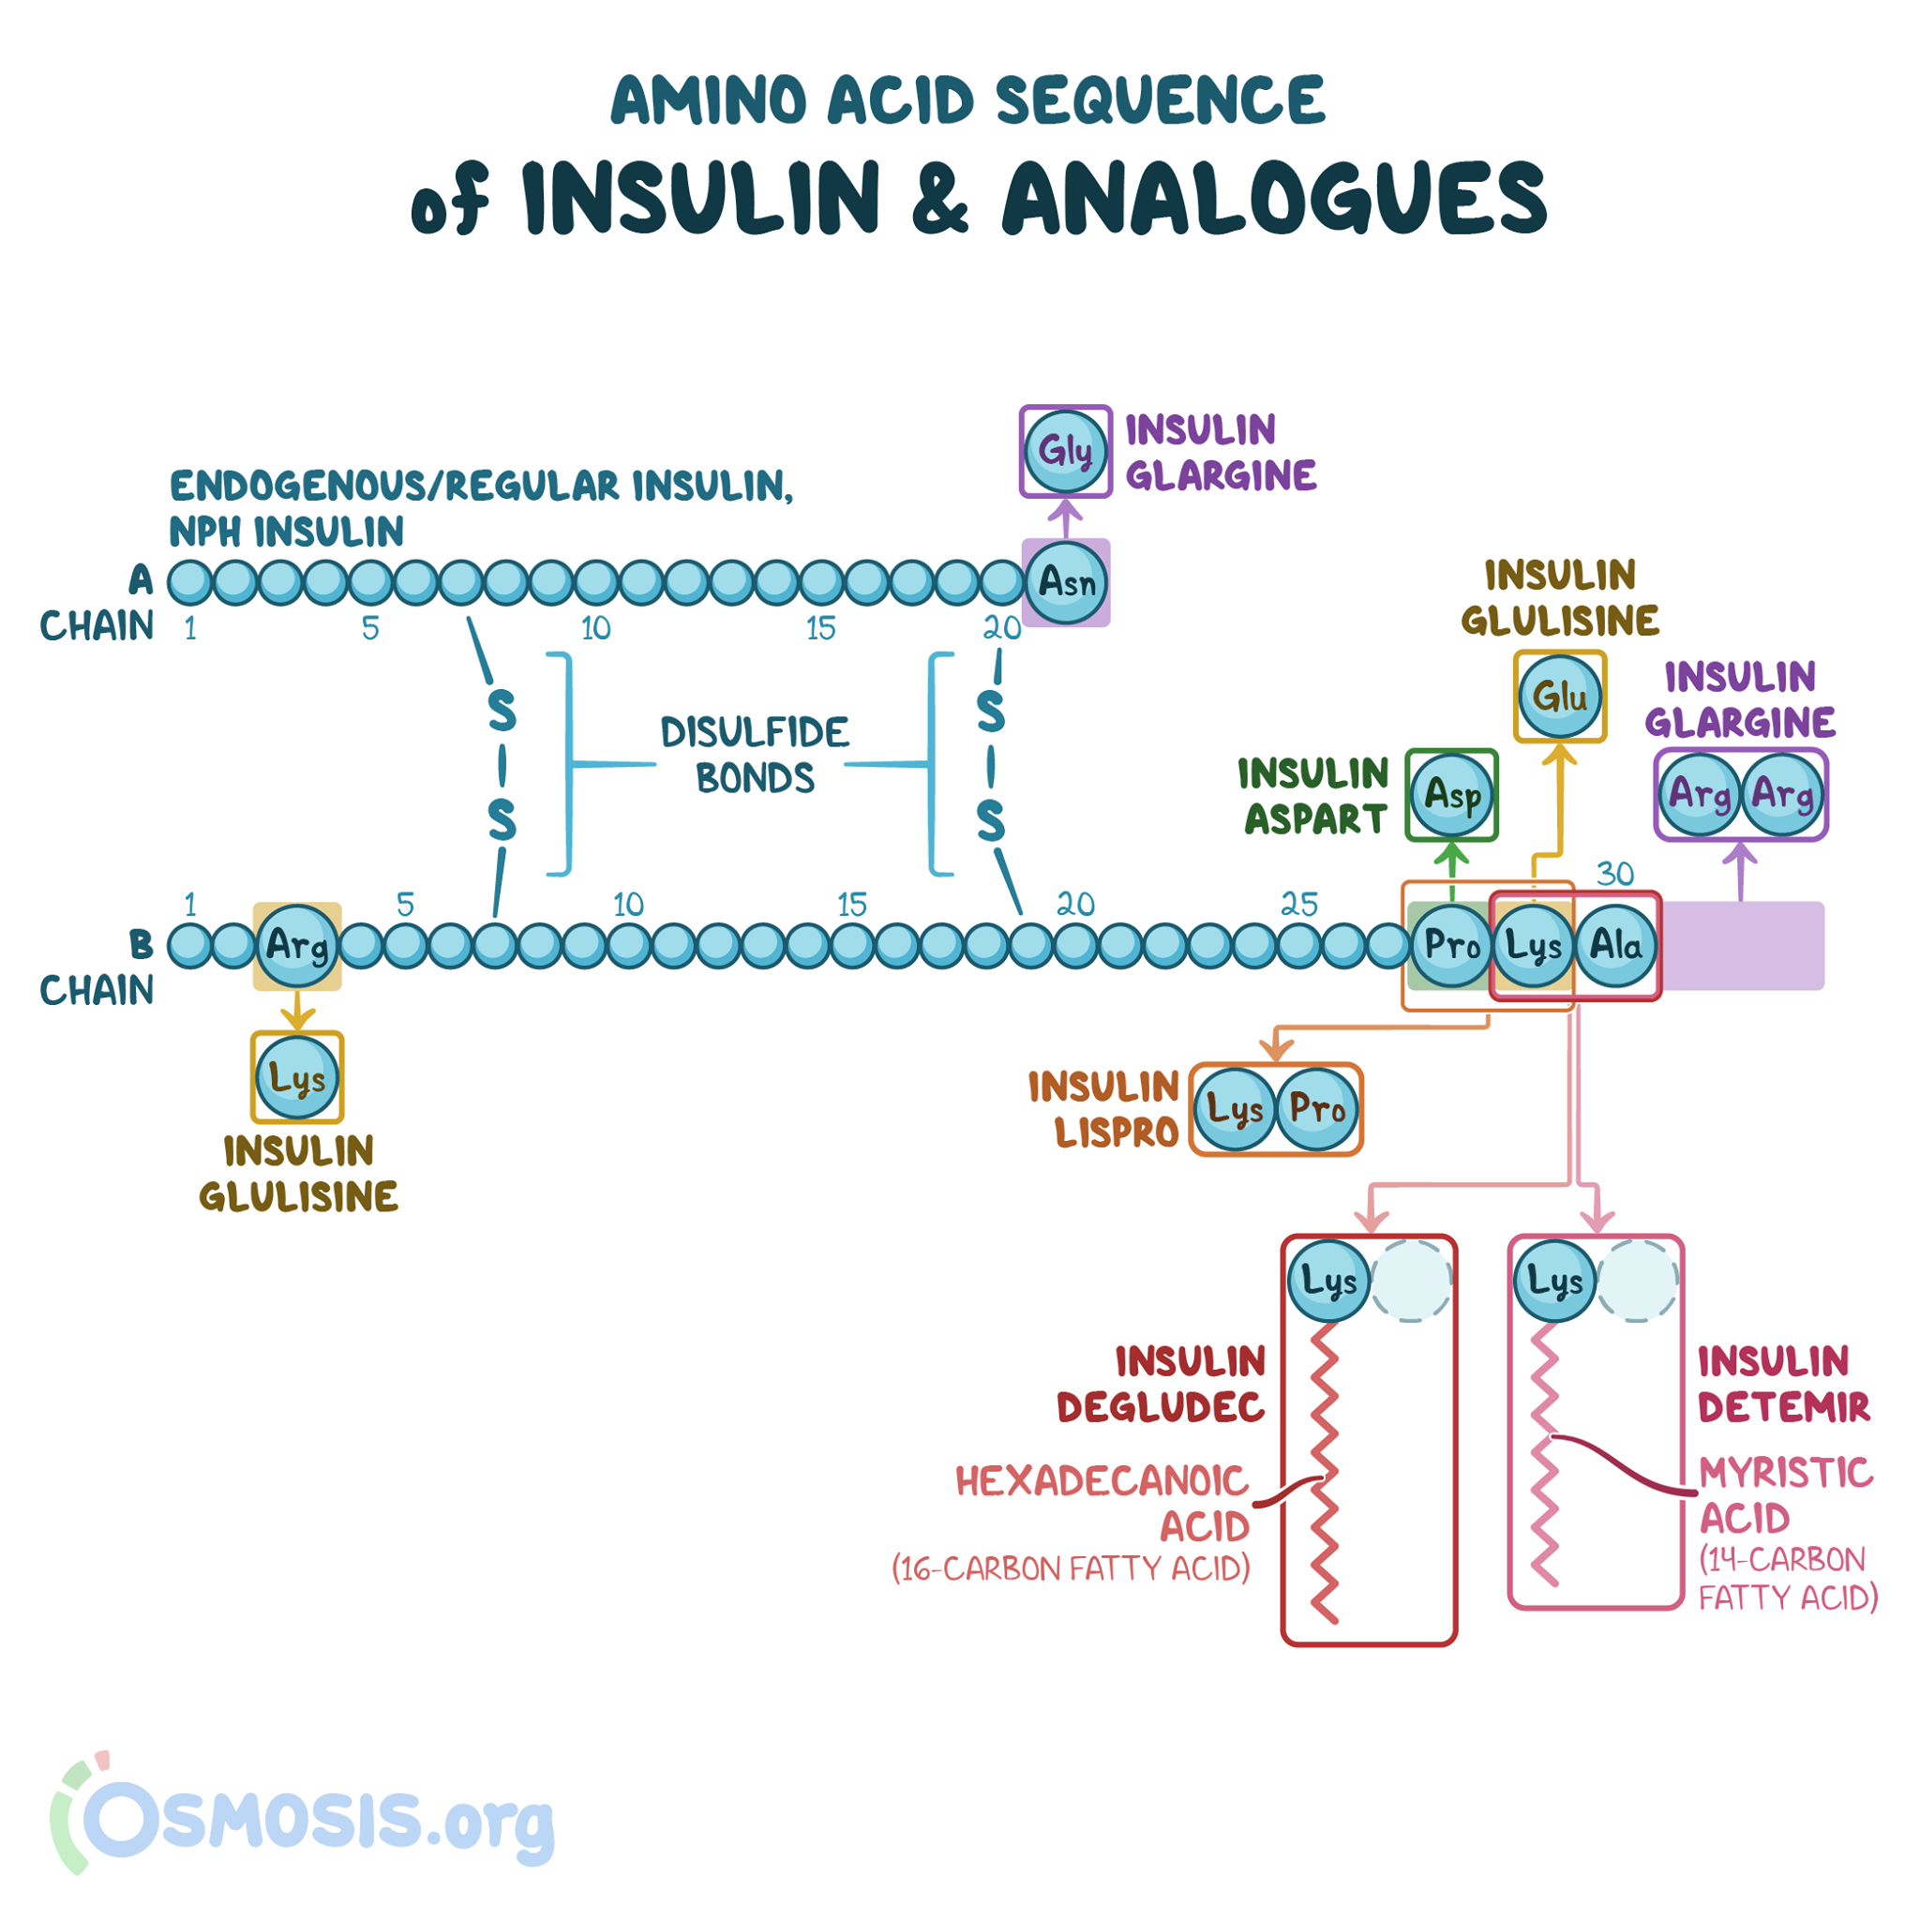
Osmosis. (n.d.). *Insulins*. Retrieved October 25, 2023, from https://www.osmosis.org/learn/Insulins

Slide 22
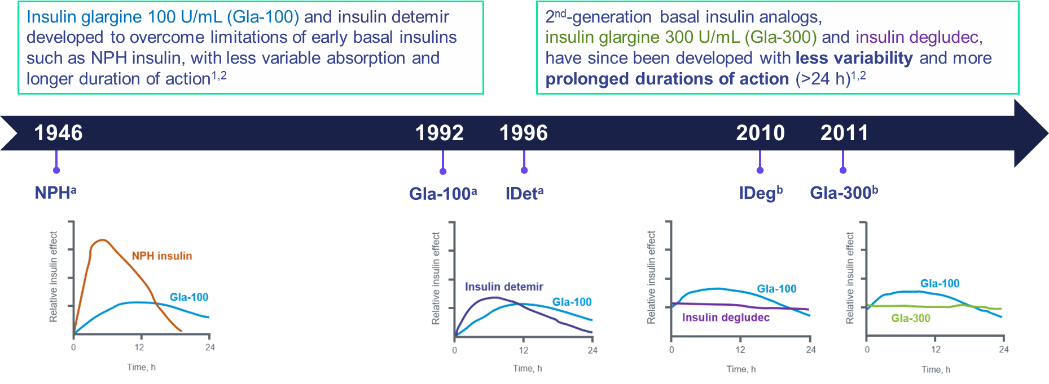
Evolution of basal insulin development from 1st- to
2nd-generation basal insulin analogs: Overcoming limitations
All graphs adapted from Pettus J, et al. Diabetes Metab Res Rev 2016;32:478–96
a- Comparison of action after a single dose for NPH and Gla-100 and for Gla-100 and insulin detemir; b- Comparison at steady state for Gla-100 and Gla-300 and for Gla-100 and insulin degludec.
1. Eliaschewitz FG, Barreto T. Diabetol Metab Syndr. 2016 Jan 6;8:2; 2. Adapted from Pettus J et al. Diabetes Metab Res Rev. 2016 Sep;32(6):478-96

Slide 23
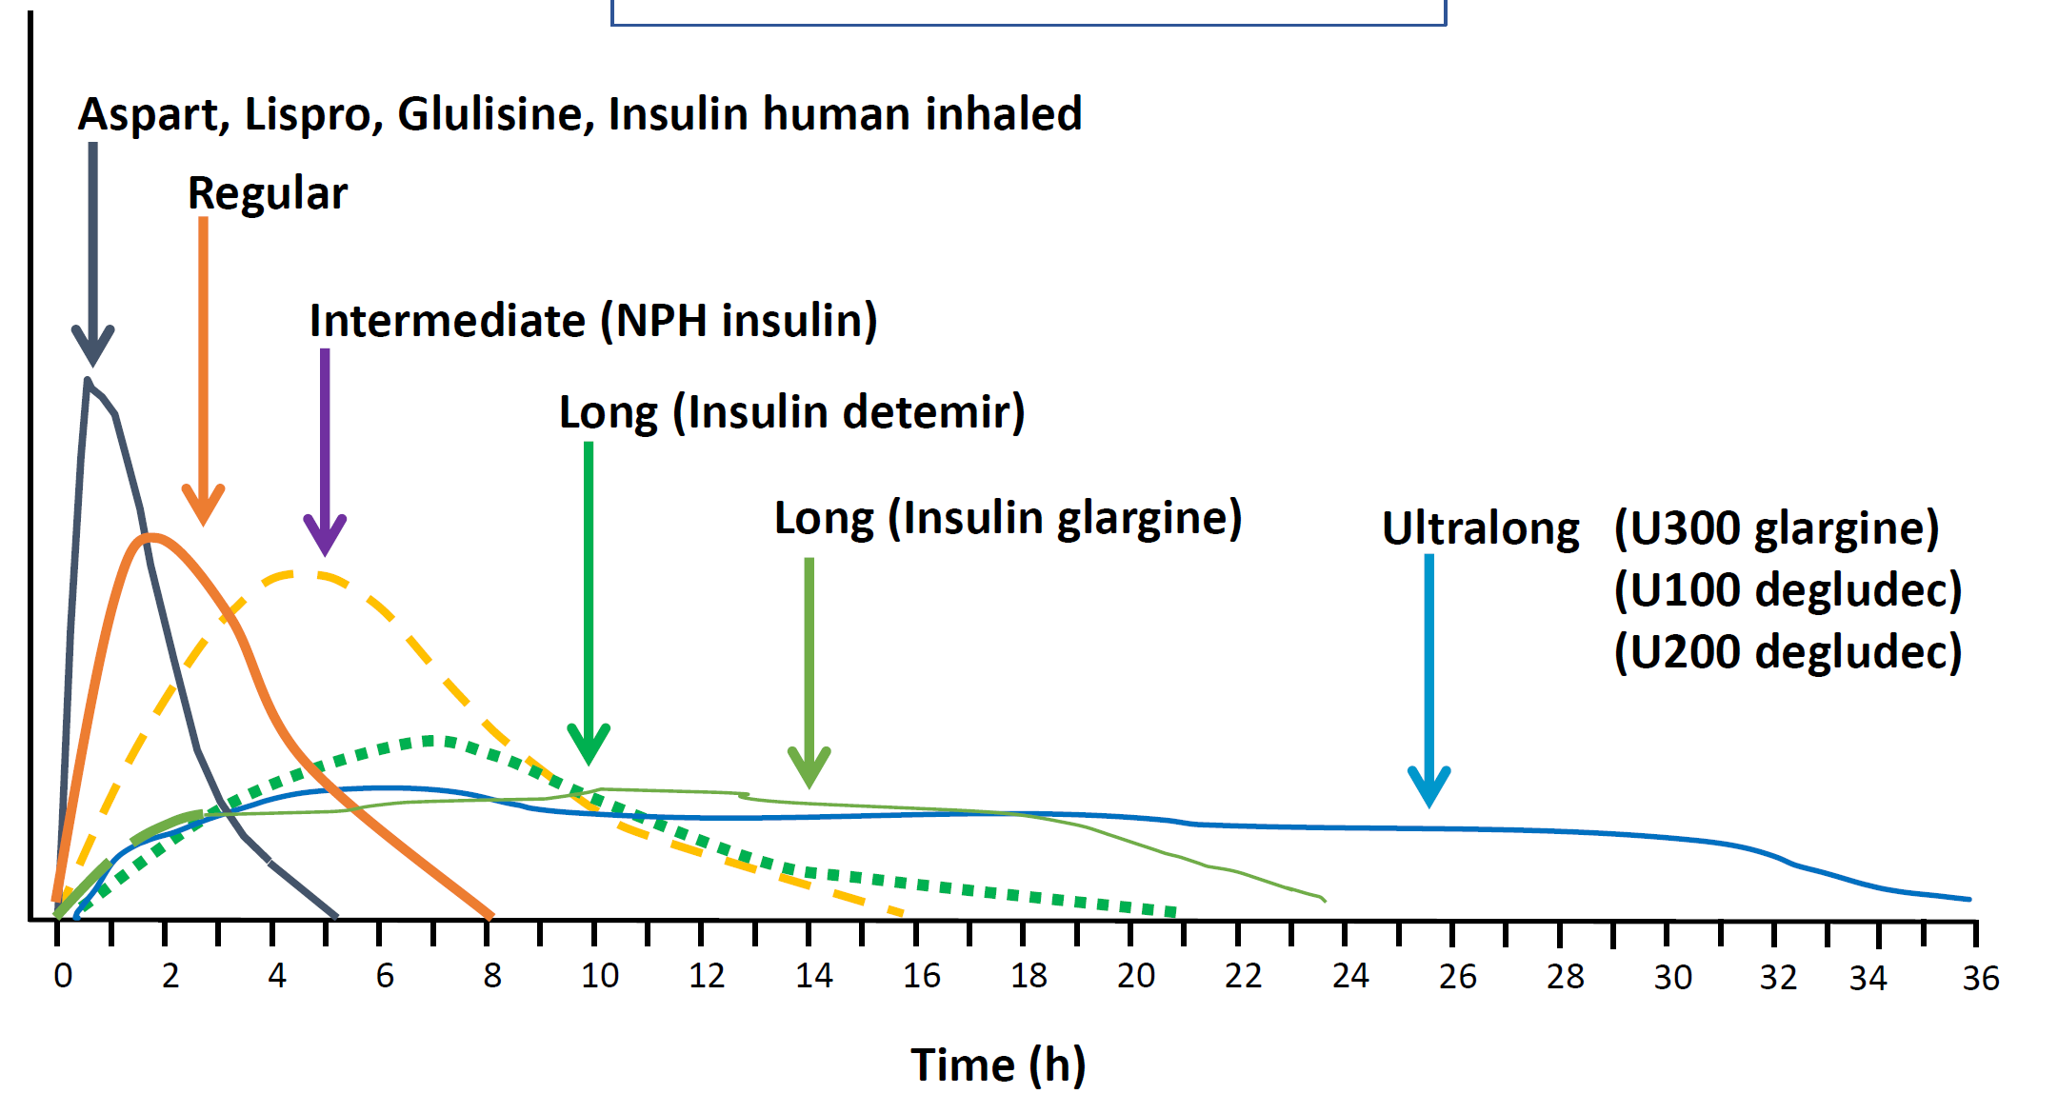
Available Insulin
Plasma Insulin Levels
Adapted from Hirsh IB. NEJM. 2005; 352:174-183; Flood TM. J Fam Pract. 2007;56(suppl 1):S1-S12. Becker RH, et al. Diabetes Care. 2014;pii:DC_140006.

Slide 24
Advantages of second generation insulin therapy
Longer duration of action
• Less glucose variability due to stable pharmacokinetic profiles
• Reaches TIR goals for both T1DM and T2DM, as well as for special populations within these categories
• Lower risk of hypoglycaemia
• Greater improvement in patient satisfaction
• Improved patient-related outcomes
• Improved quality of life.

Slide 25
Hypoglycemia is a key barrier to optimal glycemic control in people with diabetes
Patient responses to hypoglycemia…^{*1}
…can negatively impact glycemic control…^{1–9}
Maintaining higher than recommended HbA_{1c} levels
Reduced treatment adherence
Negative impact on QoL,
and physical, mental and
social functioning
Fear of future episodes
*In the 4 weeks following baseline. Results shown are from a non-interventional, multicentre, 4-week prospective-cohort survey of hypoglycemic events conducted across 2004 sites in 24 countries from 2012 to 2013. 27,585 subjects were ≥18 years of age at the time of enrolment, with T1D (n=8,022) or T2D (n=19,563), treated with insulin for >12 months. QoL, Quality of life; T1D, Type 1 diabetes. 1. Khunti K, et al. Diabetes Res Clin Pract. 2017;130:121–29; 2. Russell-Jones D, et al. Diabetes Obes Metab. 2018;20:488–96; 3. Willis WD, et al. Expert Rev Pharmacoecon Outcomes Res. 2013;13:123–30; 4. Sakane J, et al. J Diabetes Investig. 2015;6:567–70; 5. Leiter LA, et al. Can J Diabetes. 2005;29:00–00; 6. Fidler C, et al. J Med Econ. 2011;14:646–55; 7. Aronson R, et al. Diabetes Res Clin Pract. 2018;138:35–43;
8. Diabetes Canada. 2018; Clinical Practice Guidelines. Available from: http://guidelines.diabetes.ca/docs/CPG-2018-full-EN.pdf [Accessed July 2020];
9. Freeman J. Postgrad Med. 2019;131:241–50.

Slide 26
Hypoglycaemia and insulin
Hypoglycaemia is common and underreported in people with T2D,¹⁻³ and is a barrier to achieving glycaemic control⁴
Mild-to-moderate hypoglycaemia can increase the risk of injury from falls or accidents⁵
Recurrent hypoglycaemia, especially severe episodes, is strongly associated with CV events⁶⁻⁸
Hypoglycaemia risk is higher in the elderly or frail, and those with renal impairment or multiple comorbidities^{9,10}
1. Aronson R, et al. Diabetes Res Clin Pract 2018;138:35-43. 2. Brod M, et al. Value in Health 2011;14:665-71. 3. Ratzki-Leewing A, et al. BMJ Open Diabetes Res Care 2018;6:e000503.
4. Cryer PE. Diabetes 2008;57:3169-76. 5. Seaquist ER, et al. Diabetes Care 2013;36:1384-95. 6. Cryer PE. Diabetes Care 2012;35:1814-6.
7. Zoungas S, et al. N Engl J Med 2010;363:1410-8. 8. McCoy RG, et al. Diabetes Care 2012;35:1897-901. 9. Moen MF, et al. Clin J Am Soc Nephrol 2009;4:1121-7.
10. McCoy RG, et al. JAMA Network Open 2020;3:e1919099-e.
Harris SB, Parente EB, Karalliedde J. Diabetes Ther. 2022. [Epub ahead of print]

Slide 27
EDITION RCTs: Gla-300 demonstrates comparable glycemic control vs Gla-100 in adults with T2D at Month 6
Gla-300
EDITION 1¹
BB
EDITION 2²
BOT switch
EDITION 3³
Insulin-naïve:
BOT start
EDITION JP 2⁴
BOT switch
EDITION AP⁵
Insulin-naïve:
BOT start
Gla-100
LSM difference
(95% CI)
0.00%
(–0.11 to 0.11)
-0.01%
(–0.14 to 0.12)
0.04%
(– 0.09 to 0.17)
0.10%
(–0.08 to 0.27)
0.02%
(–0.10 to 0.14)
n=404 n=400
n=404 n=407
n=432 n=430
n=120 n=120
n=397 n=201
0.0
–0.5
LSM HbA1c change from baseline to Month 6, %
–1.0
–1.5
The EDITION studies were multicenter, randomized, open-label, parallel-group, Phase 3 studies, with similar designs and endpoints, comparing the efficacy and safety of Gla-300 vs Gla-100 in people with diabetes (T2DM studies only shown on this slide) across various population groups. Across all trials, the primary endpoint of non-inferiority in HbA1c reduction was met.
BB, basal-bolus therapy; BOT, basal-supported oral therapy; CI, confidence interval; LSM, least square mean
1. Riddle MC, et al. Diabetes Care 2014;37:2755–62; 2. Yki-Järvinen H, et al. Diabetes Care 2014;37:3235–43; 3. Bolli GB, et al. Diabetes Obes Metab 2015;17:386–94;
4. Terauchi Y, et al. Diabetes Obes Metab 2016;18:366–74; 5. Ji L, et al, Diabetes Obes Metab 2020;22:612–621

Slide 28
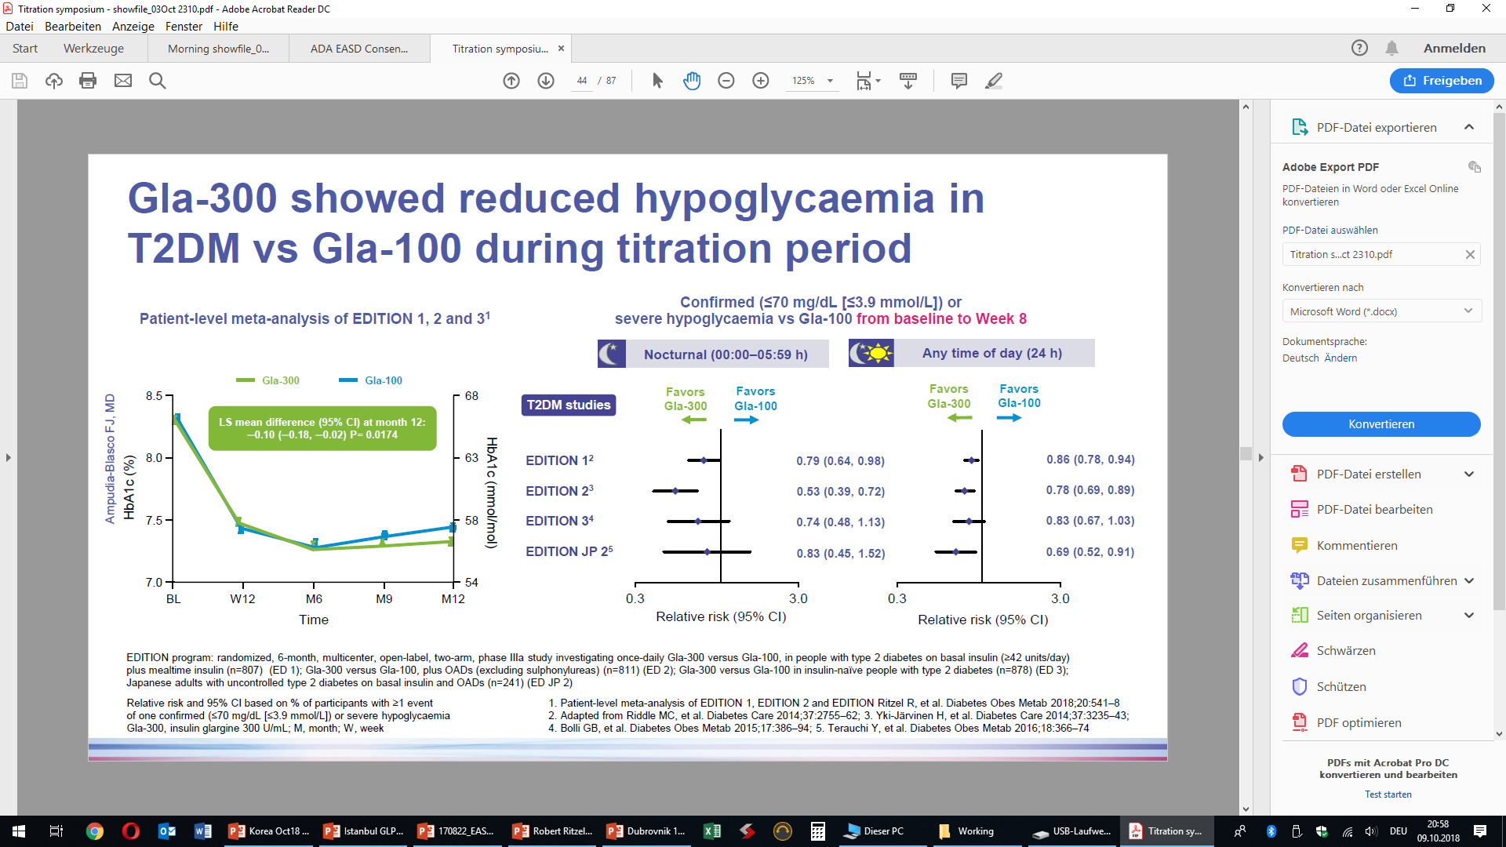
Gla-300 versus Gla-100 in T2DM
EDITION

Slide 29
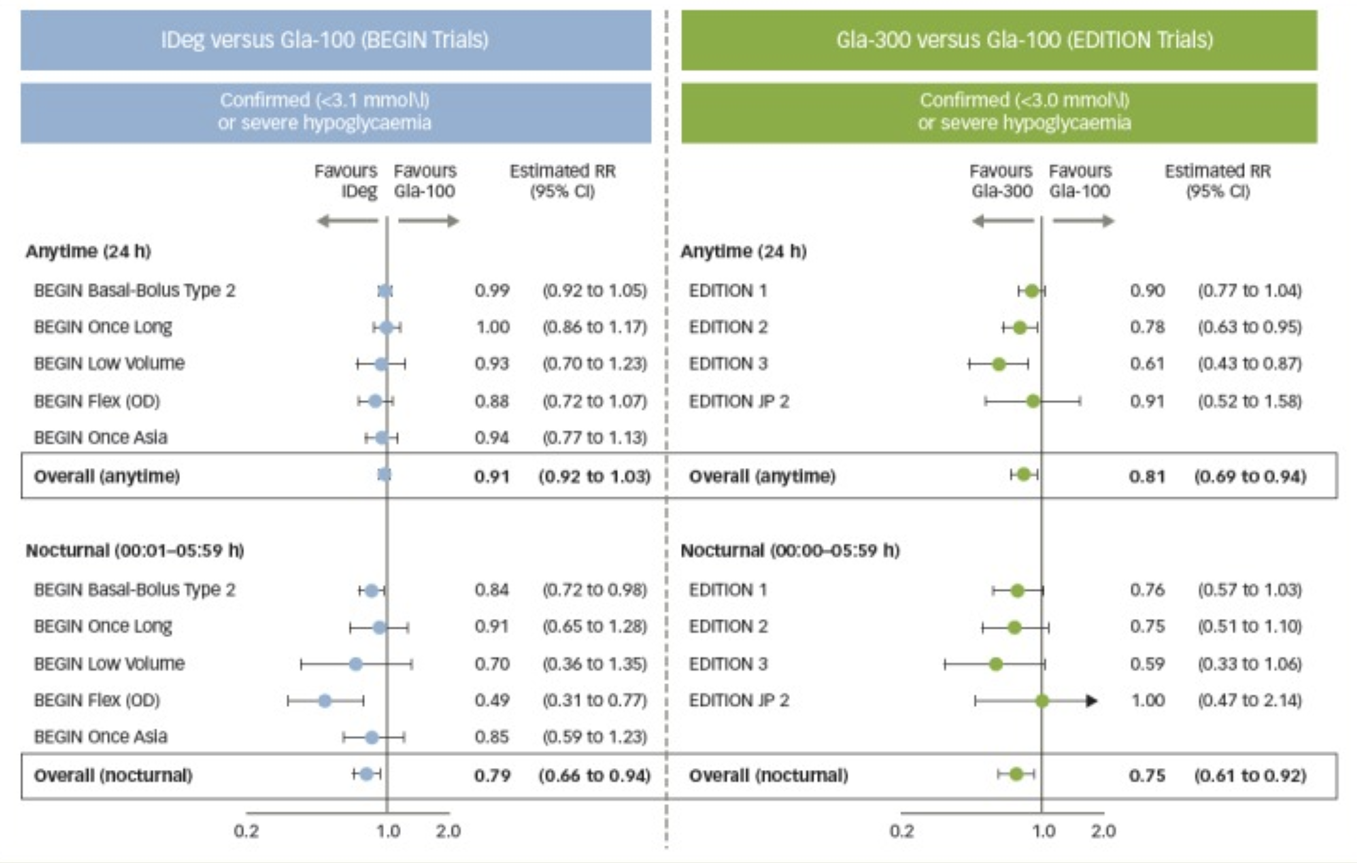
Mauricio D, Hramiak I. Second-Generation Insulin Analogues - a Review of Recent Real-World Data and Forthcoming Head-to-Head Comparisons. Eur Endocrinol. 2018

Slide 30
BRIGHT study design
Multicenter, open-label, 1:1 randomized, active-controlled, 2-arm parallel-group,
non-inferiority study in adult participants with uncontrolled T2DM
Screening
(2 weeks)
Treatment period
(24 weeks)
Post treatment
(7 days)
Titration target: fasting SMPG 80–100 mg/dL (4.4–5.6 mmol/L) without hypoglycemia
Eligible patients:
≥18 years
T2DM duration ≥1 year
HbA1c ≥7.5 to ≤10.5 % at screening
BMI ≥25 to ≤40 kg/m²
OAD use ± GLP-1 RAs, at stable dose for ≥3 months
No prior insulin useª
Starting dose: 0.2 U/kg as per labeling
Gla-300 once daily (PM) (n=466)
Follow-up
Initial active titration
Late maintenance titration
(0–12 weeks)
(13–24 weeks)
IDeg-100 once daily (PM) (n=463)
Follow-up
Starting dose: 10 U as per labeling
Stratification by:
HbA1c at screening (<8.0/≥8.0 % [<64/≥64 mmol/mol])
Use of SU or meglitinides at screening (Yes/No)
Titration Phase
Maintenance Phase
Study
end
Treatment end
Primary endpoint
ªWith the exception of a maximum of 8 consecutive days or 15 days total prior insulin use
BMI, body mass index; GLP-1 RA, glucagon-like peptide-1 receptor agonist; OAD, oral antihyperglycemic drug; SMPG, self-monitored plasma glucose; SU, sulfonylureas
Rosenstock J et al. Diabetes Care. 2018 Aug 13. pii: dc180559.

Slide 31
BRIGHT primary endpoint
Non-inferiority of Gla-300 vs IDeg in HbA1c reduction at W24 in insulin-naïve T2D adults
LS mean difference for Gla-300 vs IDeg-100:
–0.05 % (95 % CI –0.15 to 0.05) (−0.6 mmol/mol [–1.7 to 0.6])
Non-inferiority p-value <0.0001
75
70
65
HbA1c (%) mean ± SE
HbA1c (mmol/mol) mean ± SE
60
55
50
BL
W8
W12
W24
Titration period
Maintenance period
Change from BL to W24 displayed as LS mean values
BRIGHT was a multicenter, open-label, active-controlled, two-arm, parallel-group, 24-week, noninferiority study in insulin-naive adults with uncontrolled T2D (N=929) designed to compare clinical outcomes between Gla-300 and IDeg-100. BL, baseline; W, week.
Rosenstock J, et al. Diabetes Care 2018;41:2147–54.

Slide 32
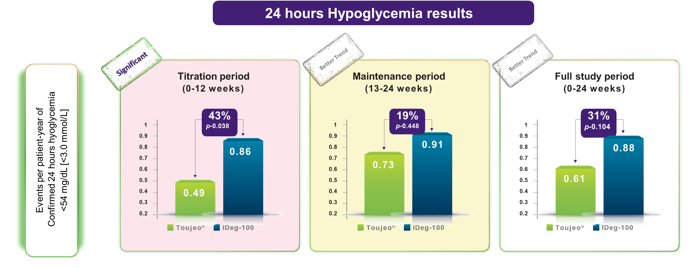
BRIGHT: Any-time hypoglycemia
Gla-300
Gla-300
Gla-300
Safety population (Gla-300, n=463; IDeg-100, n=462).
Confirmed hypoglycemia included documented symptomatic or asymptomatic hypoglycemia (≤70 mg/dL or <54 mg/dL), and severe events if any; only 1 participant experienced severe hypoglycemia (1 event), in the Gla-300 group, due to a skipped evening meal and not reducing her insulin dose after a non-severe event 2 days earlier Overall, 43.7% and 47.8% of participants in the Gla-300 and IDeg-100 groups, respectively, reported adverse events during the 24-week study period. *All p-values presented are nominal. OR, odds ratio
Rosenstock J, et al. Diabetes Care 2018;41:2147–54.

Slide 33
Key messages: Glycaemic control and hypoglycaemia in RCTs in adults with diabetes
Gla-300 vs Gla-100
EDITION studies
Gla-300 vs IDeg
The BRIGHT study
Comparable HbA_{1c} reductions between
Gla-100 and Gla-300^{1–7}
Similar glycaemic control with Gla-300 and IDeg for HbA_{1c} and FSMPG reduction in T2DM patients⁹
Lower risk of confirmed or severe hypoglycemia in T2DM with Gla-300 vs
Gla-100⁸
Incidence and rates of anytime and nocturnal confirmed hypoglycemia comparable for Gla-300 and IDeg during full study and maintenance periods⁹
Lower or similar hypoglycemia risk in T1DM with Gla-300 vs Gla-100^{5,7}
Lower incidence and rates of confirmed hypoglycemia with Gla-300 vs IDeg at any time of day during the titration period⁹
FSMPG, fasting self-monitored plasma glucose
1. Riddle MC, et al. Diabetes Care. 2014;37(10):2755–2762; 2. Yki-Järvinen H, et al. Diabetes Care. 2014;37(12):3235–3243; 3. Bolli GB, et al. Diabetes Obes Metab. 2015;17(4):386–394; 4. Terauchi Y, et al. Diabetes Obes Metab. 2016;18(4):366–374 (main article and Supplementary Table 2); 5. Home PD, et al. Diabetes Care. 2015;38(12):2217–2225; 6. Data on file, EDITION 4 CSR (6 months) pg 88; 7. Matsuhisa M, et al. Diabetes Obes Metab. 2016;18(4):375–383 (main article and Supplementary Table 1); 8. Roussel R, et al. Diabetes Metab. 2018;44(5):402–409; 9. Rosenstock J, et al. Diabetes Care. 2018;41:2147–2154.

Slide 34
Mrs. XN, 56-year-old nurse
Comorbidities | Type 2 diabetes (2014) Hypertension (2010) Dyslipidaemia (2014)
Treatment | Metformin 1000mg bd po Glimepiride 6mg daily po Vildagliptin 50mg twice daily Enalapril 10mg bd Atorvastatin 20mg nocte
Physical Examination | Waist circumference – 102cm BMI – 32.5 kg/m² BP 138/89 mm Hg No diabetic retinopathy | No albuminuria HDL Cholesterol – 0.9mmol/L LDL Cholesterol – 2.3 mmol/L HbA1c 9.2%

Slide 35
Defining a target HbA1c
Risk of hypoglycaemia
Duration of disease
Life expectancy
Comorbidities
Presence of macrovascular disease
Patient factors – adherence, motivation
Resources, social support, education

Slide 36
Efficacy of Anti-diabetic interventions
 | HbA1c lowering (%)
Lifestyle | 1-2
Metformin | 1-2
Sulfonylureas | 1-2
Pioglitazone | 0.5-1.4
DPP 4 inhibitors | 0.5-0.8
SGLT2 inhibitors | 0.8-1.5
GLP-1 Receptor Agonist | 0.5-1.0
Insulin | Treat to target
Bariatric surgery | >1.5
Kalyani RR. Glucose-lowering drugs to reduce cardiovascular risk in type 2 diabetes. N Engl J Med 2021; 384(13)

Slide 37
Which regimen?
Basal | Multiple Daily Injections
Taking sulfonylurea | High post-prandial glucose
Inconsistent meal timings | High carbohydrate meals
Afternoon hypoglycaemia | Nocturnal hypoglycaemia
 | Able to conduct frequent glucose monitoring
Patient preference | Patient preference
Kalyani RR. Glucose-lowering drugs to reduce cardiovascular risk in type 2 diabetes. N Engl J Med 2021; 384(13)

Slide 38
Insulin initiation
Reasons to consider a second generation insulin in this patient Risk of hypoglycaemia Timing of insulin especially because of work schedule Addressing glycaemic variability
Limitations Cost
How to start 0.2u/kg in a single dose
How to titrate Monitor fasting capillary glucose Titrate up by 2u every 4 days

Slide 39
Key messages: various populations
Gla-300 provides comparable glycaemic control and reduced hypoglycaemia (nocturnal) risk during the titration period vs Gla-100 in adults with T1DM¹
T1DM adult patients
Patients with impaired renal function
Gla-300 provides comparable glycaemic control and a reduced hypoglycemia risk vs Gla-100 in T2DM patients regardless of renal function²
Gla-300 results in comparable reductions in HbA_{1C} and low or lower risk of documented symptomatic hypoglycemia vs Gla-100 in older patients with T2DM, particularly those ≥ 75 years³
Older patients
Pregnancy
The use of Gla-100 or Gla-300 during pregnancy is not associated with any specific adverse events⁴
EDITION JUNIOR*
RCT designed to assess the efficacy and safety of Gla-300 vs Gla-100 in children and adolescents with T1DM⁵
*Gla-300 is only indicated in adults; Risk criteria for developing hypoglycemia: 1. Experienced at least 1 severe hypoglycemic episode within the past year; 2. Moderate chronic renal failure (estimated glomerular filtration rate of 30–59 mL/min/1.73m2); 3. hypoglycemic symptom unawareness; 4. Exposure to insulin for longer than 5 years; or 5. An episode of hypoglycemia (symptoms and/or blood glucose level ≤70 mg/dL within the last 12 weeks
1. Home PD, et al. Diabetes Obes Metab. 2018;20(1):121–128; 2. Escalada J, et al. Diabetes Obes Metab. 2018;20(12):2860–2868; 3. Ritzel R, et al. Diabetes Care 2018;41(8):1672–1680; 4. Bertolini M, et al. Poster presentation at EASD 2017; Abstract 937; 5. https://clinicaltrials.gov/ct2/show/NCT02735044 (last accessed March 2019).

Slide 40
Follow-up
Patient did very well on basal insulin initially. HbA1c decreased by 2 %. Lost to follow-up and presented more than 5 years later. HbA1C - 8.5 % Insulin dose had been increased by other practitioners. Required prandial insulin Non-compliant – various reasons
What next ?

Slide 41





Initiating and intensifying insulin therapy can be burdensome to people with diabetes due to the impact of numerous factors…
Factors associated with insulin injection omission:¹
Daily injection frequency
Injection embarrassment
Injection pain
Weight gain
Fear of hypoglycemia
Such factors may lead to a delay in treatment intensification and inadequate glycemic control,² as well as poor adherence to treatment¹
1. Peyrot M, et al. Diabetes Care 2010;33:240–5; 2. Blonde L, et al. Diabetes Ther 2018;9:1347–58.
41

Slide 42

…and treatment advancement with complex regimens is associated with certain disadvantages
Advantages
Disadvantages
Progressive addition
of a rapid-acting insulin to a BI regimen
Starting with a single prandial dose (with largest meal of the day) is simple and effective*
Can be advanced to multiple prandial doses if necessary
Greater flexibility for people on irregular schedules*
Hypoglycemia risk
May require multiple daily injections
Weight gain
Titrating insulin may be difficult
to manage
Can lead to frequent eating*
Increased risk of weight gain
and hypoglycemia*
Switch to premix insulin
Simplified regimen vs basal–bolus therapy*
Addition of a daily or weekly GLP-1 RA
Similar efficacy to other advancement options (such as basal +/basal–bolus regimens)
Lower risk of weight gain and hypoglycemia vs insulin advancement options*
GI side effects*
Additional injections required
Several dose increases required before reaching maintenance dose
Once-daily FRC of a BI and a GLP-1 RA
Potent glucose-lowering actions vs individual components*
Greater durability of glycemic effect vs addition of BI alone*
Less weight gain vs complex insulin regimens
Less hypoglycemia vs complex insulin regimens*
Max BI dose capped at 60 U for iGlarlixi and 50 U for IDegLira
*Noted in multiple guidelines. BI, basal insulin; FRC, fixed-ratio combination; GI, gastrointestinal; GLP 1 RA, glucagon-like peptide-1 receptor agonist; U, units.
American Diabetes Association. Diabetes Care 2021;44(Suppl 1):S111–S124.; Davies MJ, et al. Diabetes Care 2018;41:2669–701;
Nuffer W, et al. Ther Adv Endocrinol Metab 2018;9:69–79; Ilag LL, et al. Clinical Ther 2007;29:1254–70; LeRoith D, et al. J Clin Endocrinol Metab 2019;104:1520–74.
42

Slide 43
Treatment simplification of complex insulin regimens may help to improve outcomes in T2D in a number of patient profiles
  An expert, multidisciplinary panel* gathered for a 2-day consensus meeting to
  evaluate the current treatment landscape with respect to guidance, published evidence,
  recommendations and approaches for simplification of complex insulin regimens
Many people with
T2D will eventually require and benefit from treatment intensification
This usually involves the stepwise addition of a new glucose-lowering agent or switching to a more complex insulin regimen
However, complex treatment regimens can result in an increased risk of hypoglycemia and high treatment burden, which may impact negatively on both therapeutic adherence and
overall quality of life
Simplifying T2D therapy strategies, when suitable and without compromising treatment efficacy and safety, offers the opportunity to ease disease burden
*This panel consisted of: Edward Jude (UK), Maciej Malecki (Poland), Ricardo Gomez Huelgas (Spain), Martin Prazny (Czech Republic), Frank Snoek The Netherlands), Tsvetalina Tankova Bulgaria), Dario Giugliano (Italy) and Kamlesh Khunti (UK). T2D, Type 2 diabetes.
Jude EB, et al. Diabetes Ther 2022 [Online ahead of print];https://doi.org/10.1007/s13300-022-01222-2
43

Slide 44

The complementary modes of action of basal insulin and
GLP-1 RAs provide a rationale for FRC therapy
Basal insulin is the most effective agent to lower FPG but it is associated with hypoglycemia and
weight gain
GLP-1 RAs can lower both
FPG and PPG without increasing hypoglycemia,
whilst mitigating weight gain
FRCs containing a basal insulin and a GLP-1 RA allow administration of both agents in a single daily injection, with the potential to improve convenience*
*A titratable fixed-ratio co-formulation allows for a less complex and more convenient dosing schedule, with fewer insulin injections and SMBG measurements (as only pre-breakfast FPG levels are required for titration) compared with intensive insulin regimens, which involve multiple daily measurements.
FPG, fasting plasma glucose; FRC, fixed-ratio combination; GLP-1 RA, glucagon-like peptide-1 receptor agonist; PPG, post-prandial glucose; SMBG, self-measured blood glucose.
Blonde L, et al. Curr Med Res Opin 2019;35:793–804.
44

Slide 45
The potential benefits of FRCs have been investigated across multiple populations of adults with T2D
Insulin-naïve people uncontrolled on OADs
Uncontrolled on
basal insulin
Uncontrolled on OADs and QD, BID or QW GLP-1 RAs
FRCs vs
basal-bolus insulin
FRCs vs
premix insulins
LixiLan-O¹
LixiLan-L³
LixiLan-G⁵
PSM comparison of
LixiLan-L & GetGoal Duo-2⁷
NMA⁹
30-week, open-label, randomized
iGlarLixi + met (n=469)
iGlar + met (n=467)
Lixi + met (234)
30-week, open-label, randomized
iGlarLixi ± met (n=367)
iGlar ± met (n=369
26-week, open-label, randomized
Continue unchanged
GLP-1 RA + met ± pio
± SGLT2i (n=257)
iGlarLixi (n=257)
LixiLan-L participants randomized to iGlarLixi were matched to GetGoal Duo-2 participants randomized to a basal-bolus regimen (n=195)
Eight RCTs (n=3538) on iGlarLixi, premix insulin and basal insulin alone or in combination with OGLDs or meal-time insulin, some open-label, 24–30 weeks
DUAL I²
DUAL II⁴
DUAL III⁶
DUAL VII⁸
SoliMix¹⁰
26-week, open-label, randomized
IDegLira QD + met ± pio (n=834)
IDeg QD + met ± pio (n=414)
Lira QD + met ± pio (n=415)
26-week, open-label, randomized
IDegLira QD + met
± SU/glinide (n=199)
IDeg QD + met ± SU/glinide (n=199)
26-week, open-label, randomized
Continue unchanged GLP-1 RA + met ± pio ± SU (n=146)
IDegLira + met ± pio ± SU (n=292)
32-week, open-label, randomized
IDegLira (n=252)
iGlar + IAsp (n=254)
26-week, open-label, randomized
iGlarLixi QD + met ± SGLT2i (n=443)
BIAsp 30 BID + met ± SGLT2i (n=444)
DUAL II Japan¹¹
Post-hoc analysis of DUAL II Japan,* examining switching from premix insulin (basal and bolus components) to IDegLira (N=39)
*DUAL II Japan was a 26-week, phase 3a randomized, treat-to-target trial comparing the efficacy and safety of IDegLira and IDeg in Japanese adults with T2D uncontrolled on premix or basal insulin therapy (N=210).¹¹ BIAsp 30, biphasic insulin aspart 30/70; BID, twice daily; FRC, fixed-rati combination; GLP-1 RA, glucagon-like peptide-1 receptor agonist; IAsp, insulin aspart; IDeg, insulin degludec; IDegLira, insulin degludec + liraglutide; iGlar, insulin glargine 100 U/mL; iGlarLixi, insulin glargine 100 U/mL + lixisenatide; Lira, liraglutide; Lixi, lixisenatide; met, metformin; OAD, oral antidiabetic drug; OGLD, oral glucose-lowering drug; pio, pioglitazone; PSM, propensity-score matched;
QD, once daily; QW, once weekly; SGLT-2i, sodium-glucose co-transporter-2 inhibitor; SU, sulfonylurea; RCT, randomized controlled trial; T2D, Type 2 diabetes.
1. Rosenstock J, et al. Diabetes Care 2016;39:2026–35; 2. Gough SC, et al. Lancet Diabetes Endocrinol 2014;2:885–93; 3. Aroda V, et al. Diabetes Care 2016;39:1972–80; 4. Buse JB, et al. Diabetes Care 2014;37:2926–33; 5. Blonde L, et al. Diabetes Care 2019;42:2108–16; 6. Linjawi S, et al. Diabetes Ther 2017;8:101–14; 7. Tabak A, et al. Diabetes Ther 2020;11:305–18; 8. Billings LK, et al. Diabetes Care 2018;41:1009–16; 9. Home P, et al. Diabetes Obes Metab 2020;22:2179–88; 10. Rosenstock J, et al. Diabetes Care 2021;44:2361–2370; 11. Watada H, et al. Diabetes Ther 2020;11:331–9.
45

Slide 46

Additionally, real-world evidence has shown that simplifying complex treatment regimens with an FRC decreases treatment burden and may improve adherence to therapy
3 MONTHS AFTER SWITCHING FROM A COMPLEX INSULIN REGIMEN TO AN FRC
Patient Population
N=62 (baseline age: 64.1 years, HbA1c: 6.42%, BMI: 33.5 kg/m², TDD 43.3 U/day
insulin requirement: 0.47 +/- 0.13 U/kg, mean duration of diabetes: 10.8 years)
Mean HbA1c* decreased by 0.3% to 6.12% (p<0.0001)
73% of people reached an HbA1c of <7.0% without weight gain and without hypoglycemia
47% of patients reached an HbA1c of <6.5% without weight gain and without hypoglycemia
HbA1c
Significant reduction in HbA1c
x1
Decreased insulin requirements
Mean insulin requirements halved (from 0.47 ± 0.13 to 0.23 ± 0.08 U/kg)
Daily injections reduced from 3.7 to 1
≤70
Fewer hypoglycemic episodes
9.7% of people had ≥1 hypoglycemic episode†
One month before baseline 45% had ≥1 hypoglycemic episode†
Less weight gain and significant reduction in BMI
Mean body weight decreased by 3 kg (from 93.8 ± 19.3 kg to 90.7 ± 19.1 kg; P<0.0001)
Mean BMI decreased by 1.14 kg/m² (from 33.53 ± 6.9 kg/m² to 32.39 ± 6.7 kg/m²; P<0.0001)
Prospective, real-world study of 62 adults with T2D treated with MDI ± metformin who had normal random C-peptide levels indicating residual beta-cell function and endogenous insulin secretion. Mean follow-up: 99.2 days. This real-world prospective analysis is hypothesis-generating only and has inherent limitations as it was not conducted as a clinical trial with prespecified endpoints or a comparator. *Baseline Hba1c: 6.42%. †Documented or symptomatic. BMI, body mass index; FRC, fixed-ratio combination, GLP-1 RA, glucagon-like peptide-1 receptor agonist; MDI, multi-dose insulin; TDD, total daily dose; T2D, Type 2 diabetes. Taybani Z, et al. Diabetologie Online. 2019; 10:1869–78.
46

Slide 47
iGlarLixi is associated with clinical benefits versus
basal-bolus insulin regimens
In people with T2D inadequately controlled on basal insulin, iGlarLixi offers an effective alternative to basal-bolus insulin regimens for reducing HbA1c, without increased risk of hypoglycemia and weight gain
HbA1c reduction
Hypoglycemia events per
patient-year
Weight change
10
85.3
0.0
7.90
iGlarLixi
Basal-bolus insulin
9
1.0
8
iGlarLixi (n=194)
Basal-bolus insulin (n=195)
LS mean change (SE):
0.70 (0.24)
-0.2
7
0.5
-0.4
7.92
LS mean difference (95% CI):
-1.32 (-1.91 to -0.72), p<0.0001)
6
Estimated rate ratio
between treatments was
2.85 (p<0.0001)
Estimated rate ratio
between treatments was
4.32 (p<0.0001)
84.7
HbA1c change from baseline (%)
5
-0.6
Number of events per patient-year
0.0
7.16
LS mean change (SE):
-0.74 (0.07)
Weight change from baseline (kg)
0
2
4
6
8
12
18
20
24
-0.8
4
26
30
6.89
LS mean difference (95% CI):
-0.28 (-0.43 to -0.13), p=0.0002)
3
-0.5
LS mean change (SE):
-0.62 (0.24)
-1.0
LS mean change (SE):
-1.02 (0.07)
2
1.94
87.1
1
0.68
0.57
86.8
iGlarLixi
Basal-bolus insulin
0
2
4
6
8
12
18
20
24
-1.0
26
30
0.13
Time (weeks)
0
Events
per patient-year
Nocturnal events
per patient-year
Time (weeks)
Study limitations: These were post-hoc analyses of data from separate trials with different protocols; the results should be considered hypothesis‑generating only.
CI, confidence interval; iGlarLixi, insulin glargine 100 U/mL; LS, least square; SE, standard error; TID, three times daily. Tabak A, et al. Diabetes Ther 2020;11:305–18.
47

Slide 48
Back to the patient
Offered the options of re-initiating basal-bolus-bolus regimen trial of a fixed ratio combination (insulin glargine/lixisenatide) bariatric surgery
Unwilling to revert to multiple daily injections Bariatric surgery- cost implications
Elected to use FRC and dose-titrate
In 6 months Improved compliance Reduction in HbA1c to 6.9% 7 kg weight loss

Slide 49




Conclusions
Many people with T2D
will eventually require a basal insulin to achieve or maintain glycaemic control
Second-generation BI
analogues, such as Gla-300 and IDeg, represent a suitable
BI option for people needing intensification of their antihyperglycaemic regimens to meet individualised glycaemic targets. U300 Glargine has been shown to be effective in T1D.
Fixed ratio combination therapy offers a practical alternative to multiple daily injections with the added benefit of a potential weight loss and lower rates of hypoglycaemia
BI, basal insulin; Gla-300, insulin glargine 300 U/mL; HCP, healthcare practitioner; IDeg, insulin degludec; T2D, type 2 diabetes
Harris SB, Parente EB, Karalliedde J. Diabetes Ther. 2022. [Epub ahead of print]

