Slide 1
The device matters – An update in Asthma management
Dr Erica Shaddock
Pulmonologist Charlotte Maxeke Johannesburg Academic Hospital and Arwyp Hospital

Slide 2
DISCLAIMER:
The contents of this presentation are not influenced by Organon, and all views and opinions expressed in this presentation are my own, based on my professional experience and expertise.
An honorarium, for this presentation, will be paid by Organon
I have previously received honoraria from Sandoz

Slide 3
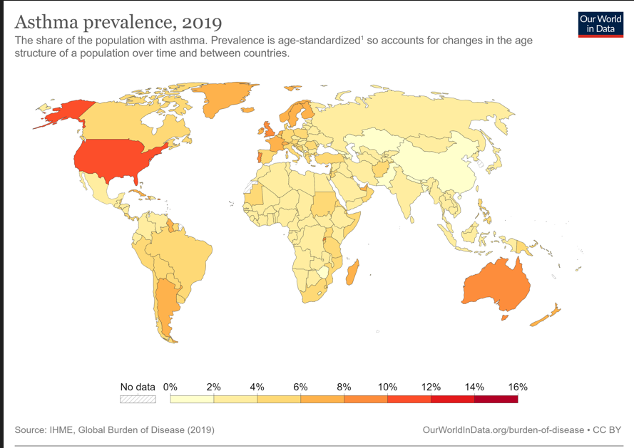
Asthma prevalence is increasing worldwide.
Most patients in both developed and developing countries do not receive optimal care and are not well controlled.

Slide 4
Very mild or mild asthma represents up to 49 % of the asthma population

Slide 5
Asthma and South Africa
South Africa is ranked 25th worldwide for asthma prevalence.
BUT
SA has the fourth-highest asthma mortality in the general population (1.5 per 100 000) and the fifth-highest asthma mortality among 5-35 year old asthmatics (18.5 per 100 000) in the world.
Despite progressive reductions over the past few decades, asthma mortality remains high in Southern African.
Pearce et al Thorax 2007;62(9):758-766.
Cazzoletti et al Int Arch Allergy Immunol 2010;151(1):70-79
Notes:
The only robust data from SA is from the ISAAC study published in 2007

Slide 6
Goals of asthma treatment
control of asthma symptoms
reduction in the risk of asthma
exacerbations
minimization of adverse effects of
medications

Slide 7
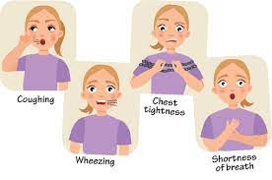
Control of Asthma Symptoms
  ⬇ in intensity and frequency of daytime and nighttime cough
  ⬇ chest tightness, wheezing and dyspnea
  Maintain normal daily activities without limitation caused by asthma symptoms
  Lung function that is normal or nearly normal

Slide 8
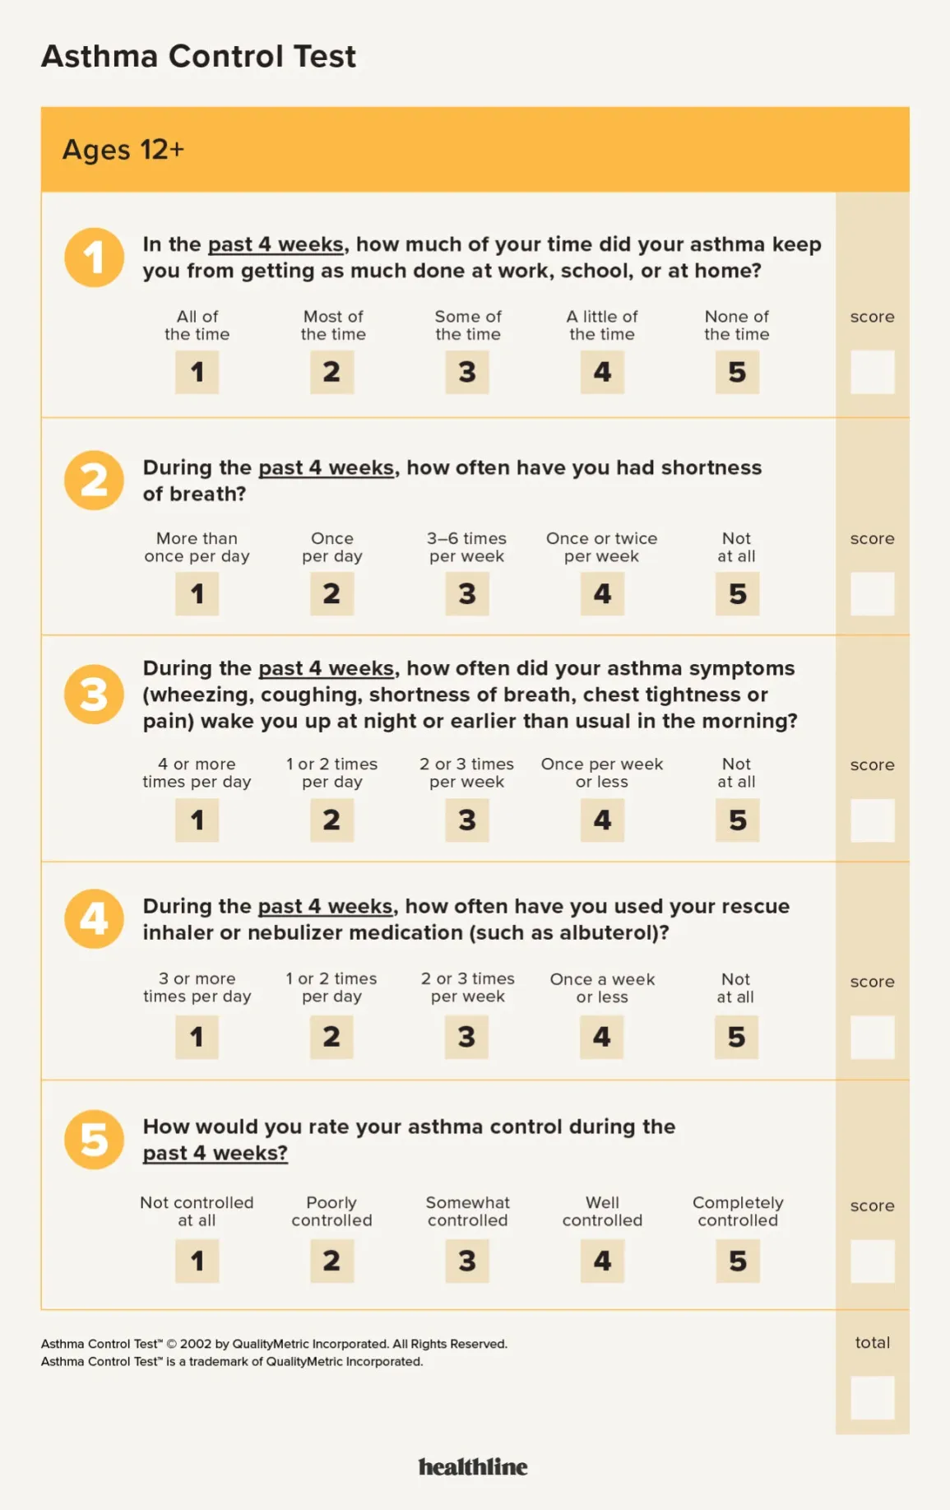
25 - complete control
20 - 25 well controlled
16-19 not well controlled
< 16 indicates very poorly controlled.
Notes:
The minimally important clinical difference has been determined to be 3 points.

Slide 9

Reduction in the risk of asthma exacerbations
  prevention of severe exacerbations
    which can be defined as deterioration that leads to treatment with oral glucocorticoids for 3 days or longer
    an emergency department visit
    or hospitalization

Slide 10
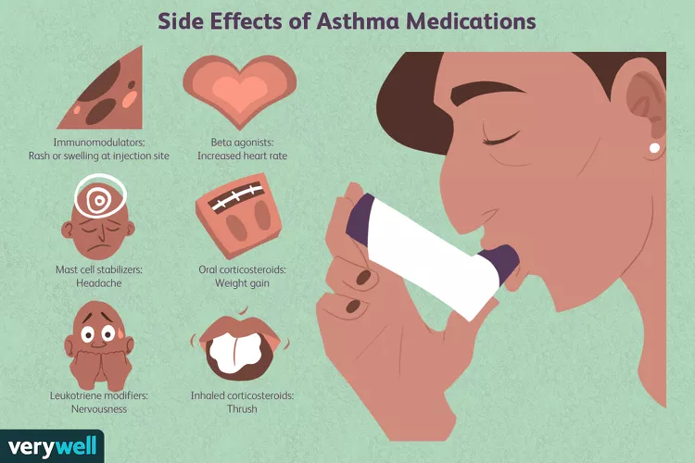
Minimization of adverse effects of medications

Slide 11
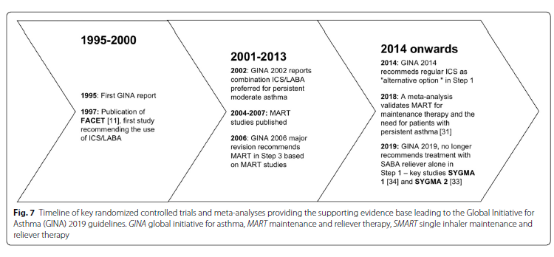
Asthma Rx has come a long way
Papi et al. Allergy Asthma Clin Immunol (2020) 16:75

Slide 12
Daily low dose inhaled corticosteroids (ICS) and as need short-acting beta2-agonist (SABA) have been standard of care for mild asthma for over 20 years.
  improvements in symptoms and lung function
  reduction in hospital admissions
  improvements in quality of life
Poor adherence to ICS and overreliance on SABA remains common among patients with asthma
  contributing to ⬆ risk of asthma-related hospitalizations and death
Data suggests SABA overuse and ICS underuse is associated with a higher risk of exacerbation or even death.
Nwaru et al. Eur Resp J 2020; 55: 55
Gonem et al Thorax 2019; 74: 705-06

Slide 13
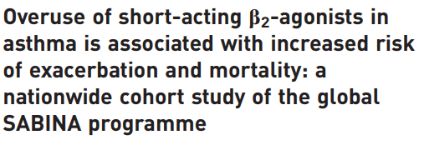

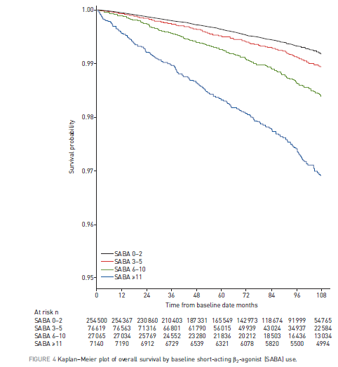
Swedish national registry
365 324 asthma patients (mean age 27.6 years; 55% female)
Nwaru et al. Eur Respir J 2020; 55: 1901872

Slide 14
Compliance with inhaled medication in patients with asthma has consistently been poor, even when patients have symptoms.
Nwaru et al. Eur Resp J 2020; 55: 55
Gonem et al Thorax 2019; 74: 705-06

Slide 15
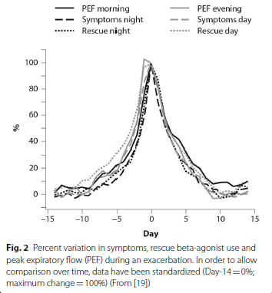
Tattersfield et al. Am J Respir Crit Care Med. 1999;160(2):594–9.
Notes:
Even 1 day of modestly high SABA use heralds an
increased risk for an attack in coming days that is reduced if the reliever is formoterol, and it is further reduced if the reliever is budesonide-formoterol

Slide 16
4 seminal trials comparing as-needed budesonide-formoterol monotherapy to daily low dose ICS:
  a similar benefit ⬇ severe asthma exacerbations in patients with mild asthma
  70 % ⬇ cumulative ICS exposure
  BUT
  Slightly poorer symptom control
Jorup, et al. N. Engl. J. Med. 2018; 378: 1865–1876.
Batemanet al., N. Engl. J. Med. 2018; 378: 1877–1887.
Beasley et al., N. Engl. J. Med. 2019; 380: 2020–2030.
Hardy et al. Lancet 2019; 394: 919–928.

Slide 17
Addresses the key drivers of ICS non-adherence
  steroid aversion
  difficulty to maintain a daily ICS regimen in the face of good symptom control.

Slide 18
What to do in 2023?

Slide 19
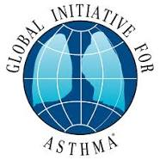

Guidelines on Asthma Management

Slide 20

Presentation | Choice of initiation medication
Infrequent symptoms < 2 times per month | As needed low dose ICS-fomoterol or as needed SABA and low-dose ICS when SABA is used
More frequent symptoms (2-4 times per month) | As needed low dose ICS-formoterol or regular low dose ICS and as needed SABA
Recurrent/almost daily symptoms, night waking and risk for exacerbations | Low-dose ICS-LABA and as needed SABA or low dose ICS-formoterol as MART
Lalloo et al, Afr J Thoracic Crit Care Med 2021;27(4)

Slide 21
Notes:
SPEAKERS: Changes in GINA 2023 for adults and adolescents :
Year added at top left, to avoid use of out-of-date versions of GINA figures
Rationale for Track 1 being the preferred regimen has been updated (see details on later slides)
As-needed ICS-SABA (if available) has been added as a reliever option in Track 2 for Steps 3–5, with most of the benefit seen in Step 3
Anti-inflammatory relievers have been identified with an asterisk (see next 2 slides for details)
NOTE: in Step 5, ‘add-on LAMA’ can be combination (triple) or separate inhalers. If a patient is prescribed triple therapy with a non-formoterol LABA, the reliever should be SABA or ICS-SABA (not ICS-formoterol).

Slide 22
Notes:
SPEAKERS:
MART was originally called SMART, with the ‘S’ coming from the brandname of the medication used in most of the studies. The ‘S’ can now stand for ‘single inhaler’, but this may cause confusion because patients may have two ICS-formoterol inhalers, one at home for their maintenance treatment, and one in their bag/pocket for as-needed doses when they are away from home.
Step 5: The dotted line for MART is to indicate that there is no evidence, in a patient taking Step 5 treatment, for switching from a SABA reliever to an ICS-formoterol reliever. However, if a patient already prescribed MART is stepped up from Step 4 to Step 5, e.g. with addition of biologic therapy, there is no need to swjtch their reliever from ICS-formoterol to SABA.
In Step 5, ‘add-on LAMA’ can be combination (triple) or separate inhalers. If a patient is prescribed triple therapy with a non-formoterol LABA, the reliever should be SABA or ICS-SABA (not ICS-formoterol).

Slide 23
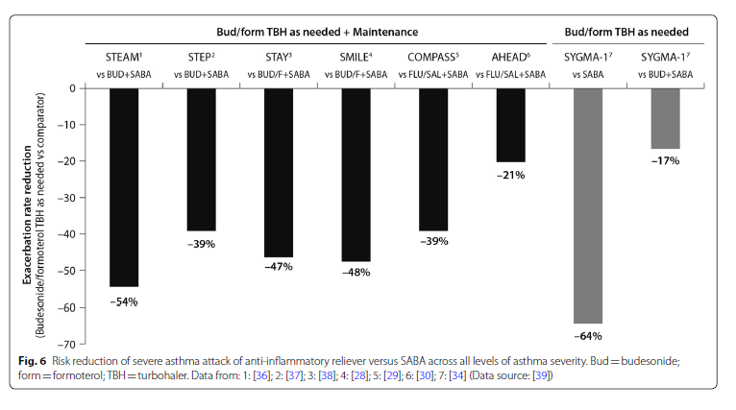
Risk reduction of severe asthma attack of anti-inflammatory reliever versus SABA across all levels of asthma severity
Papi et al. Allergy Asthma Clin Immunol (2020) 16:75

Slide 24
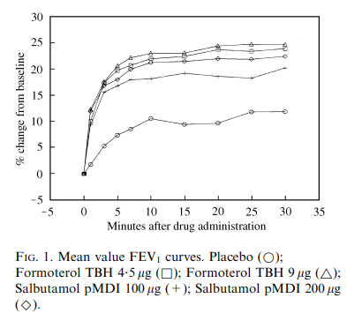
PRACTICAL POINTS
Does ICS-formoterol work as quickly as a SABA for relief of symptoms and bronchoconstriction?
Seberova et al Respiratory Med 2000; 94: 607-611

Slide 25
PRACTICAL POINTS
Does ICS-formoterol work as quickly as a SABA for relief of symptoms and bronchoconstriction?
  YES
  Rapid relief of asthma symptoms is a fundamental need for individuals with asthma. The onset of action of formoterol is as rapid as salbutamol, but it has the added advantage of a longer duration of action.

Slide 26
Notes:
Sobieraj DM, Weeda ER, Nguyen E, et al., Association of inhaled corticosteroids and long-acting beta-agonists as controller and quick relief therapy with exacerbations and symptom control in persistent asthma: A systematic review and meta-analysis. JAMA, 2018. 319: 1485-1496.
Cates CJ and Karner C, Combination formoterol and budesonide as maintenance and reliever therapy versus current best practice (including inhaled steroid maintenance), for chronic asthma in adults and children. Cochrane Database Syst Rev, 2013. 4: CD007313.
Rabe KF, Atienza T, Magyar P, et al., Effect of budesonide in combination with formoterol for reliever therapy in asthma exacerbations: a randomised controlled, double-blind study. Lancet, 2006. 368: 744-53.

Slide 27
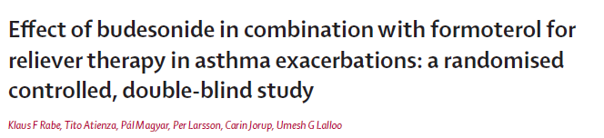
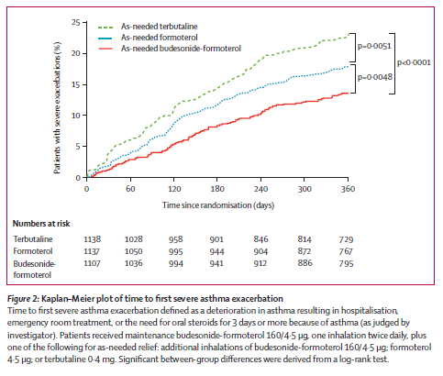
Rabe et al. Lancet 2006; 368: 744–53

Slide 28
Notes:
Lazarinis N, Jørgensen L, Ekström T, et al., Combination of budesonide/formoterol on demand improves asthma control by reducing exercise-induced bronchoconstriction. Thorax, 2014. 69: 130-136.
Duong M, Gauvreau G, Watson R, et al., The effects of inhaled budesonide and formoterol in combination and alone when given directly after allergen challenge. J Allergy Clin Immunol, 2007. 119: 322-7.

Slide 29
Notes:
SPEAKERS
The main benefit of using budesonide-salbutamol (ICS-SABA) as a reliever has been seen in Step 3. There is no evidence yet for safety and efficacy of budesonide-salbutamol in Steps 1–2.
Track 2 requires two inhalers. Check inhaler technique carefully if the patient’s maintenance treatment and reliever treatment are in different inhaler devices.
In Step 5, ‘add-on LAMA’ can be combination (triple) or separate inhalers.

Slide 30
Notes:
SPEAKERS: the addition of as-needed ICS-SABA in Track 2 was because of evidence from this RCT (MANDALA) published in 2022

Slide 31
How to decide on which track or inhaler my patient must be

Slide 32
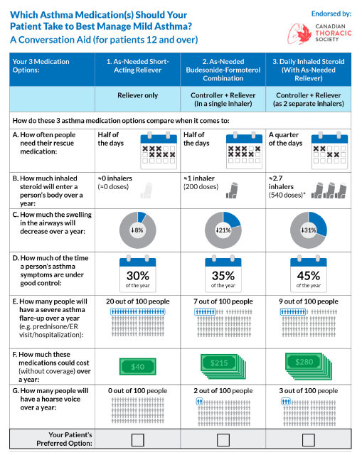
Gagne et al. Respiratory Medicine 2022; 201 :106568

Slide 33
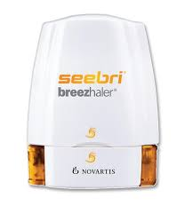

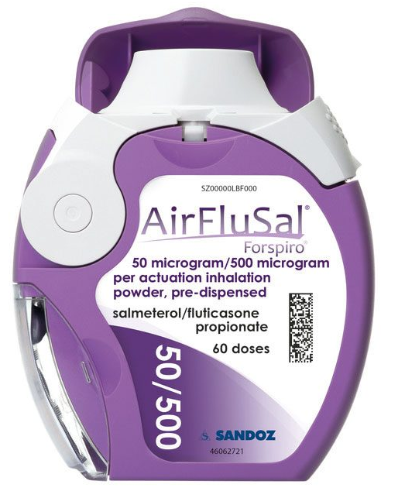
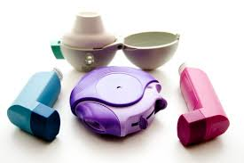
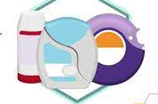
Principals for appropriate inhalation device
Availability of drug in device
Patients beliefs and satisfaction with previous devices
Try minimise number of different devices
Shared decision making especially when changing device

Slide 34
Principals for appropriate inhalation device
Patients cognition, dexterity and strength
DPI – needs forceful and deep inhalation
MDI – need coordination between device triggering and inhalation
Consider spacers and nebulisers
Consider cost

Slide 35
Device | Minimum required inspiratory flow rates (L/min) Acceptable | Minimum required inspiratory flow rates (L/min) Good | Flow resistance | Concerns
pMDI | 10 | 20 | Lower compared to DPI | Co-ordination
pMDI plus spacer | 15 | 20 | Low | Co-ordination
Turbohaler | 30 | 60 | Medium-high
Diskus | 30 | 60 | Medium | Dose emission is flow
Handihaler | 20 | 30 | High | dependant
Breezhaler | 50 | 50 | Low
Ellipta | 30 | 30 | Medium
Forsipro | 30 | 60 | Low-medium
Adapted from P. Haidl et al. Respiratory Medicine 118 (2016) 65e75

Slide 36
My patient is uncontrolled now what ?

Slide 38
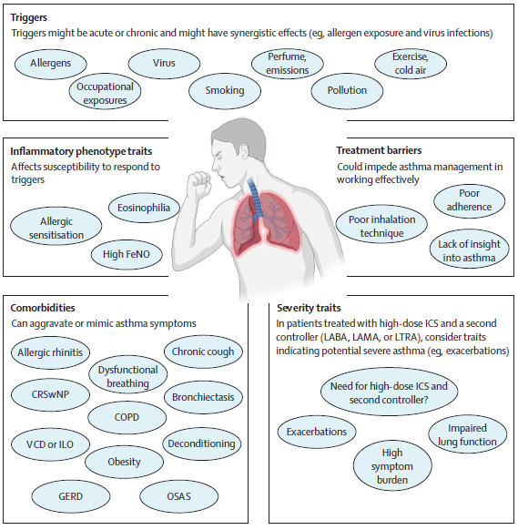
Porsbjag et al. Lancet 2023; 401: 858–73

Slide 39
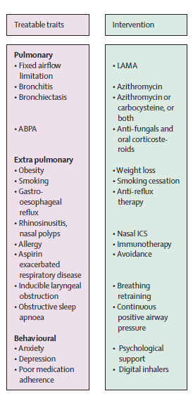
Refer
Some simple changes
Don’t Forget
Porsbjerg et al. Lancet 2023; 401: 858–73

Slide 40
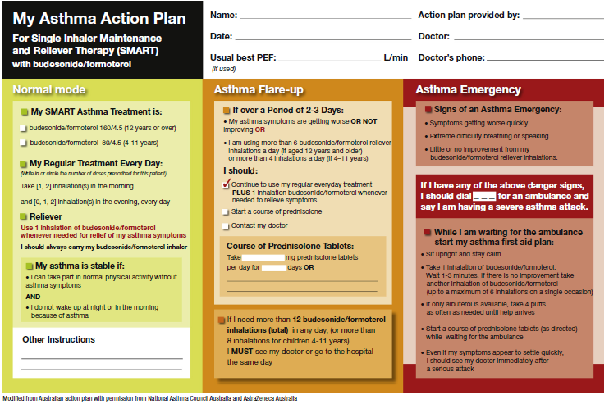
www.lung.org www.aafa.org www.nationalasthma.org
Reddel et al J Allergy Clin Immunol Pract 2022;10:S31-S8

Slide 41
Questions?

