Slide 1



Measuring and Advancing Quality of Care Through Evidence-Based Practice-Management Strategies
Dr Eduard Delport
Medscheme
October 2023

Slide 2
Measuring and Advancing Care Quality Through Evidence-Based Practice-Management Strategies
Presentation Outline
Measuring Quality of Care Delivery: A Pragmatic, Real-World approach.
Evidence-based Practice Management Strategies To Improve Quality Of Care
Components of Care Management applied within a Care Episode
Primary Care Delivery Investment and Quality of Care
Evidence-based and practical approach to integrating technology solutions within one's practice
Understanding the Gartner Hype-Cycle as it relates to Health-Technology
EHR duplication, clinician administrative burden decreasing quality of care.
Advancing Chronic Care Outcomes through outgoing Virtual Care

Slide 3

















Medscheme Health Professional Strategy Unit working in Collaboration with IPAs as Bridge to Funders
The Importance of IPAs and Family Practitioner Representation
Family Practitioners
IPAs and GP Leadership
Funders
Admin and Care Support
Medscheme
Health Professional Strategy Unit
Patient Care
Funding

Slide 4
Most Family Practitioners Are Generally Cost-Efficient And Within A Similar Utelisation Band.
REPI²
Healthcare Analytics for Family Practice
Family Practitioner (FP) Overall Cost and Utelisation, National Distribution
85% of FPs within 15% of 50th Centile
In other words, most FPs are generally within a similar utilization band.
Benchmark
1. Narrow distribution around benchmark
Benchmark
2. Left shift
Category 1
Category 2
Category 3
Cat 1
Cat 2
Cat 3
2014
2021
Dr Eduard Delport, Medscheme

Slide 5

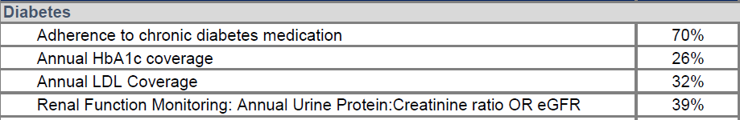
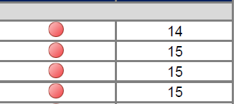

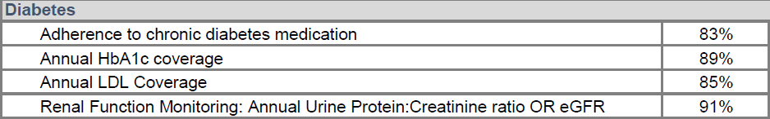

Aspects Of Care Measured To Determine Family Practitioner Quality Of Care Delivery.
REPI²
Healthcare Analytics for Family Practice
How is Quality of Care Delivery Measured?
Measuring Processes:
Claims Data
Measuring Clinical Outcomes:
Pathology Test Results
Measuring Care Impact:
Downstream Utilization
1. Typical Poor Performing Family Practitioner
Below-average Chronic Care Delivery for Diagnosed Diabetic patient panel.
2. Typical High Performing Family Practitioner
Above-average Process and Clinical Outcomes measures, despite high-average age of 53yo.
Dr Eduard Delport, Medscheme

Slide 6
A The Importance Measuring Family Practitioner Level Quality of Care Delivery: A Pragmatic, Real-World approach.
REPI²
Healthcare Analytics for Family Practice
Broad National Distribution of Family Practitioner (FP) Quality of Care.
FP Quality of Care Delivery National Distribution
Category 3
Category 2
Category 1
30%
30%
Large National Below Average Performing FP Footprint
Poor Clinical Process and Outcomes Measures.
Large National Above-Average Performing FP Footprint
Above-average Clinical Process and Outcomes Measures.
Dr Eduard Delport, Medscheme

Slide 7

A The Importance Measuring Family Practitioner Level Quality of Care Delivery: A Pragmatic, Real-World approach.
REPI²
Healthcare Analytics for Family Practice
Broad National Distribution of Family Practitioner (FP) Quality of Care.
FP Quality of Care Delivery National Distribution
Category 3
Category 2
Category 1
30%
30%
What Are The Additional Aspects to consider When Measuring Clinical Care Quality?
Why Measuring Care Processes And Clinical Outcomes Only Is Not Sufficient.
Does applying Primary Care Level VBC Funding Models Make Sense in the South African Context.
Dr Eduard Delport, Medscheme

Slide 8
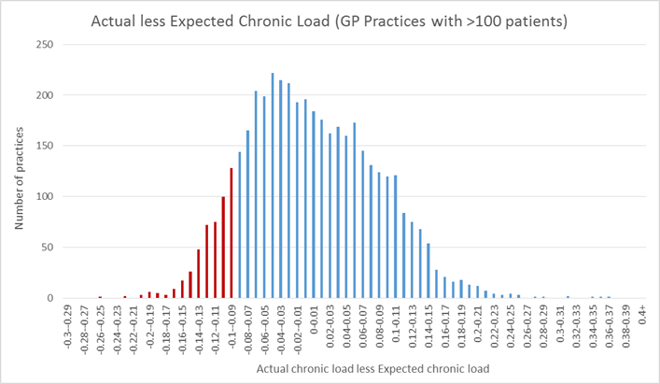
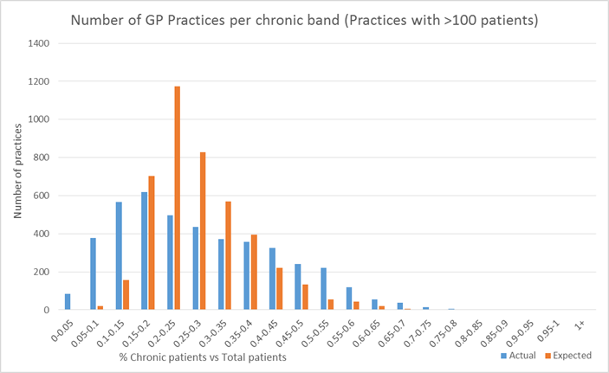
Holistic and Pragmatic Approach to Quality-of-Care Measurement:
Tracking Chronic Disease Clinical Outcomes only is not enough.
REPI²
Healthcare Analytics for Family Practice
1. Practice Specific ‘Chronic Disease Blind-spot’:
Calculating the Practice Specific Undiagnosed Unregistered patient footprint.
EXPECTED CHRONIC DISEASE FOOTPRINT FOR PRACTICE DEMOGRAPHIC | 80 PATIENTS (EXPECTED)
ACTUAL ATTRIBUTED PATIENTS WITH CHRONIC DISEASE | 50 PATIENTS (ACTUAL DIAGNOSED AND REGISTERED) | 30 PATIENTS (UNDIAGNOSED / UNREGISTERED)
250-400 Practices with significant undiagnosed unregistered patient footprint.
Dr Eduard Delport, Medscheme

Slide 9
Holistic and Pragmatic Approach to Quality-of-Care Measurement:
Tracking Chronic Disease Clinical Outcomes only is not enough.
REPI²
Healthcare Analytics for Family Practice
2. Practice Specific Chronic Disease Quality Of Care Assays
Global Measurement of Quality-of-Care Delivery, including Practice Specific Chronic Disease Blind-spot .
REPI²
Healthcare Analytics for Family Practice
Practice Specific Chronic Disease Assays:
Improved Accuracy of measuring quality of care delivery.
Pragmatic Quality of Care Measurement, not to punify, but to support.
Dr Eduard Delport Pr 0732532 Practice Specific Quality of Care Chronic Disease Assay: Diabetes
Diabetes | Expected Diabetics for Practice Demographic | 50
 | Actual Diabetics Diagnosed and Registered |  | 30 (60%)
 | HBA1C's coverage in Diagnosed Diabetics |  |  | 20 (40%)
 | HBA1C's below 8,5% |  |  |  | 10 (20%)
Dr Eduard Delport, Medscheme

Slide 10
Aspects Of Care Measured To Determine Family Practitioner Quality Of Care Delivery.
.
REPI²
Healthcare Analytics for Family Practice
How is Quality of Care Delivery Measured: Full Framework
Aspect of Care Delivery | Measurement
Appropriate Chronic Condition Screening, Diagnoses And Program Enrolment | A. Quantifying the undiagnosed / unregistered population footprint.
Adherence To Appropriate Chronic Care Provision And Clinical Decision Making for the Following Chronic Conditions: Hypertension Diabetes Atherosclerotic cardiovascular disease (coronary heart disease, cerebrovascular disease and peripheral arterial disease) Hyperlipidaemia Asthma Mental Health HIV | A. Medicine and Treatment Adherence.
 | B. Process measures: Disease monitoring Disease complication monitoring
 | C. Clinical outcomes monitoring
 | D. Downstream utilization: Specialist utilisation In-hospital utilisation
Preventative Care and Vaccination | A. Cancer and other screening. B. Influenza and other vaccinations.
Dr Eduard Delport, Medscheme

Slide 11
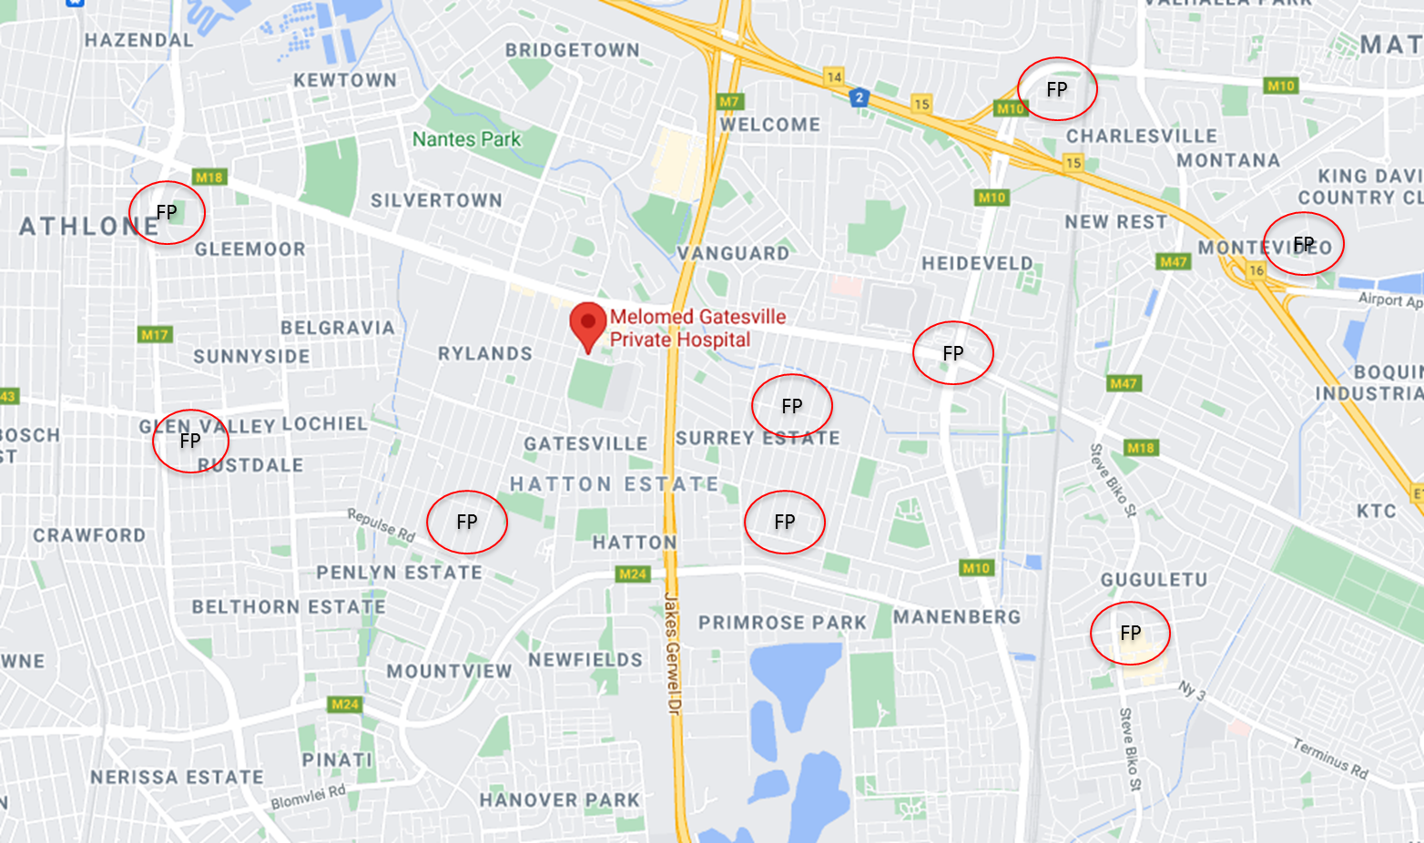
Holistic and Pragmatic Approach to Quality-of-Care Measurement:
Tracking Chronic Disease Clinical Outcomes only is not enough.
REPI²
Healthcare Analytics for Family Practice
1. Practice Specific Chronic Disease Quality Of Care Assays: Hospital Catchment Application
GATESVILLE CATCHMENT GP Chronic Quality of Care Assay
Total Attributed patients for FP's within identified geographic region | 12330
Avarage REPI Quality of Care Score per geographic region: | 2.9
Total ALL DISEASE undiagnosed / unregistered chronic patients per geographic region | 2096 (17%)
Expected Diabetics for per identified geographic region. | 565 | 565
Total undiagnosed / unregistered chronic Diabetics per geographic region | 170 | 170 (31%)
Actual Diabetics Diagnosed and Registered per geographic region. | 395 |  | 395 (69%)
HBA1C's coverage in Diagnosed Diabetics per geographic region | 210 |  |  | 210 (53%)
HBA1C's above 8,5% per geographic region | 55 |  |  |  | 55 (26%)
HBA1C's below 8,5% per geographic region | 155 |  |  | 155 (74%)
Dr Eduard Delport, Medscheme

Slide 12
Holistic and Pragmatic Approach to Quality-of-Care Measurement:
Tracking Chronic Disease Clinical Outcomes only is not enough.
REPI²
Healthcare Analytics for Family Practice
2. External Factors Influencing Practice Specific Quality of Care Delivery Outcomes
Clinical and industry appropriate Quality of Care Measure interpretation paramount.
Various External, Non-healthcare Provider Related Factors, Influence Overall Disease Outcomes
Social Determinants of Health
Aspects Paramount In Appropriate Quality Of Care Delivery Measurement
Practice specific
Clinically appropriate
Holistic approach
Non-punitive, for the purpose of practice support and mentorship.
Dr Eduard Delport, Medscheme

Slide 13
Holistic and Pragmatic Approach to Quality-of-Care Measurement:
Tracking Chronic Disease Clinical Outcomes only is not enough.
REPI²
Healthcare Analytics for Family Practice
3. Specialist to Family Practitioner Chronic Care Delivery Overlap
Example: Specialist to Family Practitioner Chronic Care Delivery Overlap
Below-average Chronic Care Delivery for Diagnosed Diabetic patient panel.
Total Diabetics Attributed to be under Family Practitioner Care
Total Diabetics Receiving Regular Follow Up At Specialist
11
Specialist to Family Practitioner Care Delivery Overlap
73%
15

Slide 14
A The Importance Measuring Family Practitioner Level Quality of Care Delivery: A Pragmatic, Real-World approach.
REPI²
Healthcare Analytics for Family Practice
Broad National Distribution of Family Practitioner (FP) Quality of Care.
FP Quality of Care Delivery National Distribution
Category 3
Category 2
Category 1
30%
Category Upgrade
Low Undiagnosed Unregistered Chronic Population / Low Chronic Disease Blind-spot
Mid To Lower Level Socio-economic Patient Demographic.
GP Focused Primary Care Level Value Based Care Remuneration appropriate?
Very Low Specialist To FP Chronic Care Delivery Overlap

Slide 15
A The Importance Measuring Family Practitioner Level Quality of Care Delivery: A Pragmatic, Real-World approach.
REPI²
Healthcare Analytics for Family Practice
Broad National Distribution of Family Practitioner (FP) Quality of Care.
FP Quality of Care Delivery National Distribution
Category 3
Category 2
Category 1
30%
30%
Large National Below Average Performing FP Footprint
Poor Clinical Process and Outcomes Measures.
Large National Above-Average Performing FP Footprint
Above-average Clinical Process and Outcomes Measures.
Dr Eduard Delport, Medscheme

Slide 16




Poor Quality of Care FPs with inadequate Chronic Condition Management:
Increases ER care-seeking and hospital level acute NCD events
REPI²
Healthcare Analytics for Family Practice
Typical Features of a “Supermarket Type” Family Practice
Under diagnosing of chronic disease: No screening protocols for high risk patients.
Under registration of chronic disease to scheme programs
Low % chronic disease in relation to average age.
Poor REPI chronic disease and preventative care metrics.
Poor Chronic Disease Management
High consultation volume per day with short consultation time of 5-7min.
Consultations
Uniform dispensing habits:
Dispensing same combination of tablets for various presenting complaints. (Panamor, Rub-Rub, Amoxil 250mg for 3days, MultiVit)
Low chronic medicine costs
Dispensing
Practice Operations and Management
Typically, locum run practices.
Probability for using non-sanctioned locums
(Nurses, clinical assosciates, non-registered providers).
Dr Eduard Delport, Medscheme

Slide 17
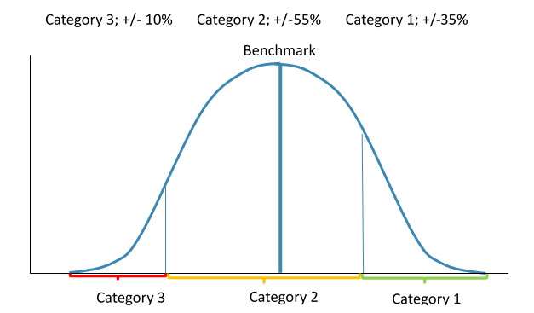

Supporting Doctors in Collaboration Family Practitioner Leadership Bodies.
REPI²
Healthcare Analytics for Family Practice
v
Why one measures Quality of Care: Medscheme Peer Mentorship Outreach Program
360 – 400 FP Outliers Identified and Enrolled to the Medscheme Peer Mentorship Outreach Program Annually
Combined Quality and Cost Outlier Peer Mentorship
Total Engagements Considered | 382 | 100%
Total Provider Claims Concerns 2021 | 67 | 17%
Total Overall Cost Blow-out Outliers for 2021 | 77 | 20%
Total Quality Outliers for 2021 | 238 | 63%
Focus on Doctors having difficulty with ensuring high Quality of Care and Care Coordination.
Senior Family Practitioners and IPA Leaders assisting in direct one on one Mentoring and Education and Support.
Combined Quality and Cost Outlier Peer Mentorship response 2021 vs 2022
Total Engagements | 382 | 100%
Improvement Post Peer Engagement | 322 | 84%
No Improvement post Peer Engagement | 60 | 16%
Program touted as possible model for NHI.
Program Outcomes presented by Prof Morgan Chetty at the 2023 BHF Conference in CPT

Slide 18
Evidence-based Practice Management Strategies To Improve Quality Of Care
The Healthcare Provider AND Health System Designers Roll in Improving Quality of Care
The roll of the Doctor, Practice Manager, Administrator and Funder Or Health System Designer in Improving Care Quality Outcomes.
Components of Care Management applied within a Care Episode
Primary Care Delivery Investment and Quality of Care
Evidence-based and practical approach to integrating technology solutions within one's practice
Understanding the Gartner Hype-Cycle as it relates to Health-Technology
EHR duplication, clinician administrative burden decreasing quality of care.
Advancing Chronic Care Outcomes through outgoing Virtual Care

Slide 19
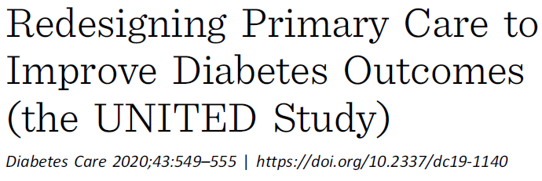
Evidence-based Practice Management Strategies To Improve Quality Of Care
Components of Care Management Leading to Superior Diabetes and Chronic Disease Outcomes
Chronic Disease Care Checklist
Atul Gawande's surgery checklist improved surgical outcomes.
Something as simple as a checklist of standards-of-care for diabetes also improves outcomes.
Chronic Patient Panel Manager or Dashboard
Guideline-Based Screenings
10.8% Improvement
Achieving performance measures
Age and gender appropriate screenings.
Hypertension, high cholesterol, depression, cigarette smoking, alcohol abuse and other health concerns.
Vital to preventing disability, suffering and even death in those with diabetes.
Health System and Funding Aspects
Shared Decision-Making and counselling
Prolonged Consultation
Virtual care follow up consultations.
Ability to increase chronic care seeking events.
A collaborative dialogue between patient and physician around what are reasonable Management Options for Each Individual.
Everyone's situation is unique, and that uniqueness must be considered in the care plan.
Dr Eduard Delport, Medscheme

Slide 20
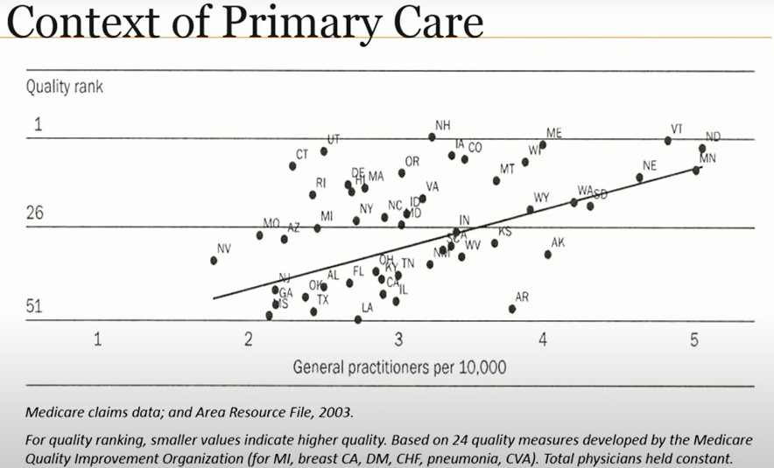
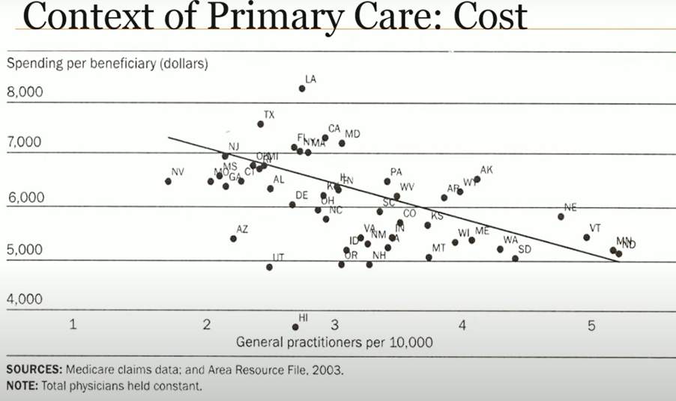
The Roll Of The Administrator, Funder Or Health System Designer
Primary Care Delivery Investment Leading To Downstream Cost Savings
Increased provider capacity and care intensity directly linked to:
Primary care investment saves money.
Retrospective Case study: Rhode Island Health Care System (Health AF, 2019)
  Doubled primary care health care spent, showed relative decrease in overall healthcare cost by 20-30%.
Improved quality of care and clinical outcomes.
Less overall resource spend.
20

Slide 21
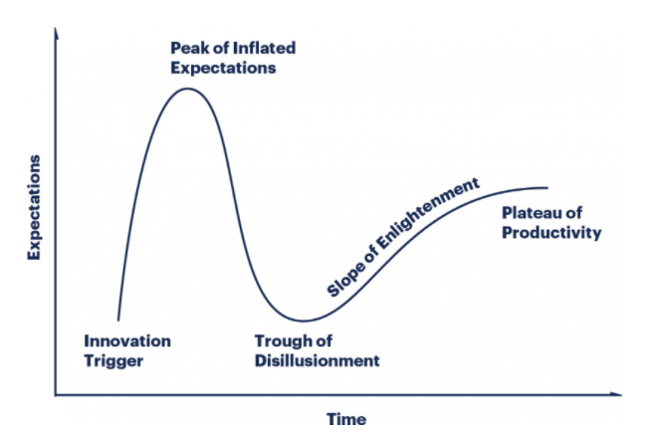
Evidence-based Practice Management Strategies To Improve Quality Of Care
Evidence-based and Approach To Integrating Technology Solutions Within One's Practice
Understanding and Applying the Gartner Technology Hype-Cycle
Application of Drone Based Delivery
Facebook Metaverse
Telemedicine and Virtual Care Application
Provider facing Electronic Health Record keeping and Application
Dr Eduard Delport, Medscheme

Slide 22

Evidence-based Practice Management Strategies To Improve Quality Of Care
Issues identified relating to doctor-to-administrator electronic medical record keeping.
“Double” electronic medical record keeping input needed from doctor.
Doctor keeping notes on own clinical record keeping interface:
EMR or physical.
1.
Additional expectation on provider to input clinical information again into a separate interface.
2.
Double EMR Input Issues
Increase provider administrative burden.
Decrease doctor-patient time spent.
Decrease doctor-patient shared decision making and dialogue.
Increase physician fatigue.
Decrease overall Quality of Care and clinical outcomes.
Decrease participating provider adherence.
Dr Eduard Delport, Medscheme

Slide 23
EMR Strategy Overview
Issues Identified Relating To Doctor-to-administrator Electronic Medical Record Keeping.
“Double” electronic medical record keeping input needed from doctor.
“There is building resentment against the shackles of the present EHR; every additional click inflicts a nick on physicians' morale.”¹⁵
Physician burnout contributor: Completing too many administrative tasks
Among doctors with physician burnout, 60 percent say too many bureaucratic tasks such as charting and paperwork are to blame. About a third say that the “computerization of the practice” or the rise of electronic health records (EHR) are one of the largest contributors to physician burnout.
“The study found that physicians spent 49.2 percent of their office day on EHRs and other desk work. “For every hour the physicians spent facing their patients, they spent nearly 2 additional hours facing the computer, entering data.
“EHRs have evolved into data-collection devices for HIPAA and other government regulations.¹³ ”“Consequently, they focus more on processes than on outcomes, adding to the physician's workload while not improving patient care”
Dr Eduard Delport, Medscheme

Slide 24
EMR Strategy Overview
Issues Identified Relating To Doctor-to-administrator Electronic Medical Record Keeping.
“Double” electronic medical record keeping input needed from doctor.
“For many physicians, the EHR has become the final straw. Although intended to overcome the flaws inherent in a paper-based system, the EHR has produced its own set of problems, perhaps the most important of which is the absence of social and behavioral factors fundamental to a patient's treatment response and health outcomes.”
Re-engineering current EHRs will be difficult. In fact, Zulman and colleagues¹⁵ concluded that, in many clinical situations, patient care could be improved simply by “de-implementing” the EHR.
Plan
  Meaningful use of EHR
  Develop uniform standards for technical EHR certification.
  Penalize vendors to ensure they develop high-quality products that support interoperability across multiple EHR systems with HHS mandating and imposing penalties to decertify systems that take part in actions that hinder true interoperability.
  Minimize the role that doctors play in administrative tasks like non-meaningful EHR.
Value Of Chronic Patient Panel Management and Dashboarding Software
e.g. SyntoP EMR
Dr Eduard Delport, Medscheme

Slide 25
Recent evidence on understanding Virtual Care, its benefits and where it is most useful within a Primary Care Delivery model.
Virtual Care
TYPE
VALUE ADD
CARE DELIVERY
Day-to-Day Care Seeking
Increasing Access Day-to-Day Care Seeking
Member Convenience Benefit Value Add
Designated Virtual Care or Telemedicine practice
AMP Anchor Practice:
Integrated Virtual Care.
Navigate health system, trained telemedicine, EMR integration, clinical oversight, etc.
Quick simple access to VC by member, THROUGH APP, phone number, website.
Note: NOT a tool for cost saving.
Chronic Disease Follow Up
Chronic disease follow up
Improved adherence and chronic care quality.
Primary Family Practitioner
A tool through which CHRONIC DISEASE FOLLOW UP CONSULTATIONS, lifestyle counselling, medicine adherence counselling and chronic script repeat can be actioned.
Primary FP pro-actively includes VC as a modality in the overall care management strategy.
Down stream cost saving value add.
Chronic beneficiary not able to renew script timeously.
Allows for ‘active follow up’ of patients who might otherwise ‘be to busy’ to attend physical consultation voluntarily
Dr Eduard Delport, Medscheme

Slide 26
A Simplified view of the Healthcare System Components in relation to Family Practitioner Level Primary Care Delivery
The importance of IPAs and Family Practitioner Representation
Family Practitioners
IPAs and GP Leadership
Funders
Admin and Care Support
Medscheme
Health Professional Strategy Unit
Patient Care
Funding

Slide 27
References
References
NMG HQA Health Quality Assessment Report of 2020, 23 July 2020
Redesigning Primary Care to Improve Diabetes Outcomes (the UNITED Study) Diabetes Care 2020;43:549–555 | Kevin A. Peterson,1 Caroline Carlin, et al.
Health Informational Exchange (HIE): Improving Patient Care Through Interoperability: Lori Manteufel et al, _/www.metastar.com
The Primary Care Revolution. Harvard Medical School Center for Primary Care Lecture Series. Director Prof Russell Phillips et al. ttps://hms.harvard.edu/
National Academies of Sciences, Engineering, and Medicine: Implementing High-Quality Primary Care: Rebuilding the Foundation of Health Care_Recomendations and Reactions._www.nationalacademies.org/ (http://reactions._www.nationalacademies.org/) Johansen et al., 2016, Martin et al., 2020
Chapman DP, Perry GS, Strine TW. The vital link between chronic disease and depressive disorders. Prev Chronic Dis [serial online] 2005 Jan [date cited]. Available from: URL: http://www.cdc.gov/pcd/issues/2005/jan/04_0066.htm.
Addressing Mental Health Promotion in Chronic Disease Prevention and Health Promotion Geraldine S. Perry DrPH, RD, Letitia R. Presley-Cantrell PhD, and Satvinder Dhingra MPH. American Journal of Public Health (ajph.
Association of Mental Health Disorders With Health Care Utilization and Costs Among Adults With Chronic Disease Sporinova et al. JAMA Network Open. 2019;2(8)

Slide 28
Thank You

