Slide 1

HIV –
New treatment options
Dr K. Mahomed
House 10c, Netcare Garden City Clinic
083 294 7007 / 011 837 8300

Slide 2
INTRODUCTION
ART is used for the treatment and prevention of HIV
The treatment of HIV
  Maximal suppression of viral replication(undetectable VL)
  Restoration of immune function ( CD4 cell count)
  ART is life long
  100% adherence is essential
  New drugs have lesser s/e and toxicity profile
  Greater selection of drugs to fit into a patient’s profile
  FDC and daily dosing
The prevention of HIV
PEP
PREP

Slide 3
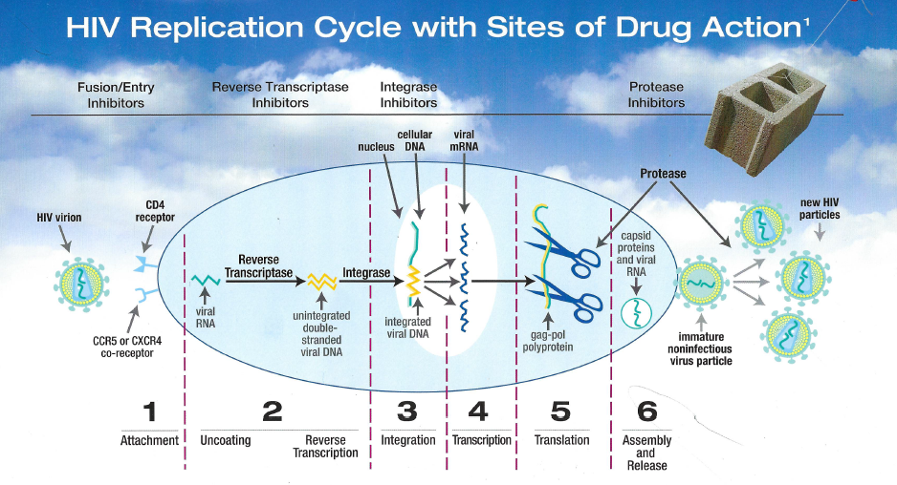
overall_1_131800355050236567 columns_1_131800355050236567

Slide 4
ARVs
overall_1_131961098581929933 columns_1_131961098581929933
Nucleoside reverse transcriptase inhibitors (NRTI)
  AZT, TDF, 3TC, FTC, ABC
Non-nucleoside reverse transcriptase inhibitors (NNRTI)
  EFV, RPV
Protease inhibitors (PI)
  Aluvia, ATV, DRV, (RTV)
Integrase inhibitors
  RTG, DTG

Slide 5
REGIMEN 1: STRENGTHS
X
TEE
TER
TLD
Used extensively previously
Can be used with TB
Fewer neurological side effects
Once daily dosing
Excellent for shift workers
No interaction with hormonal contraception
No teratogenicity
Keeping options open
Rapid viral suppression
High genetic barrier to resistance
Do not need initiation VL
Once daily dosing (AM)
Excellent for shift workers
No food restriction
Can be used with TB (double dose DTG)
No interaction with hormonal contraception)
Use in PEP

Slide 6
REGIMEN 1: STRENGTHS – DUAL THERAPY
DL
(Dolutegravir-Lamivudine)
DR
(Dolutegravir-Rilpivirine)
Injectables
Alternate option
Initiation
Switching
Not inferior to triple therapy
Once daily dosing
Cost-effective
Less nausea (2%)
Less renal issues (1%)
Switching
Not inferior to triple therapy
Once daily dosing
Cost-effective
Solid
Cabotegravir / Rilpivirine
Monthly injections

Slide 7
REGIMEN 1: CAUTION
X
TEE
TER
TLD
Neuro-psychiatric s/e (pyschosis, bad dreams, insomnia, fatigue, drowsiness, dizziness, memory loss)
Hepatoxic
Gynaecomastia
Drug rash
Cannot use in shift workers
VL < 100,000
Cannot be used with TB
Ulcer drugs
Weight gain
Insomnia, agitation
Diabetes (increases metformin levels)
First trimester (neural tube defects)

Slide 8
REGIMEN 1: CAUTION – DUAL THERAPY
DL
(Dolutegravir-Lamivudine)
DR
(Dolutegravir-Rilpivirine)
Baseline VL > 500 000
CD4 < 200
Rifampicin (C ↓ DTG levels)
Not for same day initiation
Not for state
Must know Hep B status (TDF)
Must be ARV naïve (not have failed / been on treatment before)
No adherence issues
PPI
TB
Meals
Cannot be re-initiation
No Hep B
On first line
VL undetectable

Slide 9
REGIMEN 2: STRENGTHS
X
LPV/r
ATV/r
DRV/r
Can be used with RIF-based TB tx, but must be double-dosed
Co-combination of ATV 300 + Norvir 100
Single tablet taken once a day, convenient dosing (previously 2 / 3 tablets)
Better tolerated, adherence advantage
Low GIT side effects
Better metabolic profile
Dyslipidaemia significantly reduced
2 tablets once a day (Truvada / Tarito, Dumiva / Tarito)
Can be taken at any time of the day
Cost and convenience
High genetic barrier to resistance
Low GIT side effects
Can be used second and third line
No jaundice
Stanford scoring

Slide 10
REGIMEN 2: STRENGTHS
TLD
See TLD (Regimen 1)
Nadia trial

Slide 11
REGIMEN 2: CAUTION
LPV/r
ATV/r
DRV/r
Pill size
B.D dosing
Greater GIT side effects (diarrhea, nausea, vomiting, abdominal pain, bloating)
Worse metabolic profile
No dyslipidaemia
Unconjugated hyper-bilirubinaemia, resulting in visible jaundice in a minority of patients. This does not indicate hepatic toxicity and is not a reason to discontinue the drug, unless it is a worry to the patient for cosmetic reasons (reversible upon discontinuation)
Cannot be used with RIF-based TB tx
Cost
400 / 100, 800 / 100, 600 / 100 B.D
Cannot use with RIF-based TB treatment

Slide 12
Earnest Trial
Nadia Trial
Failing regimen 1
Recycle NRTI’s with a PI
No resistance test needed
REGIMEN 1
Failing TEE
Switch to TLD
Even if viral load detectable
No resistance test needed
REGIMEN 2
If on PI, can switch to TLD
If VL undetectable
No resistance test needed
DTG second line as good as DRV

Slide 13
Drug potency and genetic barrier to resistance
overall_1_131970356238751664 columns_1_131970356238751664 27_1_131970358011780321 28_1_131970358495723451
DTG
DRV/
RTV
3 log
EVG
RAL
EFV
ATV/R
TV
Potency (estimated log
change in viral load)
RPV
2 log
FTC
3TC
1 log
ABC
TDF
1
2
3
4
Genetic barrier to resistance
(Approximate number of mutations needed to fail)
Source: Danielle Ciuffetelli, Pharm.D CROI, 2016; Ambulatory Hepatology/Infectious Diseases Clinical Pharmacist; Hospital of the University of Pennsylvania, Philadelphia, Pennsylvania

Slide 14
New Regimen options
overall_0_131969641589018051 columns_1_131969638180641873 44_1_131969641135914914 66_1_131969646109594877
NNRTI-based regimen
INSTI-based regimen
First line
Preferred regimens
TER
TDF + XTC + RPV
TEE: TDF+ XTC+ EFV
TLD
TDF + XTC + DTG
Second line
Recommended regimens
TLD
TDF + XTC + DTG
NRTIs + PI
Third line
Recommended regimens
DRV/r ± INSTI ± NRTIs
NNRTI(2) ± DRV/r NRTIs
Salvage
Individualize ART according to genotype result, known drug toxicity profile and past drug history

Slide 15
PREVENTION
PEP
PREP
Exposure
Effective within 72 hours
Rapid
TLD
1/12
Re-test
HIV –
Rapid, creat, HepB, Elisa
Truvada
Cycle on and off

Slide 16
CASE 1:
Patient on TEE, 2 years, defaulted meds
January 2022
CD4 69 VL 694000 creat 105
X
Restart old meds
In view of lo CD4,
switch to TE+PI
Today TLD

Slide 17
CASE 2:
Patient on TEE, 10 years, 7/52 pregnant
CD4 429 VL 25000 creat 45
TE and PI
Today TLD

Slide 18
CASE 3:
March 2018
Patient on TEE, Defaulted meds for 1 year
CD4 53 VL 17000 creat 147 hepb +
Dumiva + PI + TDF (2/week)

Slide 19
CASE 4:
November 2020
Patient on TEE
CD4 44 VL 160000 creat 85 urine lam -
TE + PI
Today TLD

Slide 20
CASE 5:
Patient on TEE
CD4 4 VL 268000 creat 55 urine lam +, crypto Ag -
TB meds
2 weeks later
TLD + D
PURBAC

Slide 21
CASE 6 :
On TEE from 2009
Switch to LAMZID + Aluvia 2017
2019 TE + PI
VL undetectable CD4 618 (Earnest)

Slide 22
Don’t forget the 5 Ps!
overall_1_131961116483328760 columns_1_131961116483328760
Pap smears
Piepie cut - Circumcisions
PEP (1/12)
Prep
Patients are people

