Slide 1
Management of T2DM - a breakthrough in modern day insulin therapy
Focus on Premixed Insulins
MODERN INSULIN IN THE
TYPE 2 DIABETIC
Dr S Joshi
MBChB (UP), M(PHARM) Med(UL), MSc (diabetes) Cardiff
Director: Diabetes Care Centre, Pretoria
Tutor: Cardiff School of Medicine, Wales, UK

Slide 2
Extrapolation from Progressive Decline of β-cell Function
100
80
60
40
20
0
Diagnosis
Despite Therapy !
Beta-Cell Function (%)
4% pa
–12
–10 –8 –6 –4 –2 0 2 4 6 8 10
Years from Diagnosis
Adapted from UKPDS 16. Diabetes 1995;44:1249–58

Slide 3
Pathogenesis of Type 2 Diabetes
Insulin
Resistance
Type 2
Diabetes
β-cell
Dysfunction
Hyperinsulinemia, then β-cell Failure
Insulin Action
Insulin
Deficiency
Hyperglycaemia
Insulin
Resistance
Euglycaemia
Normal
IGT
DM
Progression of
Type 2 DM
Diabetes Care 1992;15:318-68
NEED INSULIN
THERAPY

Slide 4
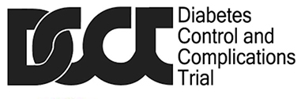

Realizing the link between blood glucose to diabetes-related complications
1970s
1970s
1990s - Tight glycaemic control has beneficial effects on microvascular outcomes^{1,2}
SMBG
HbA_{1c}
7%
ukpds
The UKPDS :
Every 1% reduction in HbA_{1c} can reduce long-term diabetes complications
Myocardial infarction
14%
Microvascular disease
37%
Lower extremity amputation or fatal peripheral vascular disease
43%
* Other hallmark trials include ACCORD; ADVANCE; VADT.
HbA_{1c}, glycated hemoglobin; SMBG, Self-monitoring of blood glucose; UKPDS, The UK Prospective Diabetes Study
1. UK Prospective Diabetes Study (UKPDS) Group.. The Lancet. 1998;352(9131):837–853. 2. DCCT. The Diabetes Control and Complications Trial Research Group. N Engl J Med. 1993;329(14):977–986
Notes:
Advancements in blood glucose management: Even as availability to insulin increased, people with diabetes continued to face significant treatment challenges due to a lack of knowledge and an inability to measure and respond to their blood glucose levels.
Practical self-monitoring of blood glucose (SMBG) is now possible²
The discovery of HbA1c enabled physicians to critically assess the impact of lifestyle changes and medication on long-term health1.
This provided the basis for a series of large-scale trials that set out to understand the relationship between glycaemic control and diabetes-related
complications.
The UKPDS shows that managing blood glucose levels is critical to avoiding or delaying diabetes-related complications in people with type 2 diabetes.
Every 1% reduction in HbA1c can reduce long-term diabetes complications. The United Kingdom Prospective Diabetes Study (UKPDS) and the Diabetes Control and Complications Trial (DCCT) are two landmark trials that convincingly demonstrated that tight glycaemic control has beneficial effects on microvascular outcomes.

Slide 5
Pathogenesis of Type 2 Diabetes
Insulin
Resistance
Type 2
Diabetes
β-cell
Dysfunction
Hyperinsulinaemia - then β-cell Failure
Insulin Sensitivity
Insulin
Levels
Glycaemia
Normal
IGT
DM
Progression of
Type 2 DM
Diabetes Care 1992;15:318-68

Slide 6
Prolonged Hyperglycaemia
Chronic Complications
  MACROVASCULAR
  Strokes
  PVD & Gangrene
  Myocardial Infarction
  MICROVASCULAR
  Nephropathy
  Neuropathy
  Retinopathy

Slide 7
Microvascular Complications Stratified by HbA_{1c}
Risk of retinopathy progression vs. mean HbA_{1c}
Mean HbA_{1c} = 11%
24
10%
20
9%
16
Progression rate
per 100 patient-years
12
8%
8
4
7%
0
1
2
3
4
5
6
7
8
9
DCCT study time (yrs)
DCCT Group. Diabetes 1995;44:968–83.

Slide 8
Lessons from UKPDS: Better Control has Less Complications
EVERY 1%
REDUCTION IN HBA_{1C}
REDUCED RISK*
1%
- 21%
Deaths from diabetes
- 14%
Heart attacks
Microvascular complications
- 37%
Peripheral vascular disorders
- 43%
*p<0.0001
UKPDS 35. BMJ 2000; 321: 405-12

Slide 9
Conclusion:
Good Control Reduces Risk
Well-controlled studies in type 1 (DCCT) and type 2 diabetes (UKPDS) show that good control reduces risk of complications
Risk reductions of more than 30% have been achieved with intensive control
Evidence suggests that any improvement in control is beneficial
Management practices in diabetes must change in the light of current data

Slide 10
Evolution of T2D treatment
Dulaglutide, Albiglutide,
Empagliflozin,
Afrezza
IDegLira,
Glargine U300
Semaglutide
Degludec,
Canagliflozin,
Lixisenatide
Bromocriptine,
Liraglutide
Islet Transplantation
Linagliptin
Colesevelam
Repaglinide
Glucovance, Nateglinide
Detemir, Exenatide,
Pramlintide
Exubera,
Sitagliptin
Metformin since 1957
Metformin (US)
Millions of people
Rosiglitazone,
Pioglitazone
Sulfonylureas
Since 1957
Glimepiride,
Acarbose,
Troglitazone,
Lispro,
Miglitol
Glargine
Aspart
Insulin since 1922
Years denote the first approval received for the drug
IDF Diabetes Atlas, 2017, 8th Edition; John R et al., Diabetes Spectrum 2014; 27:82-86; Gourgari et al., Journal of Diabetes and its Complications, 31, 2017:1719-1727
Notes:
http://www.diabetes.org/about-us/75th-anniversary/timeline.html

Slide 11
The Physiological Insulin Profile
Mealtime insulin excursions.
Rapid rise; short duration
50
40
30
Serum insulin (mU/l)
20
Flat basal insulin profile
10
0
0800
1200
1600
2000
2400
0400
0800
Breakfast
Lunch
Dinner
Y Kruszynska et al. Diabetologia 1987;30:16.

Slide 12
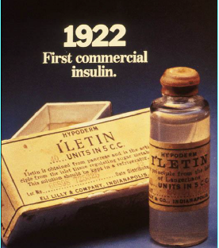
Though insulin was discovered it was still not a cure
✓
Some early users died of hypoglycaemia, but insulin seemed to provide a remarkable relief
✓
By the 1940’s, however, diabetic complications began to appear
Pain & allergic reactions were common and serious side effects of the first insulins
✓
Ghazavi MK, Johnston GA.et al. Clinics in dermatology. 2011;29(3):300–305; Schernthaner G. Diabetes care. 1993;16(Supplement 3):155–165

Slide 13
Understanding
Biopharmaceutical Aspects of Insulin

Slide 14
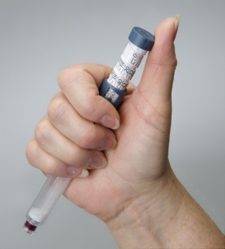
Administration
Dissociation, Dissolution
T. Depot
Absorption
Diffusion
Antibodybound
Free Insulin
Distribution
Diffusion
Sensitivity
Exercise
Diet
Hormones
Action
LIVER 70%
KIDNEY 10%
FAT & M. 20%
Degradation
Elimination
Target Cell

Slide 15
Factors Affecting Insulin Absorption
 |  | SITE OF | ADMINISTRATION
INSULIN PREP | ADMINISTRATION | SITES | WITHIN SITES
PHYSICAL STATE: Soluble Particulate Crystalline | INJECTION: Needle Jet Sprinkler No. of Depots | ROUTE: Subcutaneous Intramuscular | Heat Cold Exercise Massage Smoking, Etc
DOSE | INFUSION | DEPTH
CONCENTRATION | INTRAPERITONEL | ANATOMIC REGION
VOLUME | INHALED | LIPOHYPERTROPHY
SPECIES

Slide 16
Events At Insulin Injection Site
INJECTION SITE
LONG-ACTING INSULIN: ISOPHANE (NPH) or LENTE
Tissue-bound insulin
SHORT-ACTING SOLUBLE INSULIN
Dimer
Monomer
Hexamer
Insulin Crystal or Particle
(ANALOGUE)
Monomer
DISSOLUTION DISSOCIATION DIFFUSION

Slide 17
Insulin Actions: Concept
Schematic
Profiles
Humalog Lispro (Monomer)
Physiological insulin profile
Soluble insulin lispro
(Hexamer-Dimer-Monomer)
Protamine crystallised insulin lispro
(Tetramer-Hexamer)
Humalog Mix-25; Mix-50

Slide 18
Guidelines for
Effective Management

Slide 19
Failed Therapy on
Oral Hypoglycaemic Agents
If control not attained with:
Diet
OHA
HbA1C > 9%
Insulin is required

Slide 20
Goals of Intensive Insulin Therapy
Maintain near-normal glycaemia
Avoid short-term crises
Minimise long-term complications
Improve quality of life

Slide 21
Adding Basal Insulin Therapy to Existing OHA Regime

Slide 22
Basal Insulin Can Reduce
Glucose Toxicity in T2DM
Without basal insulin
Treated with basal insulin
400
7.2 mmol/l excursion
22.2
300
16.7
4.7 mmol/l excursion
Plasma Glucose (mmol/L)
Plasma Glucose (mg/dL)
11.1
200
100
5.6
0
Breakfast
Lunch
Dinner
0
6AM
10AM
2PM
6PM
10PM
2AM
6AM
Derived from Hirsch IB Clinical Diabetes 2005; 23:78-86

Slide 23
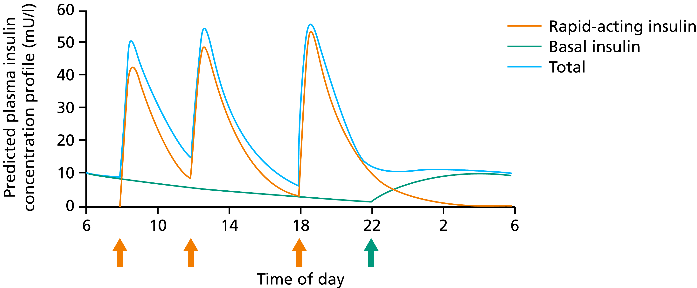
Basal Insulin Therapy
Basal insulin
Endogenous insulin
Normal Endogenous insulin
Predicted plasma insulin concentration profile (mU/l)
Time of day
Continue SU + Metformin Start dose: 0.3 u/Kg body Wt. Titrate according to FBG (6 mmol/l)

Slide 24
Variability in Time-Action Profile of Basal Insulins
Clamp 1
Clamp 2
Clamp 3
Clamp 4
8.0
NPH insulin
8.0
Insulin glargine
8.0
Insulin detemir
Patient 1
Patient 2
Patient 3
6.0
6.0
6.0
GIR mg/(kg•min)
4.0
4.0
4.0
2.0
2.0
2.0
0
0
0
0
6
12
18
24
0
6
12
18
24
0
6
12
18
24
Time (hours)
Time (hours)
Time (hours)
Glucose infusion rate profiles following four non-consecutive injections of identical doses (0.4U/kg, thigh) in three patients
T. Heise et al. Diabetes 2004;53:1614-1620

Slide 25
Implications of within-subject Pharmacodynamic Variability
Insulin detemir | Insulin glargine | NPH insulin
The subject’s risk of experiencing less than half their mean overall insulin effect (hyperglycaemic risk)
0.5% or 2 times per year | 7.5% or 27 times per year | 15.5% or 57 times per year
The subject’s risk of experiencing more than twice their mean maximal insulin effect (hypoglycaemic risk)
0.1% or 0.5 times per year | 2.7% or 10 times per year | 6.5% or 24 times per year
T. Heise et al. Diabetes 2004;53:1614-1620

Slide 26
Summary:
Desirable Properties of Basal Insulin
Soluble at neutral pH: avoids burning reactions at injection sites
Kinetic profile long for protracted action (24 hrs) and peakless: Less morning hypoglycaemia and therefore less weight gain
Time-action profile predictable & reproducible within patients avoids the problem of frequent variations in blood glucose values

Slide 27
Adding Premix Insulin Therapy to Existing
OHA Regime

Slide 28
Why do pre mixed insulin treatments work well in T2DM?
T2DM characterized by insulin insufficiency; still have some endogenous insulin secretion
Less likely to develop DKA
Lesser burden of injections: compliance

Slide 29
The Dual-Release Insulin Concept
Physiological insulin profile:
  - basal component
  - meal-related peak
Profiles are schematic
Rapid-acting insulin
analogue together with
a basal insulin analogue provide physiological insulin replacement
Premix analogues such as Humalog Mix® 25/50 mimic physiological insulin secretion
Physiological insulin profile
Soluble insulin aspart
Protamine crystallised insulin aspart
Humalog Mix® 25/50

Slide 30
Pre-mix Insulin Therapy Once Daily
Rapid-acting insulin
Basal insulin
Endogenous insulin
Predicted plasma insulin concentration profile (mU/l)
Time of day
Start dose: 10 – 12u a.c. Titrate according to FBG
Continue Glibenclamide 5mg bd + Metformin 850mg bd

Slide 31
PREMIXED/ C0-formulated INSULINS AVAILABLE
BOLUS/BASAL combinations of 30/70 or 25/75
Bolus insulin with protaminated insulin: Premixed
Bolus insulin with longer acting basal analogue insulin: C0-formulated

Slide 32
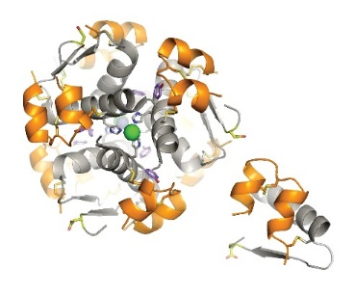

Biphasic insulin aspart
The core science

Slide 33
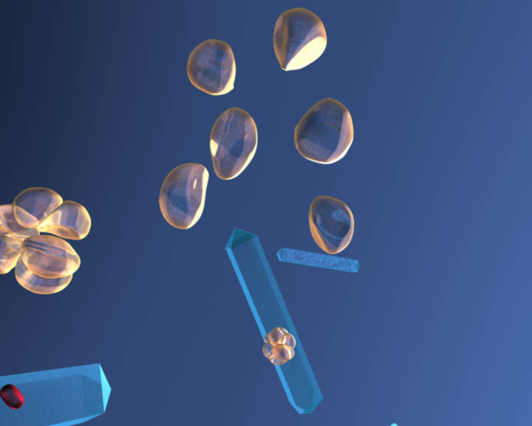
How is BIAsp 30 different from BHI 30?
BIAsp 30
A premixed
suspension of:
BHI 30
A premixed
suspension of:
Regular
human insulin
Soluble insulin aspart
30%
30%
Protamine-crystallised
insulin aspart
70%
70%
NPH insulin (protaminated human insulin)
BIAsp 30
BHI 30
BHI, biphasic human insulin; BIAsp, biphasic insulin aspart; NPH, neutral protamine Hagedorn
BIAsp 30 SPC. http://ec.europa.eu/health/documents/community-register/2000/200008013730/anx_3730_en.pdf
Notes:
33
BIAsp 30 is a biphasic suspension of insulin aspart (rapid-acting human insulin analogue) and protamine-crystallised insulin aspart (intermediate-acting human insulin analogue).

Slide 34
2.1
Efficacy and safety in type 2 diabetes
  BIAsp 30 for insulin initiation
  RCTs

Slide 35
BIAsp 30: RCTs
Study | No. of patients | No. of countries | Regimen or arms | Baseline HbA_{1c} (%) | End-of-study HbA_{1c} (%)
INITIATE¹ | 233 | 1 | BIAsp 30 BID vs. IGlar OD | 9.7 9.8 | 6.9* 7.4
EuroMix² | 255 | 7 | BIAsp 30 BID + met vs. IGlar + glim | 9.2 8.9 | 7.5** 7.9
ACTION³ | 200 | 1 | BIAsp 30 BID met + pio vs. met + pio | 8.1 8.1 | 6.5*** 7.8
OnceMix⁴ | 433 | 15 | BIAsp 30 OD vs. IGlar OD (both + met + glim) | 8.5 8.5 | 7.1* 7.3*
EasyMix⁵ | 521 | 2 | BIAsp 30 OD vs. IGlar OD (both + met + glim) | 8.2 8.1 | 7.4 7.5
*p<0.01 difference between treatments at end of trial; **p<0.0002 difference between treatments at end of trial; ***p<0.0001 difference between treatments at end of trial
BIAsp, biphasic insulin aspart; BID, twice daily; IGlar, insulin glargine; OD, once daily; met, metformin; glim, glimepiride; pio, pioglitazone; RCT, randomised controlled trial
1. Raskin et al. Diabetes Care 2005;28:260–5; 2. Kann et al. Exp Clin Endo Diab 2006;114:527–32; 3. Raskin et al. Diabetes Obes Metab 2009;11:27–32; 4. Strojek et al. Curr Med Res Opin 2009;25:2887–94
Notes:
4 x RCTs , each comparing the use of BIAsp 30 with different treatment options. On average, these trials demonstrate that BIAsp 30 can significantly lower HbA_{1c} compared with baseline, and often more so than the comparator arm.

Slide 36
Meta-analysis change in HbA_{1c}
Change in HbA_{1c} level between
basal-bolus and premix groups resulted in a small and
non-significant difference
(0.09%; p=0.130)
Study
ES (95% CI)
% weight
Malek, 2015 |  | -0.1, (-0.30, 0.10) | 8.33
Jia, 2015 |  | 0.00 (-0.15, 0.15) | 9.28
Giugliano, 2014 |  | -0.14 (-0.41, 0.13) | 6.89
Tinahones, 2014 |  | -0.22 (-0.42. -0.02) | 8.35
Riddle, 2014 |  | 0.40 (0.07, 0.73) | 5.89
Bowering, 2012 |  | -0.04 (-0.28, 0.20) | 7.55
Levin, 2011 |  | 0.60 (0.16, 1.04) | 4.39
Fritsche, 2010 |  | 0.48 (0.25, 0.71) | 7.64
Miser, 2010 |  | 0.00 (-0.27, 0.27) | 6.93
Jain, 2010 |  | 0.17 (-0.03, 0.37) | 8.33
Liebl, 2009 |  | 0.23 (0.07, 0.39) | 9.00
Rosenstock, 2008 |  | 0.22 (0.03, 0.41) | 8.61
Ligthelm, 2008 |  | -0.10 (-0.27, 0.07) | 8.81
Overall (I²=74.4%, p=0.000) |  | 0.09 (-0.03, 0.21) | 100.00
0.5
0.75
HbA_{1c} (%)
-1
-0.75
-0.5
0
0.25
1
-0.25
Favours premix
Favours basal-bolus
CI, confidence interval; ES, estimate
Giugliano et al. Endocrine 2015;doi:10.1007/s12020-015-0718-3
Note: weights are from random effective analysis

Slide 37
Meta-analysis risk of hypoglycaemia
No statistically significant difference in the event rate for overall hypos, which averaged 12.1 PYE in the basal-bolus group and 12.2 PYE in the premix group
Study
ES (95% CI)
% weight
Jia, 2015 |  | 0.80 (-1.26, 2.86) | 20.11
Giugliano, 2014 |  | 1.50 (-1.98, 4.98) | 15.25
Tinahones, 2014 |  | -3.40 (-7.76, 0.96) | 12.56
Riddle, 2014 |  | 5.00 (1.15, 8.85) | 14.05
Bowering, 2012 |  | -3.00 (-8.85, 2.85) | 9.06
Fritsche, 2010 |  | 4.50 (-2.43, 11.43) | 7.24
Miser, 2010 |  | -1.00 (-6.20, 4.20) | 10.44
Jain, 2010 |  | -7.60 (-14.76, -0.44) | 6.91
Rosenstock, 2008 |  | 1.50 (-8.11, 11.11) | 4.39
Overall (I²=51.9%, p=0.034 |  | 0.16 (-2.07, 2.38) | 100.00
-1
-0.75
0
0.25
0.5
0.75
1
-0.5
-0.25
Hypoglycaemia (episode/patient/year)
Favours premix
Favours basal-bolus
Note: weights are from random effective analysis
CI, confidence interval; PYE, patient-years of exposure; ES, estimate
Giugliano et al. Endocrine 2015;doi:10.1007/s12020-015-0718-3

Slide 38
Meta-analysis change in weight
No statistically significant difference in weight change, which averaged 2.4 kg in the basal-bolus group and 2.2 kg in the premix group
Study
ES (95% CI)
% weight
Giugliano, 2014 |  | 0.00 (-0.74, 0.74) | 13.41
Tinahones, 2014 |  | 0.63 (0.08, 1.18) | 16.95
Riddle, 2014 |  | -0.30 (-1.79, 1.19) | 5.60
Bowering, 2012 |  | -0.14 (-0.85, 0.57) | 13.93
Fritsche, 2010 |  | -1.40 (-2.35, -0.45) | 10.37
Miser, 2010 |  | -0.30 (-1.08, 0.48) | 12.74
Jain, 2010 |  | -0.10 (-3.66, 3.46) | 1.20
Liebel, 2009 |  | -0.30(-0.98, 0.38) | 14.42
Rosenstock, 2008 |  | -0.50 (-1.37, 0.37) | 11.39
Overall (I²=48.6%, p=0.049) |  | -0.21 (-0.61, 0.19) | 100.00
-4
-3
-2
-1
Weight (kg)
0
1
2
3
4
Favours premix
Favours basal-bolus
Note: weights are from random effective analysis
CI, confidence interval; PYE, patient-years of exposure; ES, estimate
Giugliano et al. Endocrine 2015;doi:10.1007/s12020-015-0718-3

Slide 39
WHY DO PATIENTS GAIN WEIGHT ON INSULIN?
Insulin is a anabolic growth hormone
Insulin doses need to be titrated correctly
Hypoglycaemia causes increased food intake
Titrating premixed insulins based on average glucose values can cause weight gain secondary to defensive eating and eating to “feed” the insulin

Slide 40
ARISE
A multi-centre prospective non-interventional study
investigating the clinical effectiveness of IDegAsp (Insulin
Degludec/Insulin Aspart) in patients with type 2 diabetes
mellitus in a real-world setting

Slide 41
Rationale
This NIS is designed to establish real-world evidence of IDegAsp usage in six countries: Australia, India, Malaysia, Philippines, Saudi Arabia and South Africa, which will add to the findings from RCTs and provide evidence of the generalisability of results thereof to a broader population of T2D patients treated with IDegAsp in local routine clinical practice.
Primary Objective
    To investigate the effectiveness of IDegAsp on glycaemic control in a real-world population of T2D patients, who have initiated or switched to IDegAsp from previous anti-hyperglycaemic treatment according to local clinical practice
NIS, non-interventional study; RCT, randomised controlled trials.
Fulcher G, Akhtar S, Al-Jaser S, et al. Improved glycaemic control in people with type 2 diabetes initiating or switching to IDegAsp from any anti-hyperglycaemic treatment in a real-world setting across six countries. Abstract and oral presentation at Australasian Diabetes Congress, August 13, 2021.

Slide 42




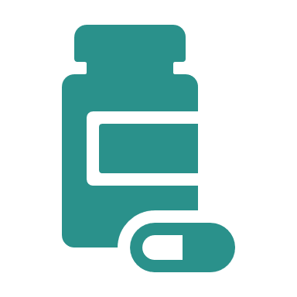


Endpoints
PRIMARY
HbA_{1C} (change in %)
SECONDARY
Change in insulin dose
total, basal, prandial
No of
hypo events
dis-continu-ation
HbA_{1C}
less than 7%
body weight
EXPLORATORY
Resource
utilisation
HbA_{1C} < 7%
without hypo
FPG, fasting plasma glucose.
Fulcher G, Akhtar S, Al-Jaser S, et al. Improved glycaemic control in people with type 2 diabetes initiating or switching to IDegAsp from any anti-hyperglycaemic treatment in a real-world setting across six countries. Abstract and oral presentation at Australasian Diabetes Congress, August 13, 2021.

Slide 43
ARISE study design
Adults with T2D
N=1112
IDegAsp as per local practice*
Week 0 (Visit 1)
Treatment initiation
Observation period (Visit 2)
Weeks 26–36 (Visit 3)
End of study
Study information
Key inclusion criteria
Countries
  Non-interventional
  Multicentre
  Prospective, primary data collection
  Visit frequency according to the local standard of care
Physician’s decision to initiate treatment with IDegAsp
Age ≥18 years
T2DM
Available HbA_{1c} value ≤12 weeks
Australia
India
Malaysia
Philippines
Saudi Arabia
South Africa
*Visit 1 (treatment initiation visit) and Visit 3 (end of study visit) were mandatory for all patients; Visit 2 was intermediary and only warranted as per clinical practice.
HbA_{1c}; glycated haemoglobin; IDegAsp, insulin degludec/insulin aspart; T2D, type 2 diabetes.
Fulcher G, Akhtar S, Al-Jaser S, et al. Improved glycaemic control in people with type 2 diabetes initiating or switching to IDegAsp from any anti-hyperglycaemic treatment in a real-world setting across six countries. Abstract and oral presentation at Australasian Diabetes Congress, August 13, 2021.

Slide 44

Navigating new horizons: ARISE results

Slide 45
Previous anti-hyperglycaemic treatment
Full analysis set
OADs only
Basal only
GLP-1RA
Basal + Bolus
Overall
Premix
Full analysis set includes all eligible patients who signed the informed consent and initiated treatment with IDegAsp.
GLP-1RA, glucagon-like peptide-1 receptor agonist; n, number of patients; OAD, oral antidiabetic drug.
Fulcher G, Akhtar S, Al-Jaser S, et al. Improved glycaemic control in people with type 2 diabetes initiating or switching to IDegAsp from any anti-hyperglycaemic treatment in a real-world setting across six countries. Abstract and oral presentation at Australasian Diabetes Congress, August 13, 2021.

Slide 46
Reasons for initiating IDegAsp treatment
    ARISE_RM-slides (08.04.2021)_vkbv.ppt; slide 15
IDegAsp, insulin degludec/insulin aspart
Fulcher G, Akhtar S, Al-Jaser S, et al. Improved glycaemic control in people with type 2 diabetes initiating or switching to IDegAsp from any anti-hyperglycaemic treatment in a real-world setting across six countries. Abstract and oral presentation at Australasian Diabetes Congress, August 13, 2021..

Slide 47
Change in HbA_{1c} from baseline
By country
Overall
9.7
Australia
9.0
India
9.8
Malaysia
9.9
Philippines
10.0
Saudi Arabia
10.1
South Africa
9.6
    ARISE_RM-slides (08.04.2021)_vkbv.ppt; slide 18
[-1.05; -0.56]
[-1.51; -1.29]
[-1.61; -0.90]
[-1.72; -1.11]
[-1.61; -1.08]
[-1.83; -1.42]
[-2.31; -1.78]
Some data may differ from the original abstract due to correction of statistical analyses
Data are change from baseline to Week 36 [95% CI]. The full adjusted model included baseline value, time, time squared of HbA1c measure, age, sex, BMI, previous anti-hyperglycaemic treatment regimen and study site. To handle (quadratic) deviation from linearity, a random coefficient model with time and time squared as fixed coefficients, and patient and patient time as random coefficients was used. An unstructured covariance matrix was used to describe the variability for the repeated measurements for patients. *P<0.0001.
CI, confidence interval; BMI, body mass index; HbA1c, glycated haemoglobin.
Fulcher G, Akhtar S, Al-Jaser S, et al. Improved glycaemic control in people with type 2 diabetes initiating or switching to IDegAsp from any anti-hyperglycaemic treatment in a real-world setting across six countries. Abstract and oral presentation at Australasian Diabetes Congress, August 13, 2021.

Slide 48
Change in body weight from baseline
By prior treatment subgroup
Overall
79.6
OADs only
75.3
Basal only
77.0
GLP-1RA
90.8
Basal + bolus
81.4
Premix
84.4
Baseline (kg):
    ARISE_RM-slides (08.04.2021)_vkbv.ppt; slide 20
[-1.10; 1.77]
[-1.28; 0.70]
[-1.51; -0.52]
[-2.09; -0.07]
[-2.32; -0.49]
[-2.70; -0.23]
Some data may differ from the original abstract due to correction of statistical analyses
Data are change from baseline to Week 36 [95% CI]. The full adjusted model included baseline value, time, time squared of body weight measure, age, sex, BMI, previous anti-hyperglycaemic treatment regimen and study site. To handle (quadratic) deviation from linearity, a random coefficient model with time and time squared as fixed coefficients, and patient and patient time as random coefficients was used. An unstructured covariance matrix was used to describe the variability for the repeated measurements for patients. *P<0.0001; **P<0.01; †P<0.05
CI, confidence interval; BMI, body mass index; GLP-1 RA, glucagon-like peptide-1 receptor agonist; OAD, oral antidiabetic drug.
Fulcher G, Akhtar S, Al-Jaser S, et al. Improved glycaemic control in people with type 2 diabetes initiating or switching to IDegAsp from any anti-hyperglycaemic treatment in a real-world setting across six countries. Abstract and oral presentation at Australasian Diabetes Congress, August 13, 2021.

Slide 49
Severe hypoglycaemic events
Prior to initiation of treatment
Prior to EOS
5
 | n | Events
Observed within 26 weeks prior to initiation of IDegAsp | 23 | 51
Observed within 26 weeks prior to EOS or at discontinuation | 3 | 3
2.5
    ARISE_RM-slides (08.04.2021)_vkbv.ppt; slide 24
Percentage of patients
0
OAD
Basal
GLP-1 RA
Premix
Basal
+ bolus
OAD
Basal
GLP-1 RA
Premix
Basal
+ bolus
Number of patients
with an event:
4
4
0
9
4
2
0
0
0
1
Some data may differ from the original abstract due to correction of statistical analyses
Total number of patients in full analysis set=1102.
EOS, end of study; GLP-1 RA, glucagon-like peptide-1 receptor agonist; IDegAsp, insulin degludec/insulin aspart; OAD, oral antidiabetic drug
Fulcher G, Akhtar S, Al-Jaser S, et al. Improved glycaemic control in people with type 2 diabetes initiating or switching to IDegAsp from any anti-hyperglycaemic treatment in a real-world setting across six countries. Abstract and oral presentation at Australasian Diabetes Congress, August 13, 2021.

Slide 50





Consider IDegAsp for initiation or intensification of insulin therapy in patients with T2D^{1,2}
Patients failing to achieve glycaemic control despite optimising non-insulin therapies
Patients with post-prandial glucose spikes, despite optimising basal insulin
Patients at increased
risk of hypoglycaemia,
including nocturnal hypoglycaemia
Patients who may benefit
from a reduced injection burden or a less complex regimen
Patients requiring
flexibility in the timing
of insulin dosing
1. Glastras SJ, et al. J Clin Med. 2020;9:1091; 2. Gunton JE, et al. Med J Aust. 2014:201:650–3 (Dec 2016 update), available: http://t2d.diabetessociety.com.au/about-us/

Slide 51
Pre-mix Insulin Therapy Twice Daily
If post-meal values remain high during the day, more insulin is obviously required.
Stop Glibenclamide. Continue Metformin 850mg bd.
Commence Pre-mix insulin, e.g. Mix-30 as: 12u bd. 5-10 mins a.c. – then titrate.
Injection times must remain same.
Cannot adjust doses on day-to-day basis.
Cannot adjust doses according to meal sizes.
Little scope for flexibility on this regime.

Slide 52
Pre-mix Insulin Therapy Twice Daily
Rapid-acting insulin
Basal insulin
Endogenous insulin
Predicted plasma insulin concentration profile (mU/l)
Time of day
Stop SU. Continue Metformin .
Start dose: 12u bd a.c. Titrate according to FBG/PPG

Slide 53
Weight Gain with Insulin Therapy
Seen in both type 1 and type 2 diabetes
? May worsen underlying defect in T2DM
Barrier to starting insulin therapy in T2DM
May decrease compliance with insulin regimens
May lower self-esteem

Slide 54
Weight Gain in Type 2 Diabetes:
UKPDS Data
10.0
Conventional group
Intensive group
7.5
5.0
Change in weight (kg)
2.5
0
0
3
6
9
12
15
Years from randomisation
UKPDS Group (33). Lancet 1998;352:837–53.

Slide 55
Insulin Detemir vs. NPH insulin in Treat-to-Target Protocol: Weight Change
Insulin detemir
86
NPH insulin
85
84
Weight (kg)
83
82
81
80
-2
1
3
5
7
9
11
13
15
17
19
21
23
Time (Weeks)
K. Hermansen et al. Diabetologia 2004;47(Suppl. 1):A273

Slide 56
HbA_{1c} and Hypoglycaemia in
Type 2 Diabetes Treat-to-Target Study
Insulin detemir
14
NPH insulin
13
12
11
10
9
8
7
Hypoglycaemic events / patient year
6
5
4
3
2
1
5
6
7
8
9
10
HbA_{1c}
K. Kolendorf et al. Diabetes 2005; 54(Suppl 2):P489

Slide 57
Using a
Bolus-Basal Regime

Slide 58
The Basal/Bolus Insulin Concept
Basal insulin
  Suppresses hepatic glucose production between meals and overnight
  40% to 50% of daily needs
Bolus insulin (mealtime)
  Limits hyperglycaemia after meals
  Immediate rise and sharp peak at 1 hour
  10% to 20% of total daily insulin requirement at each meal

Slide 59
Basal insulin: targets FPG > PPG
  Benefit: Only 1-2 injections per day
  Drawback: Patients may require prandial insulin to reach HbA_{1c} targets
Prandial (mealtime) insulin: targets PPG > FPG
  Benefit: Most physiologic; best at targeting PPG
  Drawback: Most injections; requires addition of basal insulin to target FPG
Premixed insulin: targets both FPG and PPG
  Benefit: Fewer injections than prandial
  Drawback: Unable to adjust components separately

Slide 60
Insulin Analogues: Desired Properties
Meal-related analogues (insulin aspart / lispro) designed to give:
  Rapid absorption
  Peak action coinciding with peak carbohydrate absorption: Flexibility in eating
Basal insulin analogue should provide:
  Slow and steady rate of absorption
  Protracted action
  Low within-subject variability in action

Slide 61
Basal-Bolus Therapy attempts to re-create Physiological Insulin Secretion
Rapid-acting insulin
Basal insulin
Total
Predicted plasma insulin concentration profile (mU/l)
Time of day

Slide 62
Mrs M: History and current therapy
History
56 y Female
Employed full-time
Diabetes and hypertension for 8 years
Complaints made to the doctor
Multiple hypoglycaemic episodes
Wants few injections with 1 device
Want medical disability due to glucose fluctuations
Diet
Balanced diet – protein, fats and carbohydrates
No alcohol use or smoking
Current therapy
PROTOPHANE 42u BD
Metformin 1000 mg BD
SU at max dose
Enalapril, amlodipine, hydrochlorothiazide, atorvastatin
Notes:
Enalapril is an ACE inhibitor. ACE stands for angiotensin converting enzyme.Enalapril is used to treat high blood pressure (hypertension) in adults and children who are at least 1 month old.
Amlodipine is a calcium channel blocker that dilates (widens) blood vessels and improves blood flow. Amlodipine is used to treat chest pain (angina) and other conditions caused by coronary artery disease.
Hydrochlorothiazide belongs to a class of drugs known as diuretics/"water pills." It works by causing you to make more urine. This helps your body get rid of extra salt and water.
Prakash is a 46 year old diabetic patient with diabetes.
He experiences post-prandial hyperglycaemia.
His diet is balanced
He is currently on 52 units glargine at night and wishes to control his diabetes with a single device and fewer injections.

Slide 63
Clinical signs and results
Test Parameter Result
HbA1c 8.5 %
Random glucose 11.5 mmol/L
Total cholesterol 4.1 mmol/L
LDL cholesterol 1.9 mmol/L
HDL cholesterol 1.0 mmol/L
Triglycerides 3.8 mmol/L
UACR 6 mg/mmoL
eGFR 72
ECG Normal
Clinical signs
BMI 30 kg/m²
Waist circumference: 105 cm
BP = 136/85 mm Hg
Retinal photographs show background retinopathy
Notes:
Prakash is overweight.
His HbA1c is elevated, however, his main contribution to this is elevated A1c is post prandial glucose levels
Total Cholesterol must be below 2.8 - 4.9 mmol/L
LDL 1.6 – 2.9
HDL 1.0 – 1.6
Triglycerides 0.5 – 1.6

Slide 64
Started on Ryzodeg ( IDegASP (insulin degludec/aspart co-formulation)
Mrs M was on:
metformin / SU for the past 8 years
Protophane 42 u bd for the past 16 months
NOW takes:
metformin 1.0 g/day
IDegASP (insulin degludec/aspart co-formulation)
    26 IU s/c in the morning before breakfast
    26 IU s/c in the evening before supper

Slide 65
Follow up after 3 months
Three month results show:
HbA1c 6.7 % At target
FPG 6.0 mmol/L Within range (4.0 - 7.0 mmol/l)
PPG 9.0 mmol/L Within range (5.0 - 10.0 mmol/l)
NO HYPOGLYCAEMIC EPISODES;
PATIENT BACK AT FULL TIME EMPLOYMENT
Notes:
Good follow up

Slide 66
Summary:
Insulin in Type 2 Diabetes
Need Aggressive Approach to Diabetes Management to Prevent Complications
Use of insulin – prerequisites :
Require regular monitoring with HBGM & HbA₁c
Should know & understand available insulin formulations
Understand mode of action of insulins
Educate patients
See & support patients regularly

Slide 67
Therapeutic Potential of Intensive Analogue-Based Insulin Therapy
Achievement and maintenance of glycaemic targets:
  HbA_{1c}
  Postprandial plasma glucose
  Fasting plasma glucose (or preprandial glucose)
Low within-subject variability
Reduced risk of hypoglycaemia
Minimal weight gain
Enhanced convenience and improved quality of life

Slide 68
Important Practical Observations
Diabetes produces symptoms at:
  Time of Diagnosis
  Time of Complications
Monitoring with HBGM and HbA₁C are the only real means of assessing degree of control
Patients feel well on almost any therapy, regardless of control – WHY?

Slide 69
Diabetes & Symptoms
Insulin
Resistance
Type 2
Diabetes
β-cell
Dysfunction
ASYMPTOMATIC
SYMPTOMS
Insulin Action
Ultimately – ALL T2DM will need Insulin
Insulin
Levels
Glycaemia
Normal
IGT
DM
Progression of
Type 2 DM
Diabetes Care 1992;15:318-68

